Slide 1
Aberdeenshire Local Development Plan 2016
Heat Network Policy

Slide 2
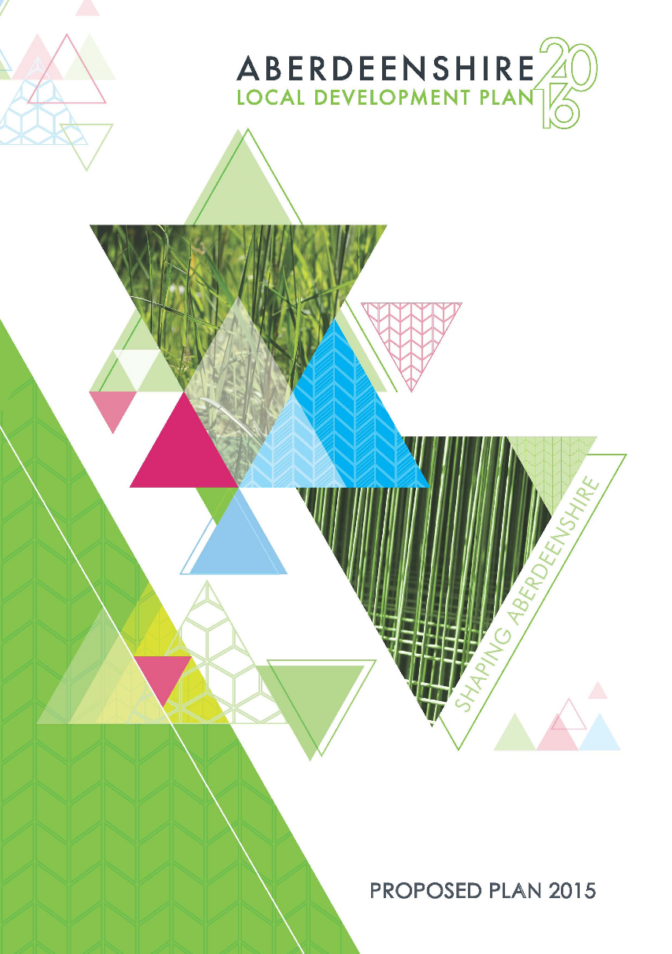
Who?
Alastair Bledowski
Policy Planner
Aberdeenshire Council
Aim of this talk is to consider key
questions that can help other
authorities develop their own heat
network policy.

Slide 3

Why?
The need for the policy comes from a mix
of “Push” and “Pull” factors.
Push factors = why we need to do something
Pull factors = why we want to do something

Slide 4
Why?
Push
Climate change targets
  42% reduction of GHG emissions by 2020
  84% by 2050
Sustainable Economic Growth
  DECC 2009 report: 2% of UK heat demand met by
  heat networks. 40% in Finland and 60% in Denmark
Social Sustainability
  Aberdeen City shows reduction in cost of fuel bills
  when using heat networks
  Fuel security and resilience

Slide 5
Why?
Pull
Climate change targets
  Contribute towards the climate change
  targets and obligations

Slide 6
Fuel Poverty
A person is living in fuel poverty if, to heat their home to a satisfactory standard, they need to spend more than 10 per cent of their household income on fuel.
Three factors influence whether a household is in fuel poverty:
  Low household income.
  Fuel costs.
  Energy efficiency.

Slide 7
  Economic Diversity
  Energetica vision is for the region to be recognised as one of the most robust and resilient economies in Europe with a reputation for opportunity, enterprise and inventiveness that will attract and retain world-class talent of all ages.

Slide 8
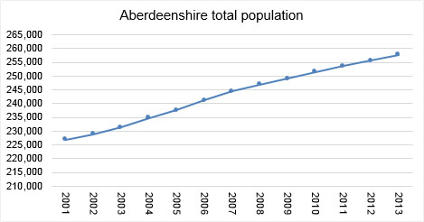
Why?
Pull
Population Growth
Aberdeenshire has the
highest rate of growth
in Scotland.
Over 11% growth in
recent years, with 9%
coming from migration
from neighbouring Local
Authority Areas.

Slide 9
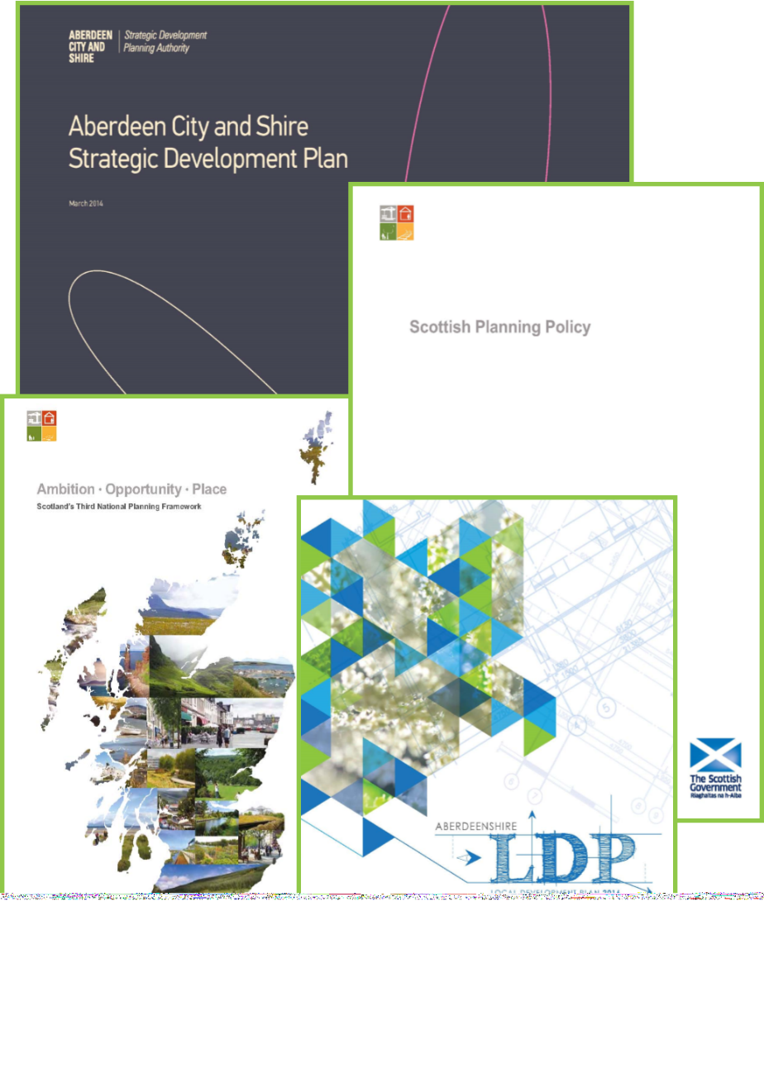
How?
Policy Analysis the main tool for
developing this policy.
Created a Position Paper looking at
national, regional and local policies.
Proposed policies then tested against
stakeholder opinion through Main
Issues Report and Proposed Local
Development Plan statutory
consultations.

Slide 10
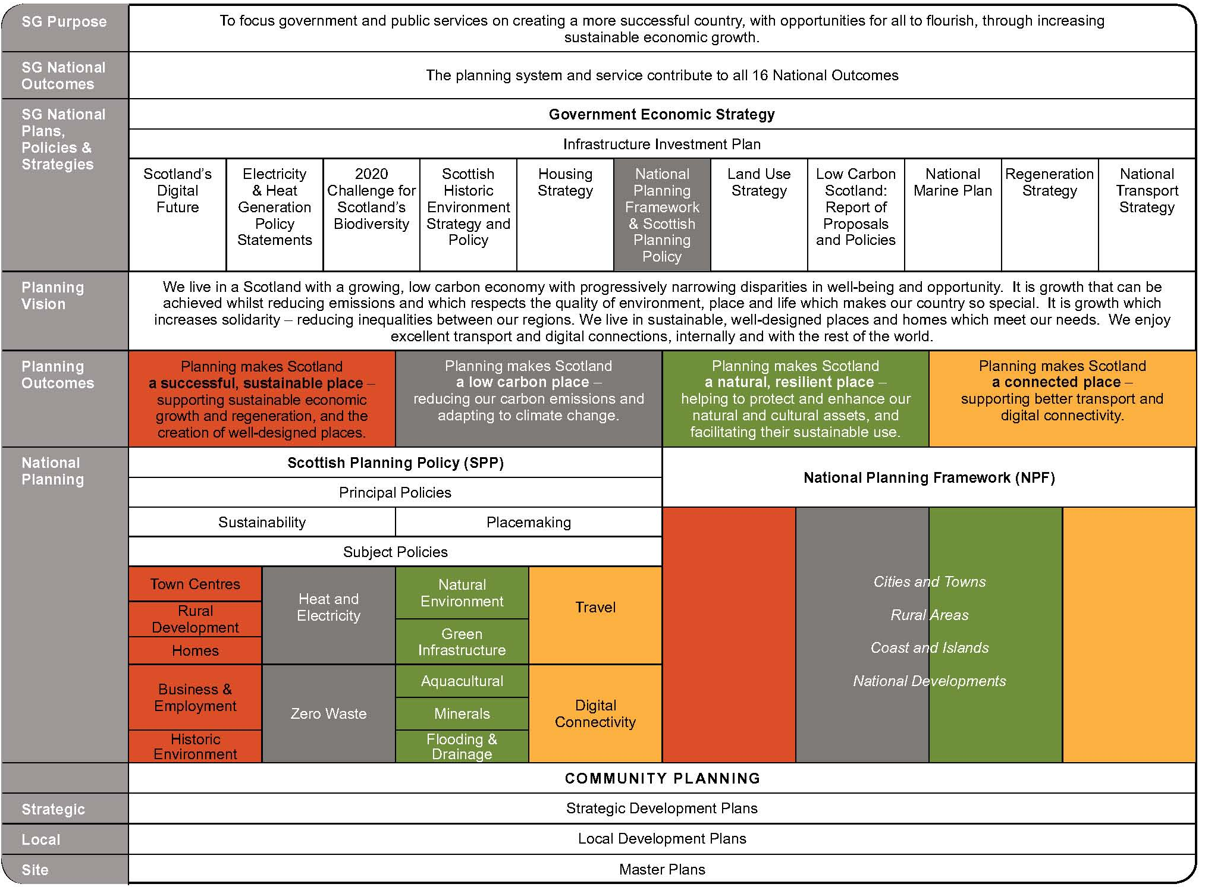
How?

Slide 11
How?
Scottish Planning Policy (SPP), published June 2014
SPP planning vision for Scotland:
“We live in a Scotland with a growing, low carbon economy with progressively narrowing disparities in well-being and opportunity. It is growth that can be achieved whilst reducing emissions and which respects the quality of environment, place and life which makes our country so special. It is growth which increases solidarity – reducing inequalities between our regions. We live in sustainable, well-designed places and homes which meet our needs. We enjoy excellent transport and digital connections, internally and with the rest of the world.”

Slide 12
How?
Scottish Planning Policy
SPP planning vision for Scotland:
“We live in a Scotland with a growing, low carbon economy with progressively narrowing disparities in well-being and opportunity. It is growth that can be achieved whilst reducing emissions and which respects the quality of environment, place and life which makes our country so special. It is growth which increases solidarity – reducing inequalities between our regions. We live in sustainable, well-designed places and homes which meet our needs. We enjoy excellent transport and digital connections, internally and with the rest of the world.”

Slide 13
How?
158. Local development plans should use heat mapping to identify the potential for co-locating developments with a high heat demand with sources of heat supply. Heat supply sources include harvestable woodlands, sawmills producing biomass, biogas production sites and developments producing unused excess heat, as well as geothermal systems, heat recoverable from mine waters, aquifers, other bodies of water and heat storage systems. Heat demand sites for particular consideration include high density developments, communities off the gas grid, fuel poor areas and anchor developments such as hospitals, schools, leisure centres and heat intensive industry.
159. Local development plans should support the development of heat networks in as many locations as possible, even where they are initially reliant on carbon-based fuels if there is potential to convert them to run on renewable or low carbon sources of heat in the future. Local development plans should identify where heat networks, heat storage and energy centres exist or would be appropriate and include policies to support their implementation. Policies should support safeguarding of piperuns within developments for later connection and pipework to the curtilage of development. Policies should also give consideration to the provision of energy centres within new development. Where a district network exists, or is planned, or in areas identified as appropriate for district heating, policies may include a requirement for new development to include infrastructure for connection, providing the option to use heat from the network.
160. Where heat networks are not viable, microgeneration and heat recovery technologies associated with individual properties should be encouraged.

Slide 14
How?
158. Local development plans should use heat mapping to identify the potential for co-locating developments with a high heat demand with sources of heat supply. Heat supply sources include harvestable woodlands, sawmills producing biomass, biogas production sites and developments producing unused excess heat, as well as geothermal systems, heat recoverable from mine waters, aquifers, other bodies of water and heat storage systems. Heat demand sites for particular consideration include high density developments, communities off the gas grid, fuel poor areas and anchor developments such as hospitals, schools, leisure centres and heat intensive industry.
159. Local development plans should support the development of heat networks in as many locations as possible, even where they are initially reliant on carbon-based fuels if there is potential to convert them to run on renewable or low carbon sources of heat in the future. Local development plans should identify where heat networks, heat storage and energy centres exist or would be appropriate and include policies to support their implementation. Policies should support safeguarding of piperuns within developments for later connection and pipework to the curtilage of development. Policies should also give consideration to the provision of energy centres within new development. Where a district network exists, or is planned, or in areas identified as appropriate for district heating, policies may include a requirement for new development to include infrastructure for connection, providing the option to use heat from the network.
160. Where heat networks are not viable, microgeneration and heat recovery technologies associated with individual properties should be encouraged.

Slide 15
How?
Local development plans should use heat mapping to identify the potential for co-locating developments with a high heat demand with sources of heat supply.
Local development plans should support the development of heat networks in as many locations as possible, even where they are initially reliant on carbon-based fuels if there is potential to convert them to run on renewable or low carbon sources of heat in the future.
Local development plans should identify where heat networks, heat storage and energy centres exist or would be appropriate and include policies to support their implementation.
Policies should support safeguarding of piperuns within developments for later connection and pipework to the curtilage of development.
Policies should also give consideration to the provision of energy centres within new development.
Policies may include a requirement for new development to include infrastructure for connection, providing the option to use heat from the network.
Where heat networks are not viable, microgeneration and heat recovery technologies associated with individual properties should be encouraged.

Slide 16
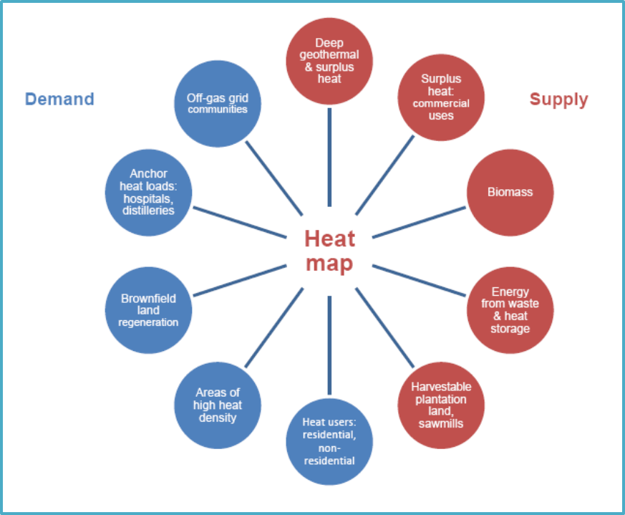

Slide 17
How?
SPP envisions a fourfold role that planning authorities must fulfil:
The planning authority must map heat, focussing on demand, supply, fuel poverty and existing heat networks.
The planning authority must support the development of new and existing heat networks, by encouraging their inclusion within new developments through policy, and by safeguarding the required pipework infrastructures.
The planning authority must be supportive of alternatives where heat networks are not appropriate.
These policies are envisioned within the wider policy area of “low carbon”, climate change and energy efficiency.

Slide 18
How?
Aberdeenshire also sits within the Aberdeen City and Shire Strategic Development Plan (SDP) area.
Published March 2014 so predates Scottish Planning Policy
No specific policies on heat networks.
However, issues is considered more generally within issues of energy efficiency, masterplanning and energy supply.

Slide 19
How?
Aberdeenshire also sits within the Aberdeen City and Shire Strategic Development Plan
“All new developments must be designed and built to use resources more efficiently and be located in places where they have as little an effect on the environment as possible… developers will need to examine the scope for including combined heat and power schemes when preparing larger development proposals.”
“We also need to tackle the supply of energy during the plan period. This will involve increasing the supply of heat and power from renewable sources and reducing emissions of climate-change gases from existing power stations… there is considerable potential in … energy from waste... biomass, as well as ground, water and air source heat pumps. A more balanced mix of renewable energy sources will be needed if we are to meet our renewables targets.”
“Use [of] master planning (and supplementary guidance) to consider the possible scope of combined heat and power schemes to contribute towards using energy more efficiently and in reducing the amount of energy used overall”.

Slide 20
How?
Aberdeenshire also sits within the Aberdeen City and Shire Strategic Development Plan
“All new developments must be designed and built to use resources more efficiently and be located in places where they have as little an effect on the environment as possible… developers will need to examine the scope for including combined heat and power schemes when preparing larger development proposals.”
“We also need to tackle the supply of energy during the plan period. This will involve increasing the supply of heat and power from renewable sources and reducing emissions of climate-change gases from existing power stations… there is considerable potential in … energy from waste... biomass, as well as ground, water and air source heat pumps. A more balanced mix of renewable energy sources will be needed if we are to meet our renewables targets.”
“Use [of] master planning (and supplementary guidance) to consider the possible scope of combined heat and power schemes to contribute towards using energy more efficiently and in reducing the amount of energy used overall”.

Slide 21
How?
Aberdeenshire Local Development Plan 2012
No references to heat networks.
Policies on energy efficiency in new buildings.
Main Issues Report had also recommended the creation a climate change policy which would consider resource use, energy efficiency and renewable energy.

Slide 22
What did we do?
The policy review concluded that new policies would be required, but they would sit within the existing policies regarding Climate Change and energy efficiency in new buildings.
Co-location opportunities are not too widespread within Aberdeenshire. A key statement within SPP was that heat networks should be encouraged wherever possible. It was decided then that a key function of this policy will be to enable future connection to heat networks as the market develops.
In all cases, major developments will be expected to provide pipeworks within the curtilage of development for connection to heat networks whether immediately or within the lifetime of the building.
It will not be necessary to actually create a heat network, however, it will be encouraged to meet carbon neutrality requirements.
An energy statement will be required for major developments that considers the use of heat networks as a part of meeting carbon reduction targets.

Slide 23


Slide 24
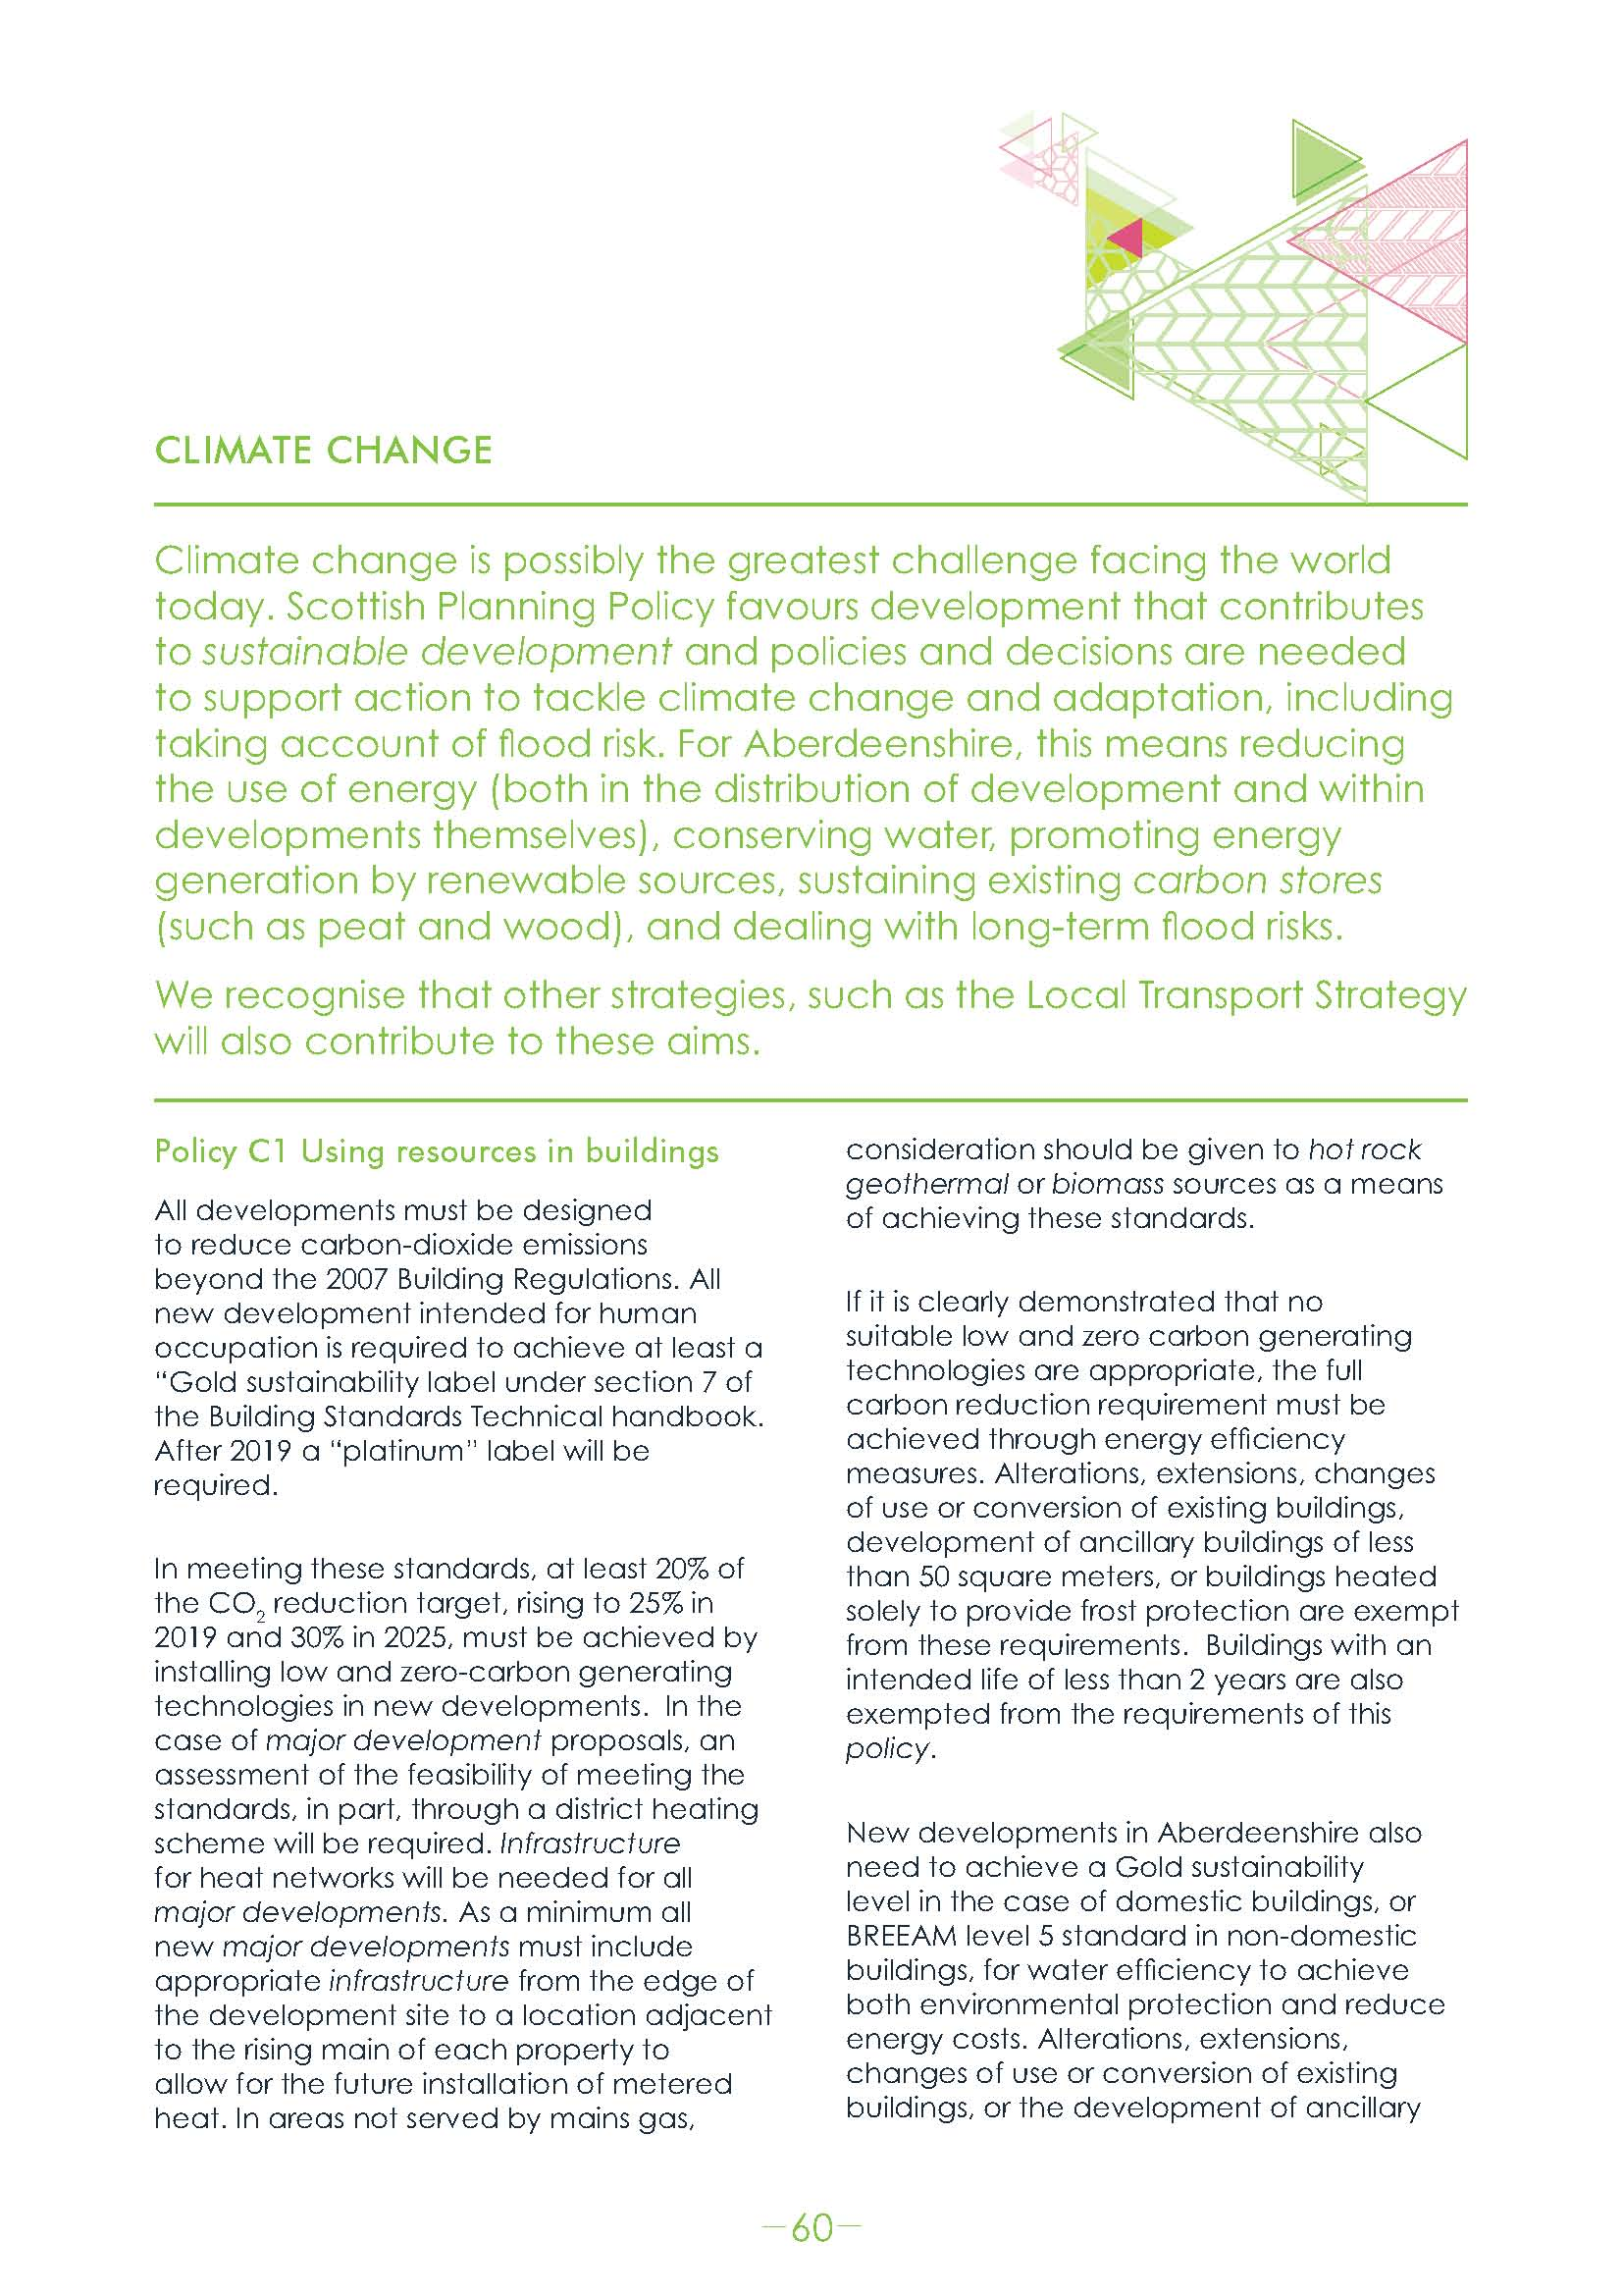
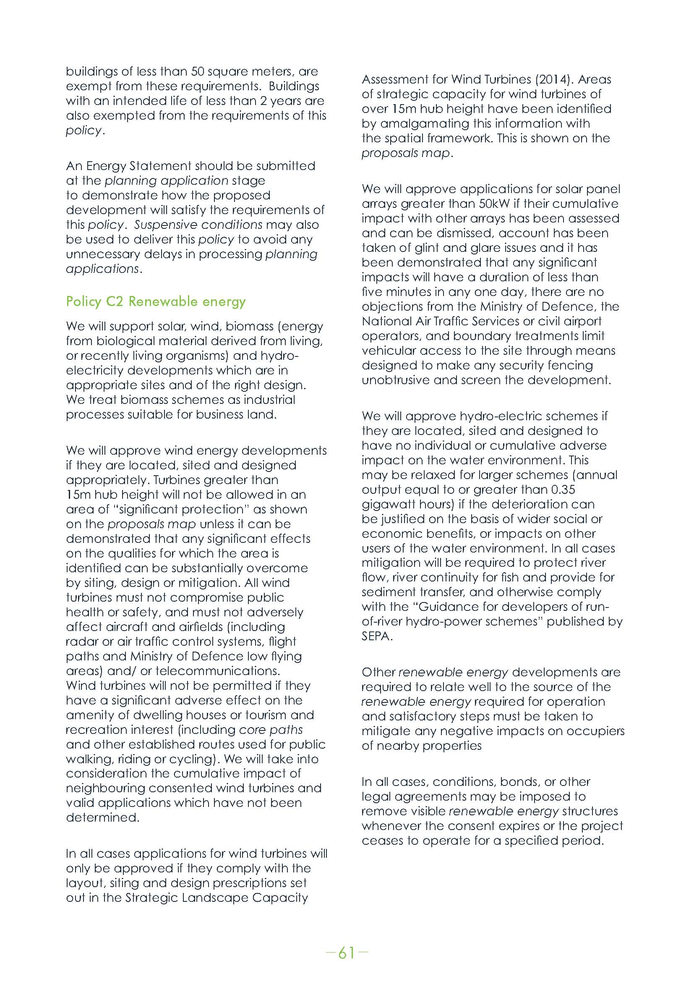

Slide 25
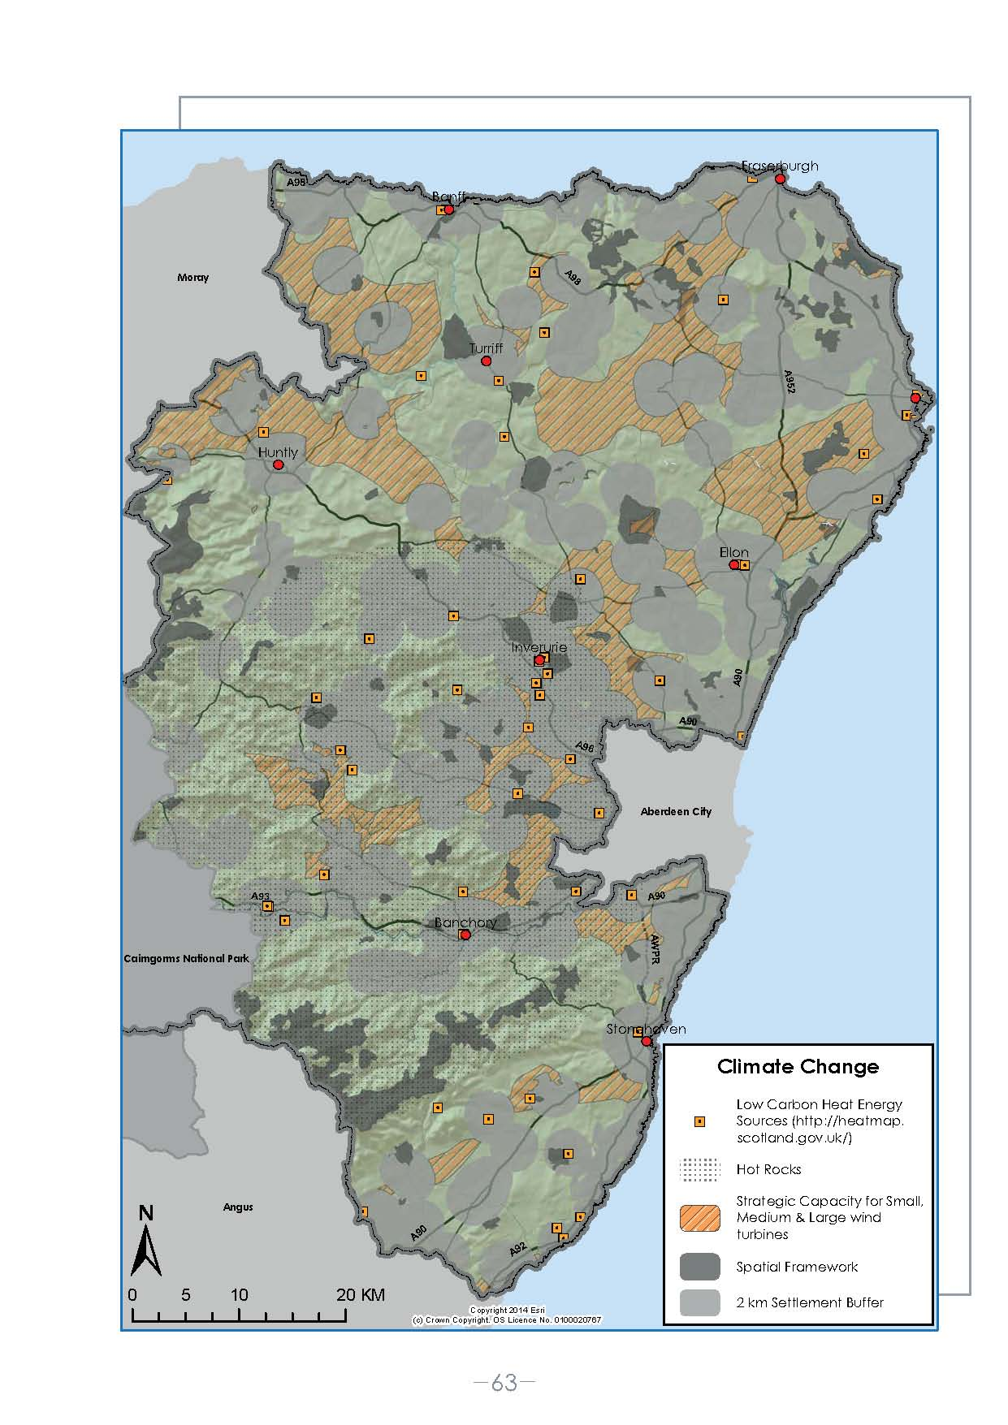
Heat Mapping
Little bit more difficult as heat demand
looks very low when mapped across
Aberdeenshire.
The whole map would be represented
as blue – low heat demand – due to
the effect of demand averaging into a
low demand across the rural areas
where populations are less dense.
Decision taken to just map heat and
low carbon energy sources for future
heat networks to link into.
Co-location opportunities are not too
widespread.
Good potential for hot rock geothermal
market in the future.
Future work will aim to develop the
heat map further.

Slide 26
What was the result?
The policy was subject to public consultation in both the Main Issues Report Addendum, published August 2014, and during the Proposed Local Development Plan consultation, in March-May 2015.
The policy has attracted some criticism from house builders and developers, but not as much as expected.
The MIR addendum only saw one house builder object to the principle.
Also the Scottish Government, SEPA, Community Councils and the public were supportive of the approach taken and only suggested minor changes.
The Proposed Plan seven developers write in. A sample of their comments are as follows:

Slide 27
What was the result?
“The requirement to provide appropriate infrastructure for the provision of metered heat would be expensive and would impact on the viability of development.”
“It is a burden on the development industry, especially where there is little prospect of a district heating scheme being installed.”
“The policy should be amended to encourage the co-location of heat sources to high demand "heat users" and to safeguard land for future heat infrastructure in accordance with paragraph 158 and 159 of Scottish Planning Policy. Co-location opportunities should be identified and options investigated to provide heat connections between potential heat users and existing / proposed heat sources.”
“Policy wording should be introduced to confirm the production of a localised Aberdeenshire Heat Map and consideration of this map when determining the location of new heat networks within the area.”
“Plans should not require the use of certain technologies such as biomass and hot rock geothermal. Hot rock geothermal or biomass sources are expensive and could render development unviable.”

Slide 28
What was the result?
It is still felt that the policy approach taken is appropriate.
The approach of the policy is to concentrate on providing opportunity for commercial production of heat, not solely on the use of waste heat. Co-locations opportunities are not as widespread as to allow heat networks to develop across Aberdeenshire. SPP supports heat networks “wherever possible”.
Not providing the infrastructure necessary to enable such a development during construction provides no future market for a heat provider and will continue the status quo.
The policy encourages the adoption of heat networks as a beneficial opportunity for developers to meat mandatory energy efficiency targets. Heat networks themselves are not necessary, but must be considered in the energy statement.
Principles yet to be tested at Examination.

Slide 29
Contact
Alastair Bledowski
Aberdeenshire Council
Woodhill House
Westburn Road
Aberdeen
AB16 5GB
alastair.Bledowski@aberdeenshire.gov.uk
01224 664 267
Follow us @shireldp

