Slide 1
Biomass DH heating in Denmark
Bo Riisgaard Pedersen,
Advisor, Danish Energy Agency
HEAT NETWORK PARTNERSHIP – DH STRATEGY SUPPORT WORKSHOP, INVERNESS
01 September 2015
1

Slide 2
Covered in this presentation
Brief facts on Danish district heating
Case: Small-scale straw-fired boiler and district heating network
  Technical facts & figures
  Operation and logistics of straw supply
  Ownership structure
  Consumer heat prices
  Heat company revenues and costs
Short introduction to heat planning
in Denmark

Slide 3
Main points
Local initiative creates
  Local development and economy
  Cheap reliable heating
Developed and approved by local authorities based on framework and guidelines from central government
…benefits both local and national economy

Slide 4
Biomass important part of Danish energy supply

Slide 5
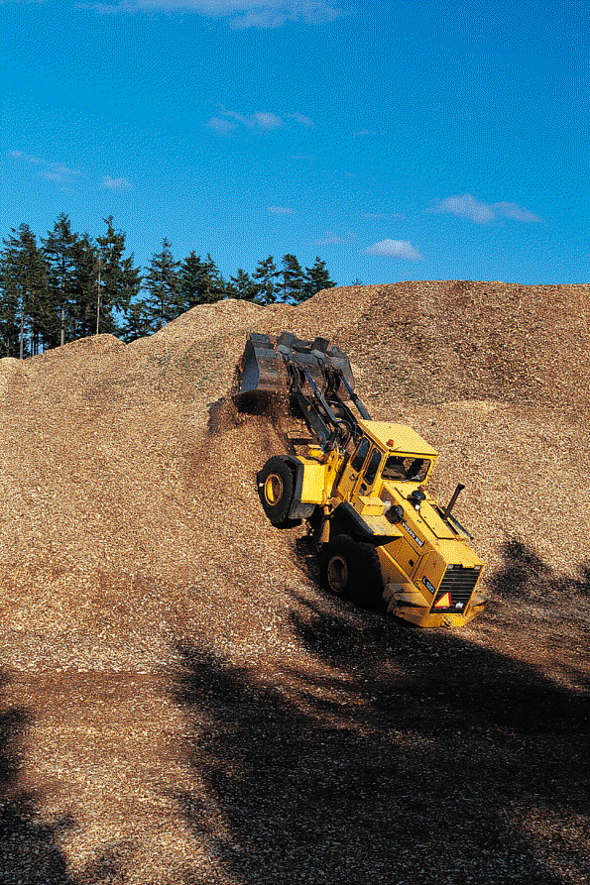
242 Biomass Plants in Denmark (using biomass as major fuel)
Wood or straw:
145 district heating plants
32 CHP plants
Biogas:
37 CHP (excl. individual farm plants)
Municipality Solid Waste:
24 CHP plants
4 district heating plants
13% of the electricity consumption and 21% of total space heat consumption from biomass.
Many large-scale CHP’s around major cities will convert to biomass in next 10 years, as many large cities adopt low carbon or zero carbon climate strategies
Notes:
Most of these use straw and wood chips as fuel. More than 200 district heating pants incinerate wood and straw.
Biogas plants are often small or medium size plants, while municipality solid waste typically is burned at medium or large scale plants.
It is noteworthy that a wide range of biomass is used at plants which differ greatly in scale. Advanced technology is developed for small, medium and large scale plants.

Slide 6
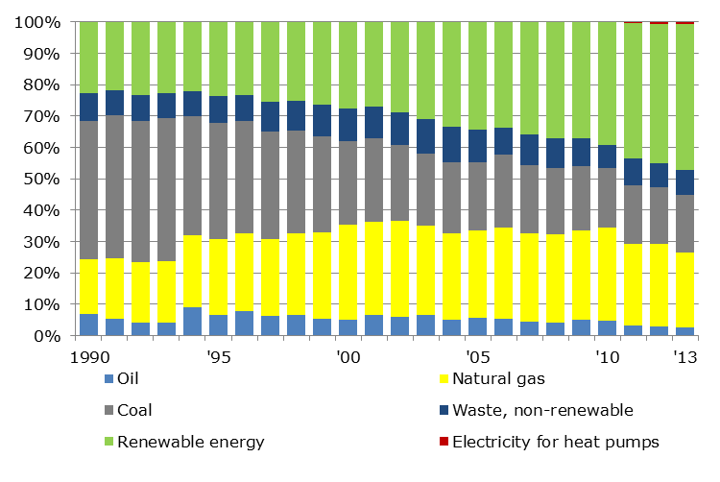
District Heating Production by Fuel
Biomass exempted from energy tax
District Heating = Heat supply for 63 pct. of all houses.
24% of all houses in Denmark are heated by biomass-based DH
Notes:
An important feature is also the introduction of clean and environmentally benign fuels. Oil has been almost phased out as a fuel for DH. Natural gas – the yellow colour - has been introduced and is to day the second most important fuel. The dominating fuel is now biomass and waste – marked by the green colour. As much as 42 pct. of all district heating is now produced on biomass.
25 years ago biomass and organic waste constituted 10 % of the fuel used for district heating – to day the share ranges at 42 %
Thus 25 pct. of all houses and buildings in Denmark are heated by biomass-based DH. The economy is very favourable, I will return to that.

Slide 7
Biomass in Danish DH sector
Currently 1.2 million tons straw used for energy production annually (almost 60% of collected volume)
Plants differ greatly in scale and advanced technology has been developed for both small, medium and large scale plants.
The majority of biomass heat plants has between 100 and 10,000 connected households and has a thermal output between 1 and 10 MW.

Slide 8
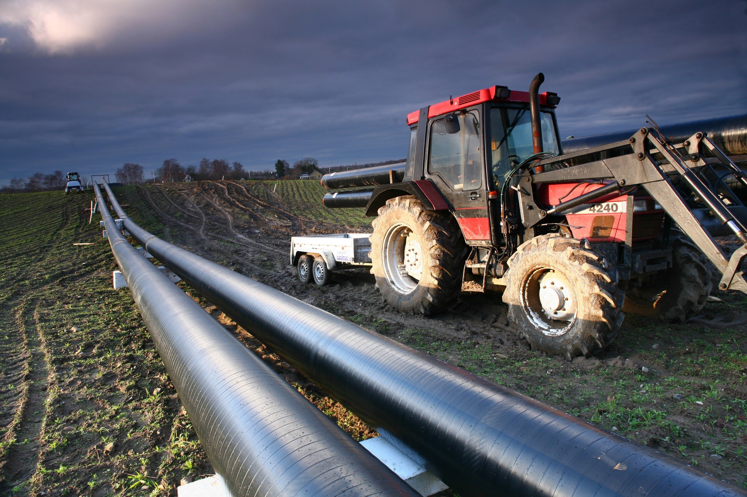

Slide 9
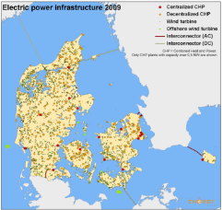
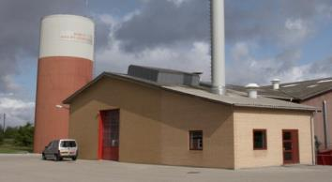
Borup heat plant
One case from Denmark
Small scale straw boiler
Short report available.
DH using locally sourced straw
Capacity:
2 x 7,5 MW
Maximum heat output:
2 x 32.000 MWh/year
Supplies 1,150 (++) households with space heating and hot water
~ 230,000 square meters.
DH since 1964 (oil) replaced in 1984 with straw-fired plant
Notes:
Borup DH plant. 30 years old plant. 7,5 MW straw full automatic boiler. Owned by 1150 houses in the local community delivering space heating and domestic hot water.

Slide 10
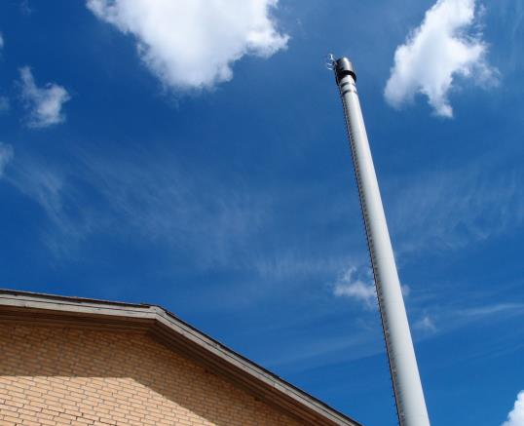
Borup straw-fired DH boiler plant
Supply heat for 1.150 households (shareholders)
Fuel consumption: 8-9.000 ton straw/year
(Energy content of straw = 14,5 GJ/ton)
Yearly fuel input = 34.000 MWh
Yearly heat output = 32.000 MWh
Efficiency of 94 %
Built in 1984 by local farmers.
Further 7,5 MW expansion put in operation November 2014.
Notes:
Straw sourced from local farmers – supply potential is approx 20.000 tons/year. Farmers also supply straw to other plants.
Straw energy in Borup replaces approx. 3 million liters of oil that would have been used if the heating was based on individual oil furnaces.

Slide 11
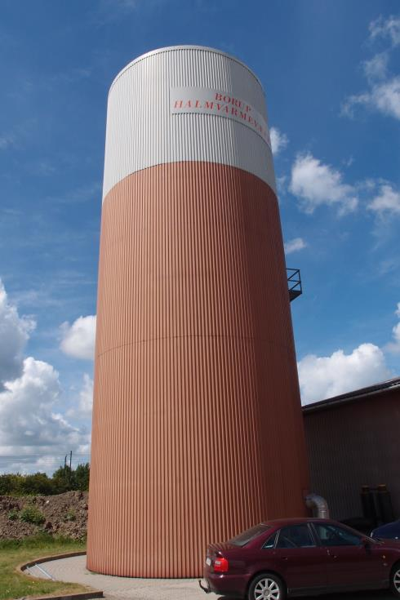
Borup straw-fired DH boiler plant
Operating time:
4300 full-load hours/year
Heat storage: 500 m3
Total cost including design, engineering, construction and testing:
35 million DKK (boiler ~ 10 million DKK)
Heat production cost = 530 DKK /MWh
3 employees
Notes:
500 m3 – enough for 16 hours operation..

Slide 12
Development at Borup HOB plant
In 1984 of group of farmers built the straw fired heat plant and sold the heat to the local heat company.
2006 – boiler was replaced (~ 1 million GBP)
In 2011 the heat company bought the straw fired heat plant from the farmers (~ 1,15 million GBP)
Boiler too small to cover demand and new additional boiler was put in operation November 2014.

Slide 13
Borup heat company
Owned and operated by a cooperative society with limited liability (Borup Varmeværk A.m.b.a) owned and controlled by the heat consumers through the annual general assembly where the Board is elected.
Supply heat to connected consumers at a non-profit basis (restriction by law).
Heat price based on necessary cost for O&M and depreciation of capital investment costs.

Slide 14
Straw purchase and logistics
15 local farmers supply straw based on 3-5 year agreements. Typical price ~50-60 GBP per tonne at 11-13% moisture content.
Contract typical states delivery of 20% of annual amount at a time.
Farmers receive ashes (fly and bottom ashes) as fertilizer. Measurements at regular intervals to ensure compliance with permitted limits.

Slide 15
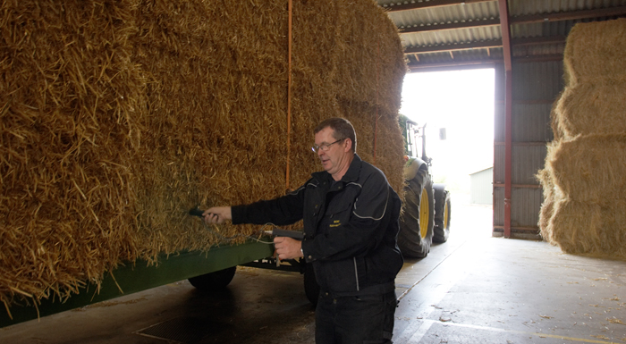
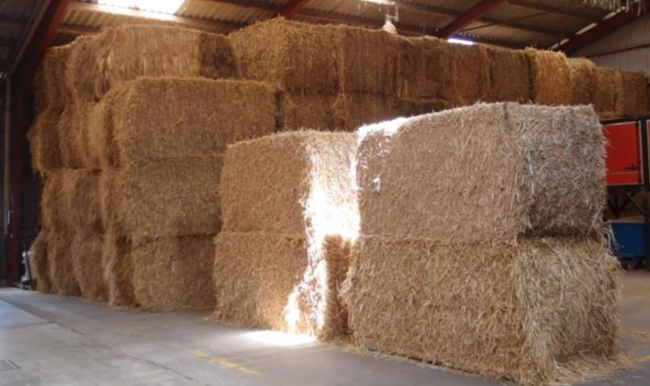
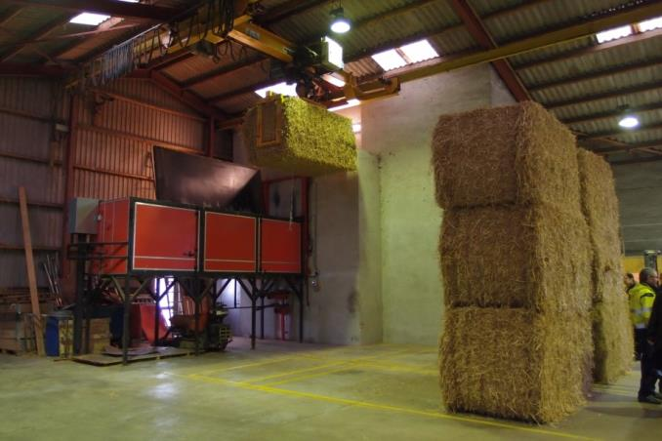
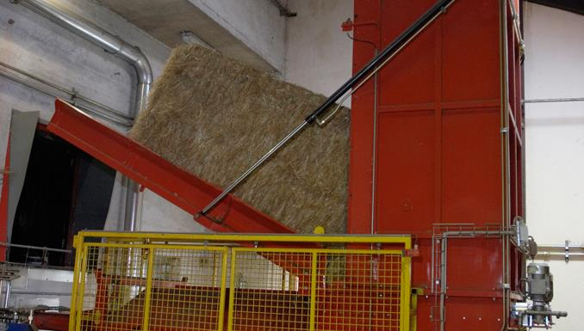
Automatic heat plant

Slide 16
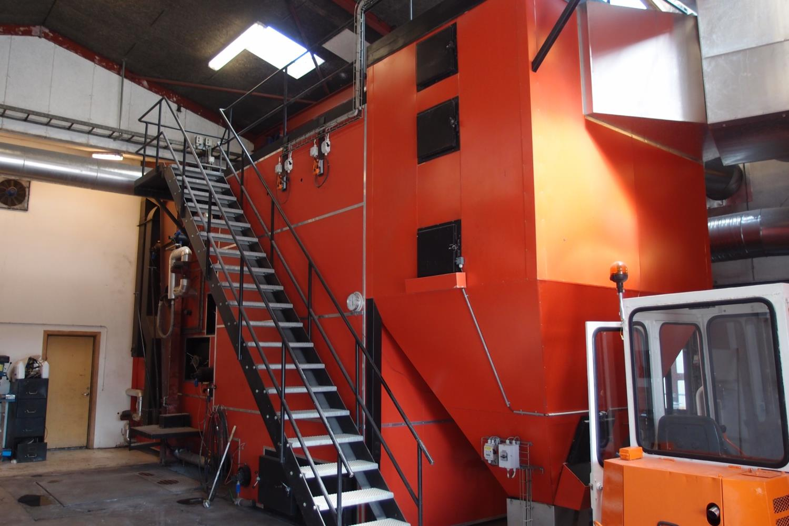
Notes:
This boiler is 8 years old. Efficiency is 94 %. Specs can be given after this presentation.

Slide 17
Daily operations
3 full-time staff + part-time administrative assistant
Usual operational tasks: minor technical issues, maintenance and supervision
1 staff on call outside office hours (receives texts from the SCADA + remote control through smart phone)
Flexible operation through heat accumulator
SCADA system

Slide 18
DH pipeline network
Each consumer has own meter (remote measurement)
Approx. 84 km of pipeline – about half is main pipeline.
Temperature is 85/40 degrees Celcius and pressure at 2/0,75-1,0 bar.
Heat loss of ~23 percent
Both delivery through heat exchanger and direct flow.
Water treated to keep pH = 9 - (ensures longest lifetime of pipes)

Slide 19
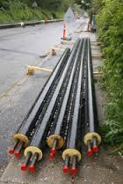
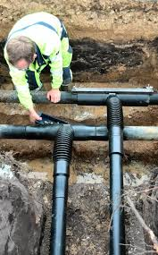

Slide 20

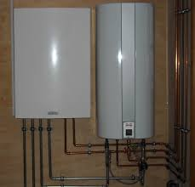


Slide 21
New boiler plant investment
Total investment: 35 million DKK (~3,4 million GBP)
  16 million DKK (1,56 million GBP) for equipment and machinery
  16 million DKK for buildings
  3 million DKK for consultancy and land
  Full turnkey delivery including start-up operations and testing
Funded through long term fixed interest loan with repayment. Interest = 0,2 %p.a. (municipality provides guarantee)

Slide 22
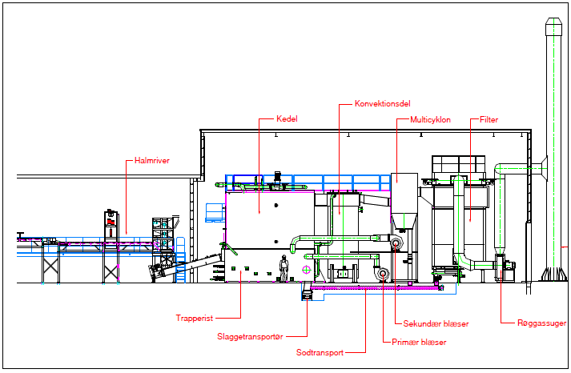
Plant layout

Slide 23
Consumer prices and operational revenue
Two-part tariff: fixed costs of 21 DKK pr. sqm + variable costs depending on heat consumption (405 DKK/MWh)
Standard household of 130 sqm and annual consumption of 18,1 MWh pays DKK 3.400 (fixed) + DKK 9.100 (variable)
Borup is among the cheapest 25 % of all DH companies
Heat company revenue= 4,9 M DKK + 9,4 M DKK

Slide 24
Operational Costs
Primary costs are straw fuel and back-up/peak load boiler fuels + associated taxes and tariffs.
Balance between revenues and costs meaning that excess revenues has to be paid back to consumers, e.g. lower heat prices next year.
But also possible to put aside revenue when very large costs is expected to incur within a few years – e.g. repair works on district heating pipelines

Slide 25
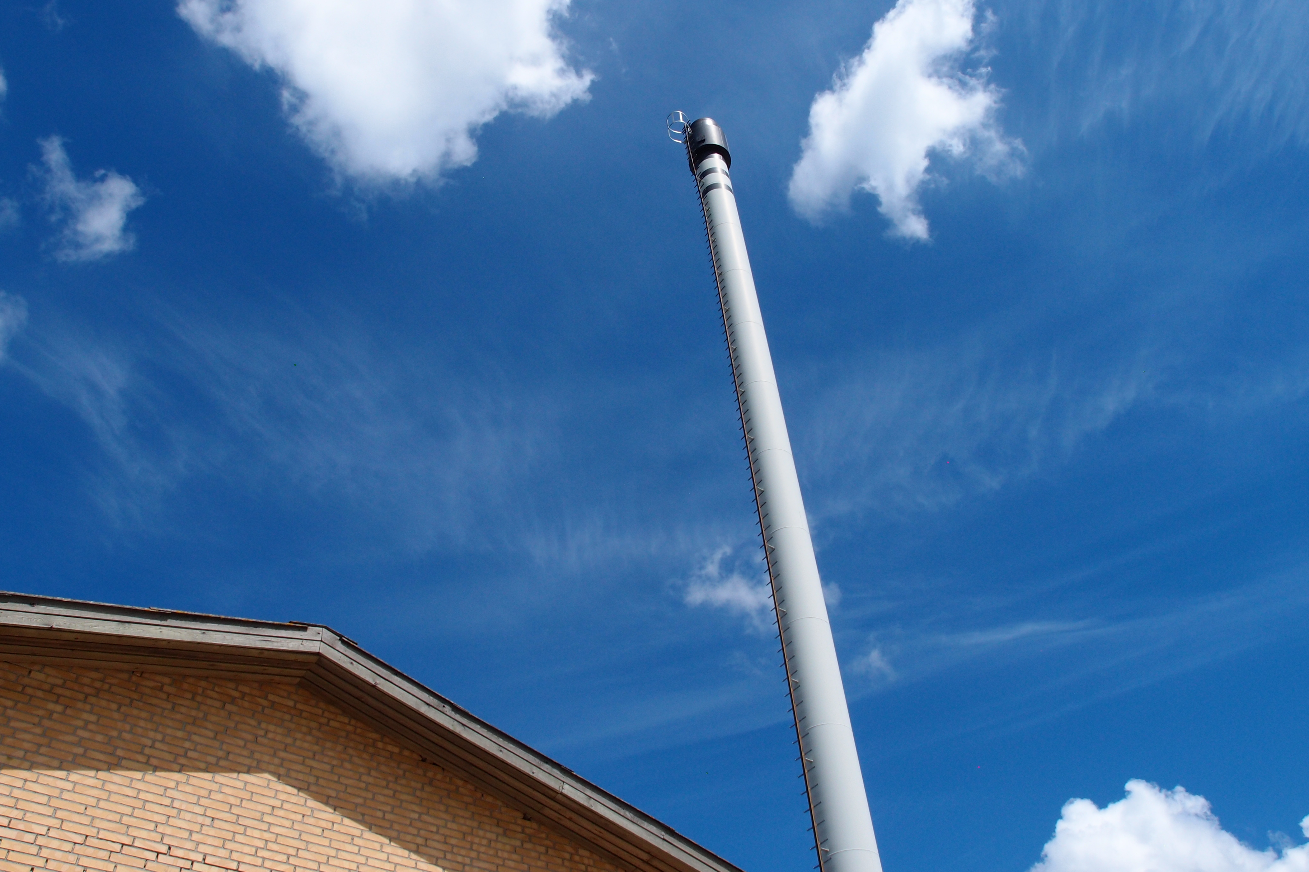
Notes:
Running more than full capacity - Actually this 7,5 MW boiler is running 8,4 MW at this time. Bagfilter is working very efficiently to keep particle emissions down.

Slide 26
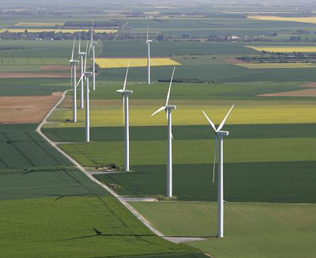
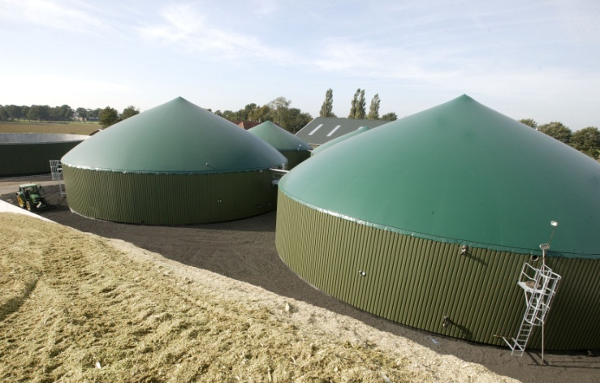
Energy Planning in Denmark
- and the municipal responsibilities
Establishment of energy plants
Local Planning and Land Use Authority
Municipal land use planning for energy supply plants
Approval of wind turbines, CHP-plants, biogas plants etc. acc. to existing regulation (land use , environment, building permit etc.)

Slide 27
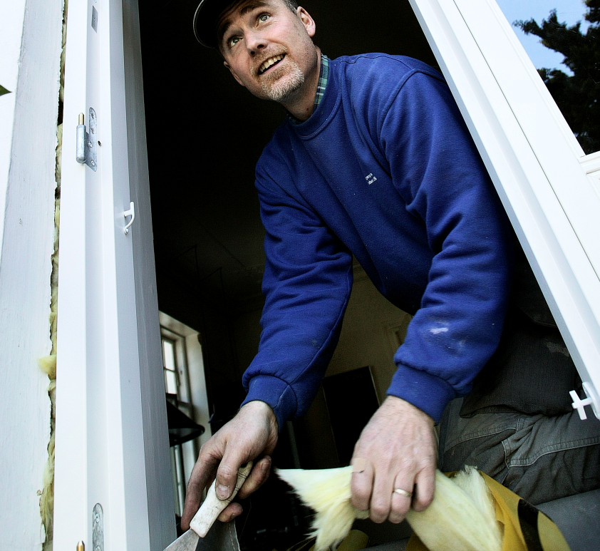
Energy Planning in Denmark
- and the municipal responsibilities
Energy efficiency and green conversion
Municipal ownership
Energy efficiency in municipal owned
  Buildings
  Transport equipment Energy supply system (some municipalities, in particular larger cities)

Slide 28
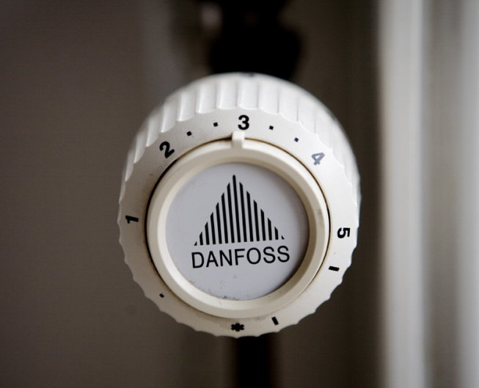
Energy Planning in Denmark
- and the municipal responsibilities
Heat supply
Local Heat Supply Authority
  Municipal heat planning
  Approval of heat supply projects (supply of district heating and natural gas)
  Increased connection to collective heat supply (DH/NG)

Slide 29
Important factors in Danish heat planning
A planning system, which ensures investigations and planning
  Clear policy direction and broad national consensus about the direction
  Central provision of assumptions (fuel price projections, technology data etc.) for the analyses and guidance to the sector on how to prepare heat plans
  Co-operation between authorities, energy supply companies and industries

Slide 30
Important factors in Danish heat planning
A well functioning decision making system
  Clear definition of roles and responsibilities between national and local authorities and supply companies
Well established implementation model
Attractive financial incentives and/or necessary instruments (”carrots and/or whips”)
Attractive contractual arrangements to promote co-generation

Slide 31

Socio Economic Methodology
Guidelines - developed by the Ministry of Finance

Slide 32
Methodology
Comparison of at least two scenarios
  Baseline
  Alternative
Levelised Cost of Energy
Sensitivity analysis
  Fuel price
  Investment
  Heat consumption
  Etc.

Slide 33
Cost Benefit analysis
Cost
Tax distortion loses
  Taxes distorts the market – Lost revenue = new taxes = loses.
Factor prices or market prices
  Market prices = everything
  Factor prices = excluding taxes and subsidies
Externalities
  SO₂/SO₄
  NO_{x}
  PM2,5 and
  CO₂

Slide 34

Basis for Socio Economic Evaluations
Calorific values
Inflation projection
$ - exchange rate
Fuel price projections
  Power Plant (CHP)
  DH production unit
  Household
Electricity price projection
Emissions from electricity
Price on emissions

Slide 35
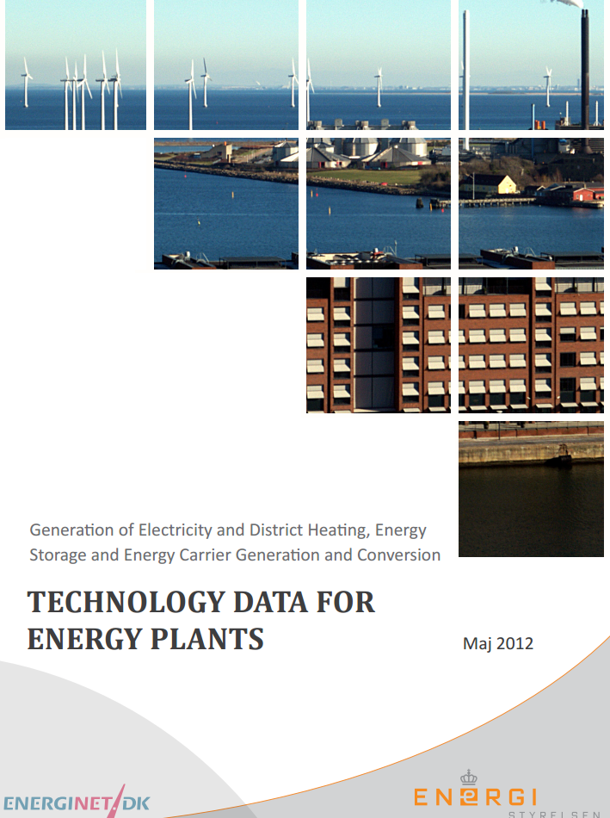
Technology Data
Thermal electricity
CHP Unit
DH Boiler
Electricity grid
DH network
DH substation
Individual heat pumps

Slide 36
Technology Data
Generating capacity for one unit (MW)
Electricity efficiency (%) net
Heat efficiency (%) net; without flue gas condensation
Heat efficiency (%) net; with flue gas condensation
Availability (%)
Technical lifetime (years)
Construction time (years)
SO2 (g per GJ fuel)
NOX (g per GJ fuel)
Unburned hydrocarbon, UHC (g per GJ fuel)
N2O (g per GJ fuel)
Specific investment (M€/MW)
Fixed O&M (€/MW/year)
Variable O&M (€/MWh)
Regulation ability
Regulation speed (MW per min.)
Minimum load (% of full load)

Slide 37
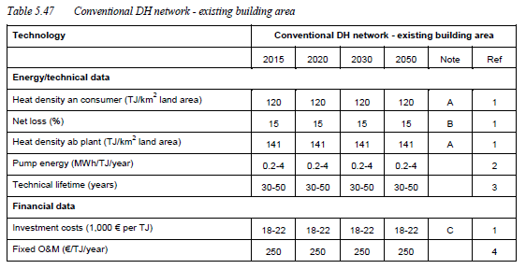
District heating networks
Source: DEA Energy Technology Catalogue

Slide 38
Danish expertise and knowhow
Danish companies and research institutions have as much as 30 years of experience within biomass (straw, wood waste and MSW) combustion.
Specialized equipment designed specifically for biomass.
A lot of companies involved in feasibility studies, design, engineering, construction and operational management.

Slide 39
Thank you
Bo Riisgaard Pedersen,
Danish Energy Agency
brp@ens.dk

Slide 40
Extra slides

Slide 41
Example no. 1:
Development of DH / CHP in the 80’ies
Policy direction clear: substitution of oil through domestic nature gas market and large district heating systems on CHP around coal fired power stations
  Mandatory nationwide municipal heat planning, guidance documents in heat planning, common assumptions (fuel price projections, technology data etc.)
  Regional co-operation groups in order to support the heat planning process, exchange of experience etc.

Slide 42
Example no. 1 (cont):
Development of DH / CHP in the 80’ies
  Decision criteria: economic feasibility and oil substitution
  Only the additional costs by establishing CHP are covered by the DH-consumers. The electricity consumers obtains same electricity prices with CHP-production as with separate power production, until the CHP-investments are paid back.
  Instruments for municipalities: Authorisation to project approval; provisions for securing high connection to network

Slide 43
Results, example 1: Development of heating systems – 1981-2011
Oil substitution:
Individual oil boilers
reduced since the 80’ies
Individual natural gas boilers “phased in” from zero since the 80’ies
The share of DH doubled from 1980. Today 1.7 mio. households supplied with DH.
Heating installations in all residential buildings
31%
62%
31%

Slide 44
Results, example 1: CHP proportion of DH-production and of el. prod.
Notes:
DK no. one in EU, followed by the Netherlands and Finland

Slide 45
Example no. 2:
Development of local CHP in the 90’ies
  National, regional and municipal heat planning completed. Clear policy direction and decision criteria
  Municipal planning followed by project specific (installation specific) planning.
  New favourable incentives for promotion of DH and local CHP: Feed in premium, investment subsidies to network, CHP-plants, heating installations etc.
Approx. 670 decentralised CHP stations based on natural gas, biomass, waste and biogas were established in the 1990s, in total 1500 MW-el
Entrepreneurs in place: local DH companies, municipalities, electricity companies and industry

Slide 46
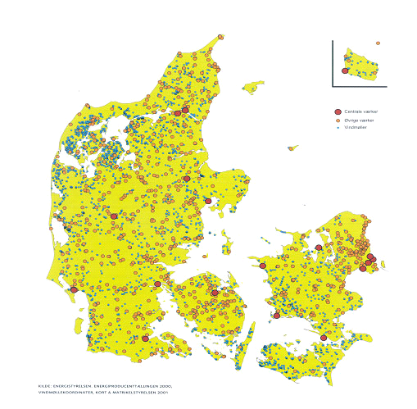
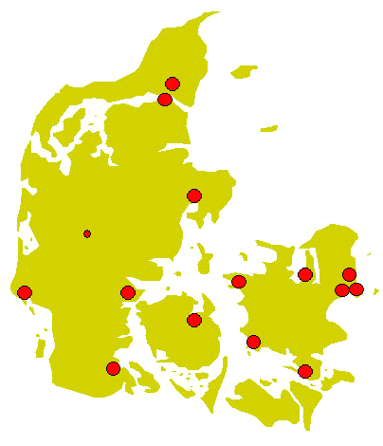
Results, example 2: Development of local CHP’s 1985-2000
Centralized production in the mid 80’s
Decentralized production in 2000
Legend:
Decentralized CHP
Centralized CHP
Wind mill park

Slide 47
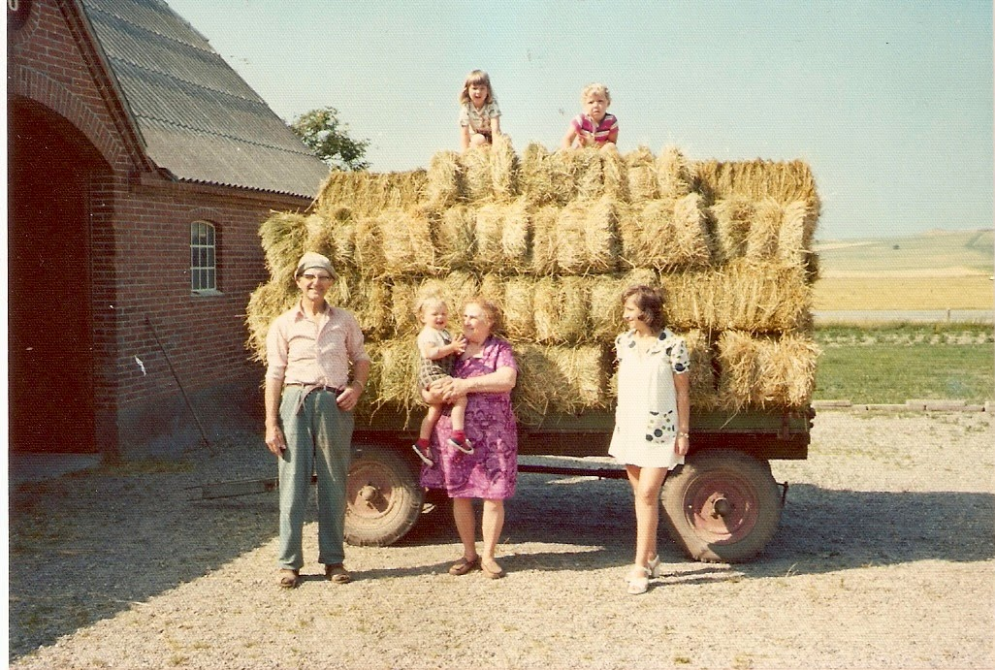
Denmark has decades of experience with biomass - especially straw

Slide 48

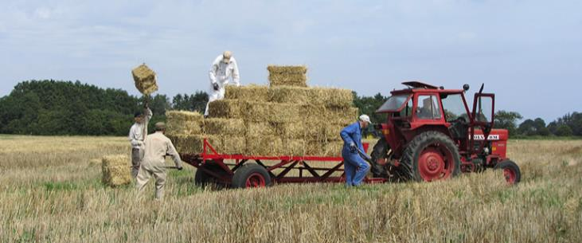
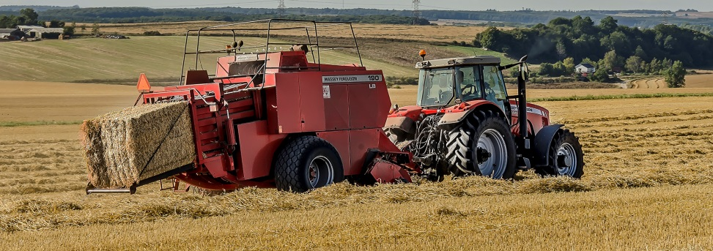
Notes:
In Denmark we have tried many different types of baling through the years and have found that the 500 kg big bale is the optimal size.

Slide 49
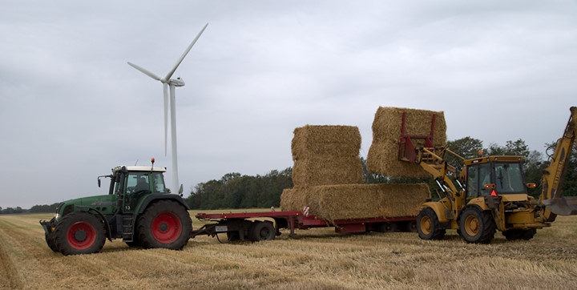
Agricultural contractors handles the straw
Notes:
Baling, storage and transport of the bales are usually done by agricultural contractors. 1 bale weighs approx. 500 kg!

Slide 51
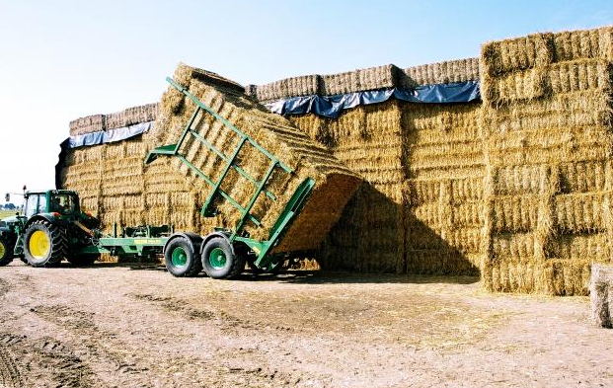
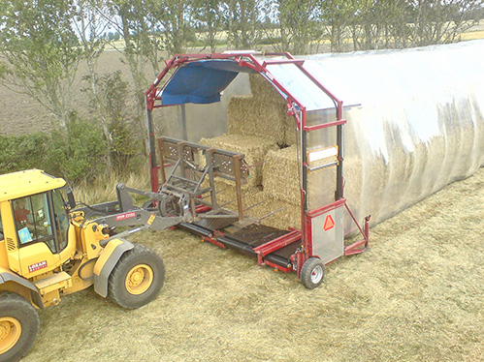
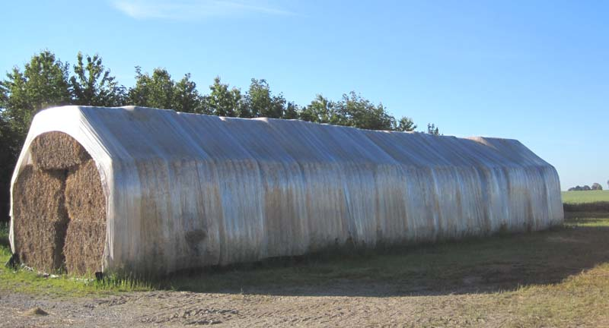
Proper storage and logistics

Slide 52
Notes:
This graph shows the technical improvement of straw fired CHP since 1988.
Since then, the technology has been developed to handle much higher steam temperatures and boiler pressures.
Denmark is well known for its wind mills. But I think Denmark should be equally well known for its highly advanced and efficient biomass plants.
In fact Denmark now has one of the worlds most efficient biomass CHP. This technology is now finding its way into China. In fact, the first of the 3 CDM-project between China and Denmark was a biomass-based power plant. This is the very start of our cooperation in this field, I believe.

Slide 53
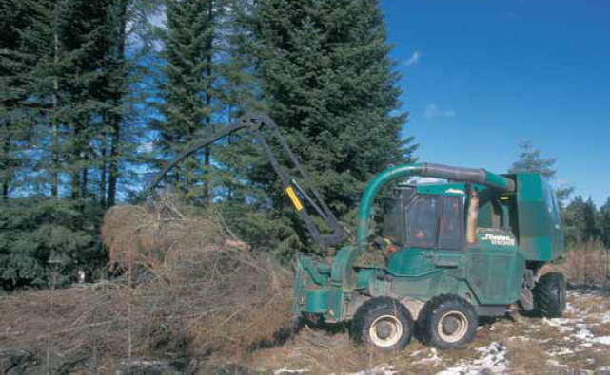

Slide 54
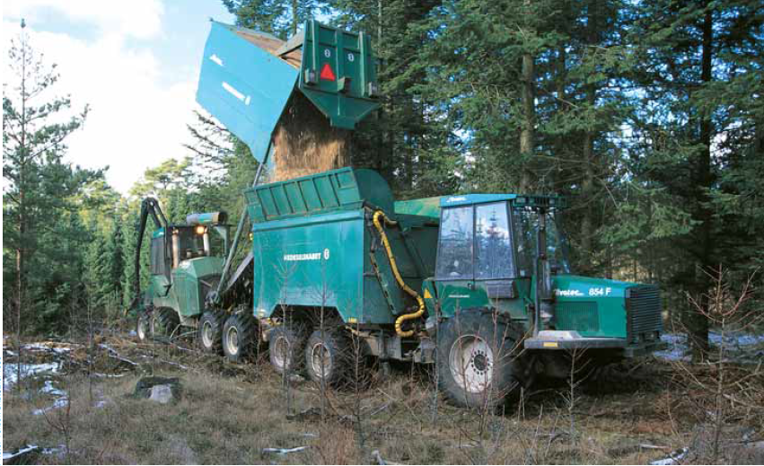

Slide 55
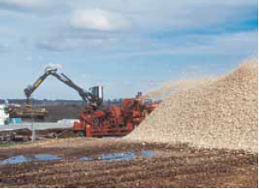
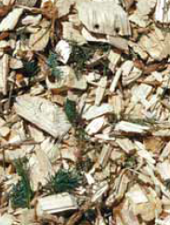
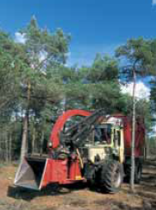
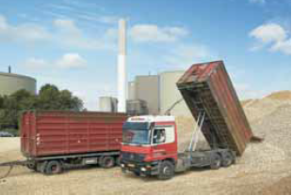

Slide 56
Wood chips boiler - example
Boiler capacity: 5,5 MW
Plant capacity: 6,9 MW (including condensing unit)
Fuel range: 20 – 60% moisture content
Fuel: Wood chips
Design pressure: 4 bar
Design temperature: 110 degrees Celsius
Source: Euro Therm A/S

Slide 57
Lessons learned - summary
Denmark has 30 years experience in using biomass for energy production
Boilers can be very efficient with a lifetime of +25 years
If handled correctly, straw is a very stable source of energy
With 20 % moisture content (max limit) straw provide 14,4 GJ/t
Proper flue gas filters can minimise emissions severely
Heat storage is essential for flexible operations.
Investment in quality equipment is the most cost-efficient in the long run – with the proper operational training and management = low heat prices and reduced air pollution

Slide 58
Bo Riisgaard Pedersen
Advisor
Danish Energy Agency
brp@ens.dk

