Slide 1


Heat Network Partnership
District Heating Strategy Support Workshop, Glasgow September 8th 2015
Deployment of district heating on a large
scale in Gladsaxe Municipality
Presentation by:
Thomas Engell
Gladsaxe Municipal District Heating

Slide 2
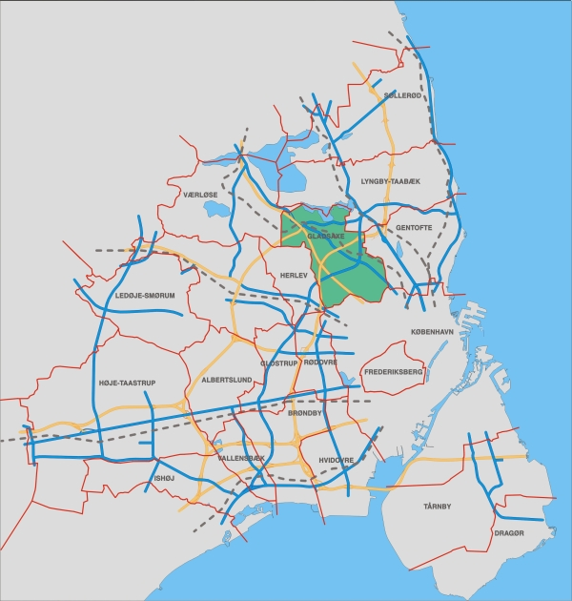
Gladsaxe
- a Suburb of Copenhagen
2,500 ha
67,350 inhabitants
20th largest local
authority
Notes:
In comparison to area, (2.500 hectare), Gladsaxe are amongst the smallest municipalities.
As to the number of inhabitants (67.350), Gladsaxe are amongst the larger municipalities.
Gladsaxe is an independent municipality, in the vicinity of Greater Copenhagen.
Approx. 32,000 inhabitants of Gladsaxe are employed, and there are approx. 38,000 workplaces in Gladsaxe.
The number of jobs within the municipality match the number of employed.
Only 9,000 of people living in Gladsaxe works within the geographical area of the municipality.
Thus, 23,000 commute out of the municipality while 29,000 commute into Gladsaxe each and every day.

Slide 3
Energy & Environmental Plans
The Municipal CO₂ reduction target:
40 percent by 2020
as compared to the 2007 emissions
Notes:
Gladsaxe Municipality has set a target to reduce Carbon Dioxide emissions by 40 percent by 2020 as compared to emissions in 2007.
CO2 emission by heat sources (2014)
District Heating (GF) 88 g/kWh
District Heating (VF) 82 g/kWh
Heat pump COP=4 102 g/kWh
Natural gas 204 g/kWh
Light oil 266 g/kWh
Electricity 407 g/kWh

Slide 4

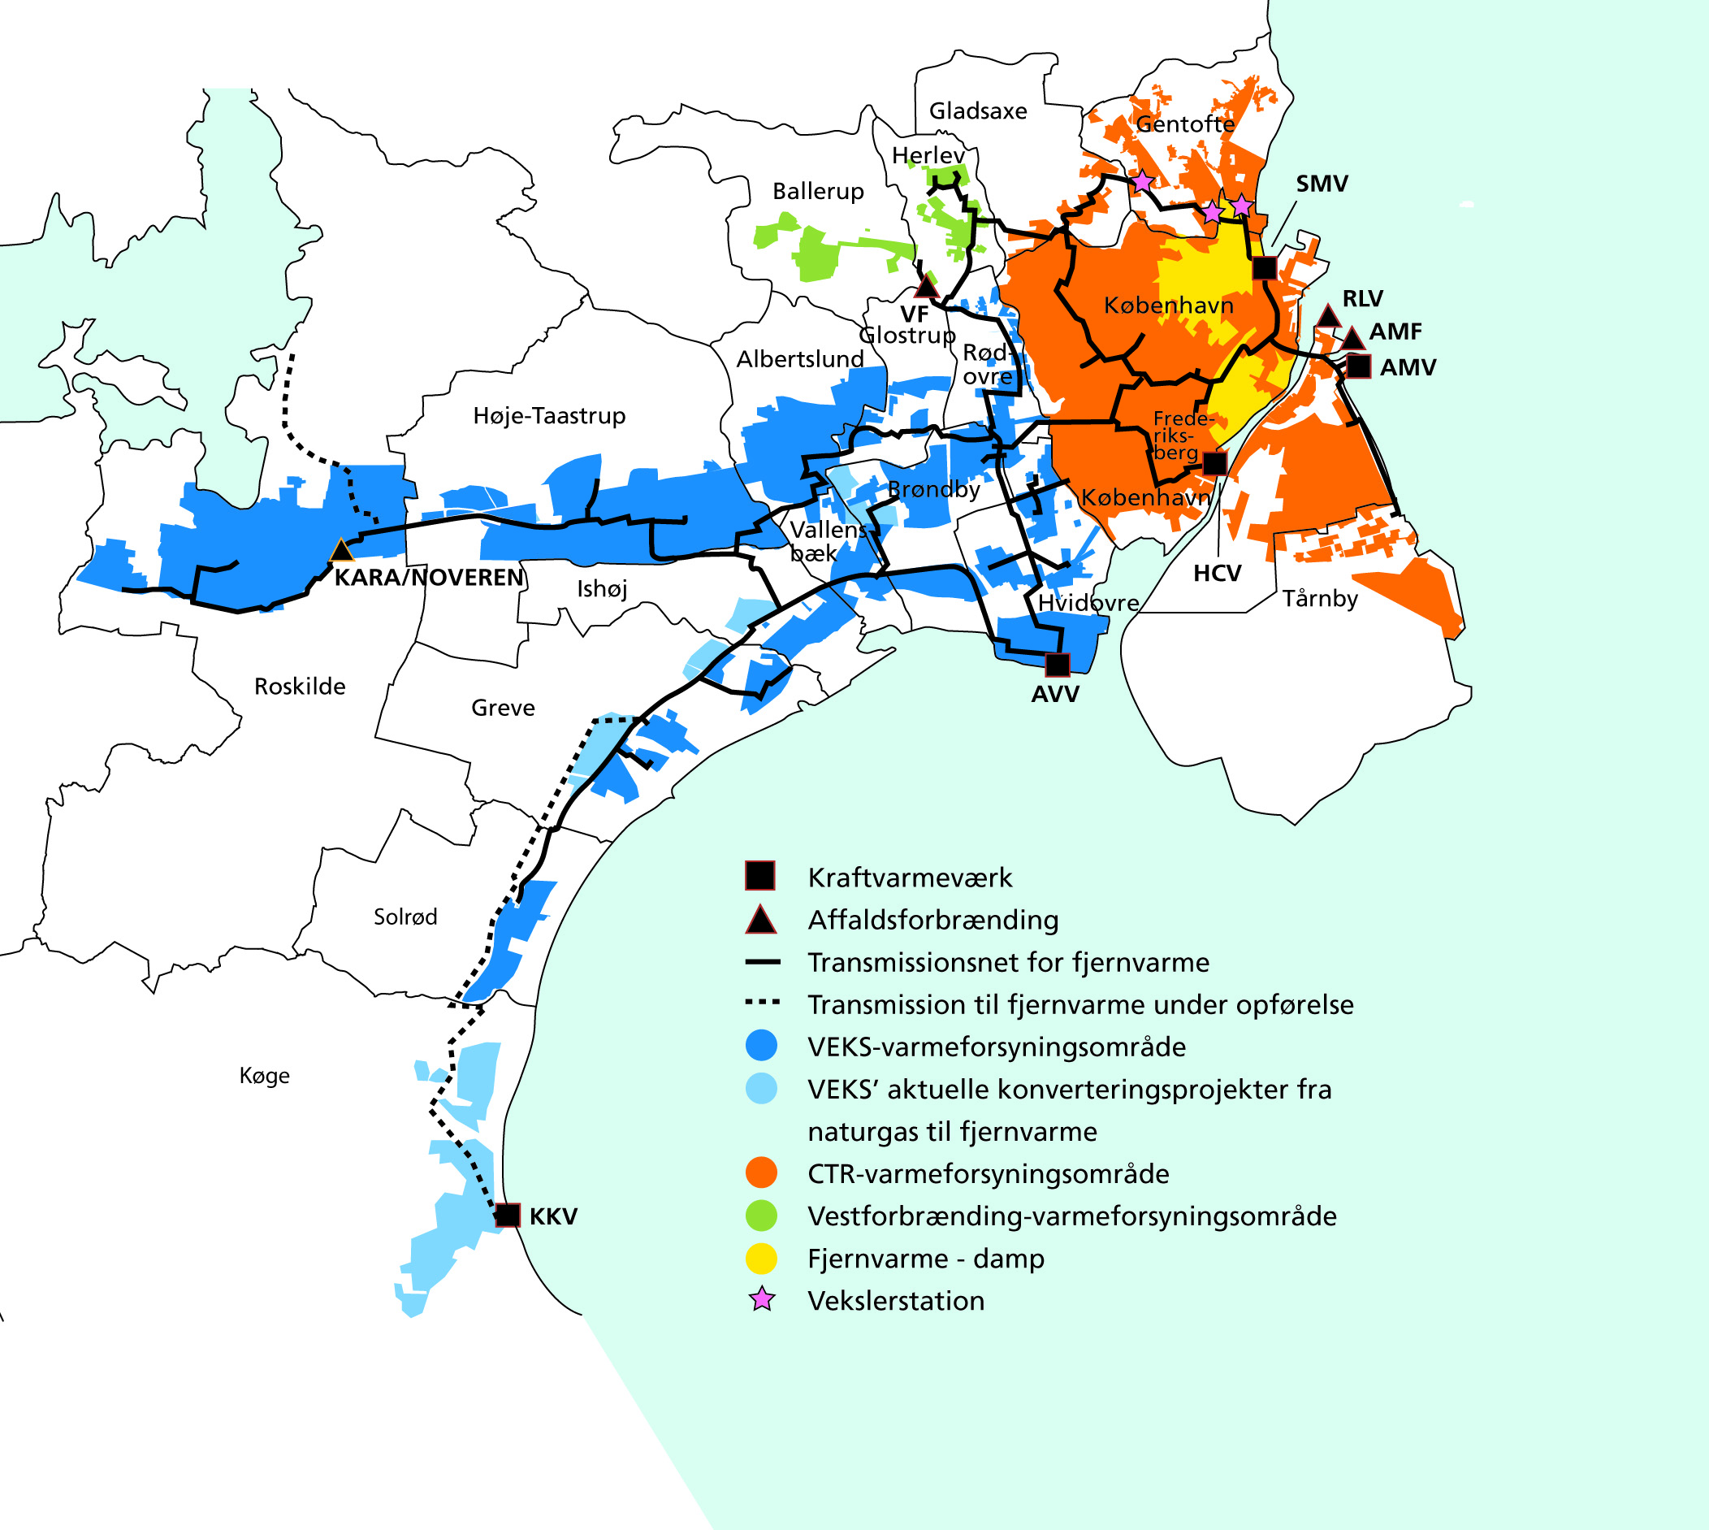

Greater Copenhagen
District Heating System
Notes:
Various sources of waste heat from CHP, waste incineration.
Transmission & distributions systems established in the 80’ies.
DH has been much cheaper than oil & natural gas due to energy efficient production, utilisation of waste heat & politicians adjusted consumer prices by adding environmental taxes on fossil fuels.

Slide 5
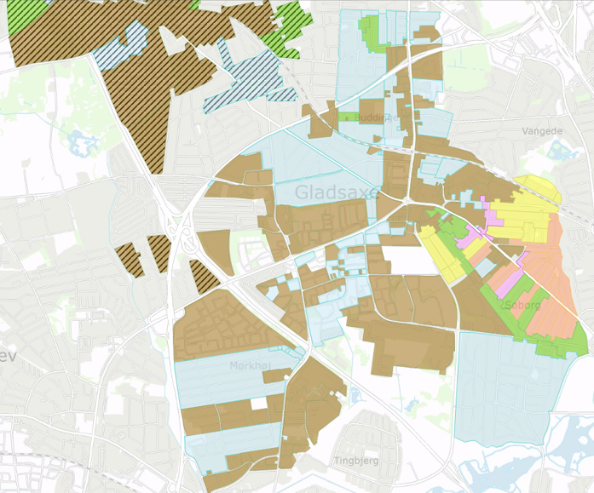

District Heating in Gladsaxe
D
VF DH area
Gladsaxe DH area
DH current extension
DH 2015 extension
DH 2016 extension
DH 2017 extension
DH potenial extension
Notes:
HEAT SUPPLY ACT
Article 1. The objective of this Act is to promote the most economic, including environmentally friendly utilisation of energy for heating buildings supplying with hot water and reduce the dependency of the energy system of fossil fuels,
Article 2. In agreement with the objectives mentioned in Article 1, the supply of heat shall be organised with a view to promoting the highest possible degree of cogeneration of heat and power
Heat supply Planning District Heating or Natural gas
Prices
Energy Regulatory Authority
Public Service Obligations (PSO)
District heating was established in the 80’ies;
coverage of approx. 20 percent of the heat demand.
In 2007 and 2008 the Municipal Council supported plans for extending the district heating networks by 2 different utilities. The main focus was on extending the networks for supply of larger consumers.
In 2013 the Municipal Council supported a plan for district heating supply of residential households when this was financial and economical viable.
By law are District heating companies operated as non-profit companies, and this is supervised by the Danish Energy Regulatory Authority.
Gladsaxe DH Municipal owned DH company, not privatised
Purchases DH from CTR (CHP, waste incineration a.o.)
Vestforbrænding Joint municipal DH company (waste incineration)
Total expected investment cost over the period 2011-2017: approx. £ 44 million by Gladsaxe DH company
In new district heating areas approx. 75 % of total heat demand connected within 2 years

Slide 6
Extension plans for District Heating
in Gladsaxe
Initial situation
(before 2010)
Current Extension & Projects (2015)
Natural gas ~65 %
Oil ~10 %
Other ~10 %
District Heating ~20 %
Gladsaxe DH 125,000 MWh
Natural gas ~30 %
Oil ~0 %
Other ~10 %
District Heating ~60 %
Gladsaxe DH 125,000 MWh
+135,000 MWh
Vestforbrænding +120,000 MWh
Total 375,000 MWh
Notes:
Master Plan to subsequently be implemented through legal proposals to be approved by the Municipal Council.
Initial number of customers: 40 (large)
Extension into natural gas area: +400 (medium to large)
Extension to residential area (NG): +1,000 (small)

Slide 7
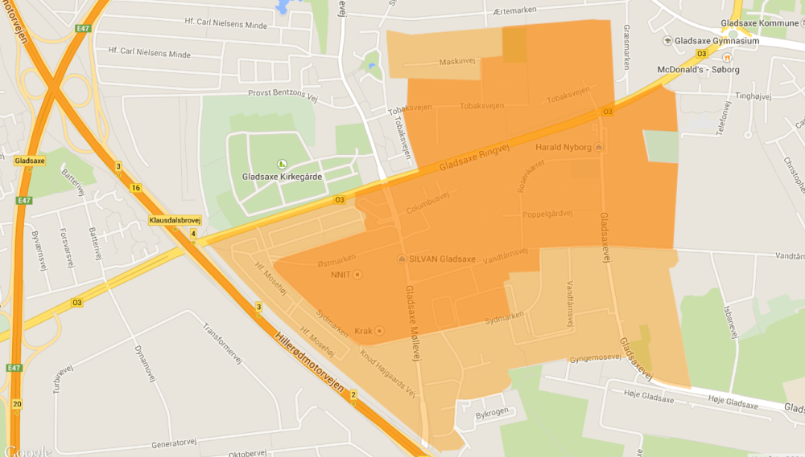
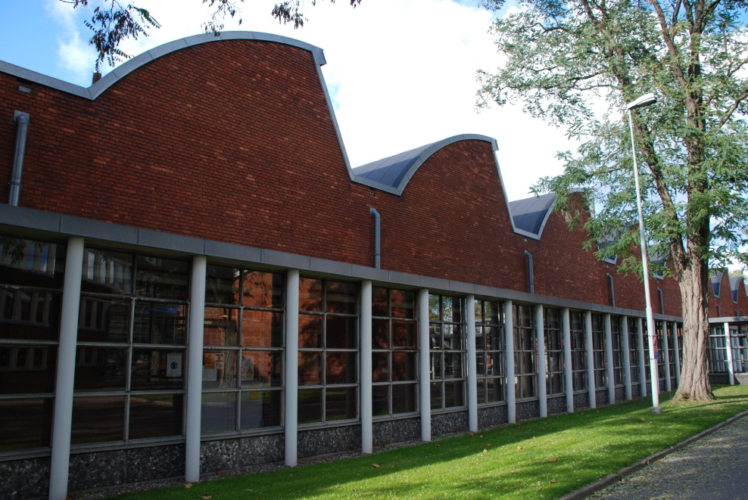
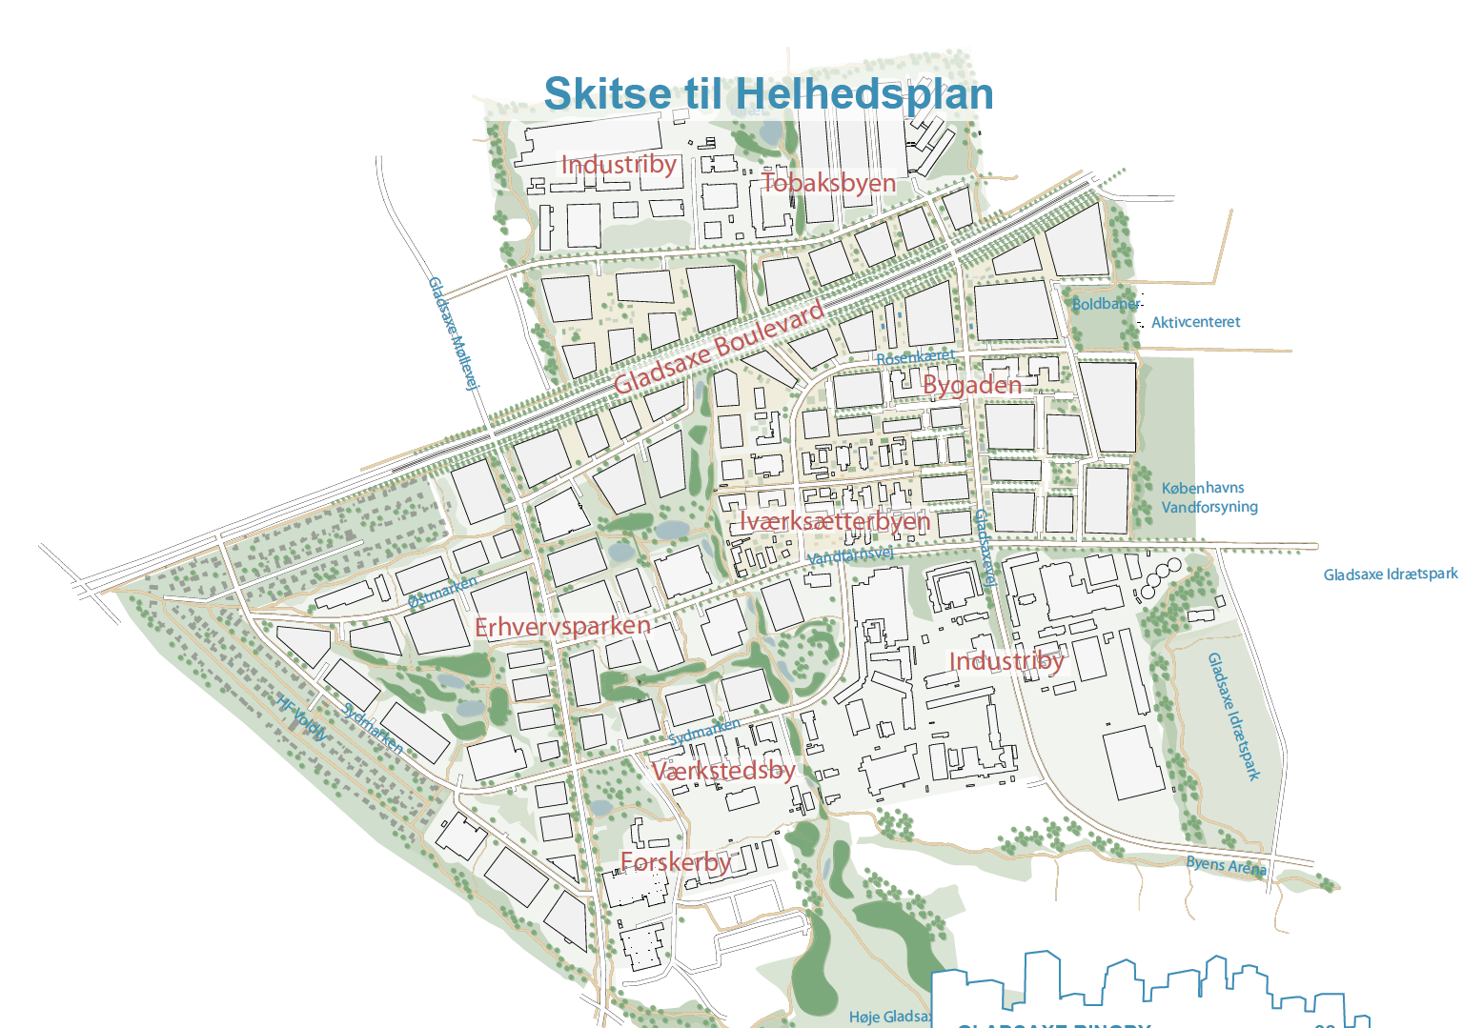
Gladsaxe Ringby – 116 ha
Light rail
Tobaksbyen
NCC Company House
Gl. Gladsaxe Skole
Alfa Laval
Novo Nordisk
Søborg Møbel?
Notes:
Physical planning
Land use
Development areas
Infrastructure
Nature protection
When planning the extension of the DH network to consider transformation of the City…
Local development plan
Dense areas near the stations with high rise buildings up to 10 stores
Mix of housing and business, retail, public purposes, green areas
Infrastructure: traffic, water, heating, solar energy

Slide 8
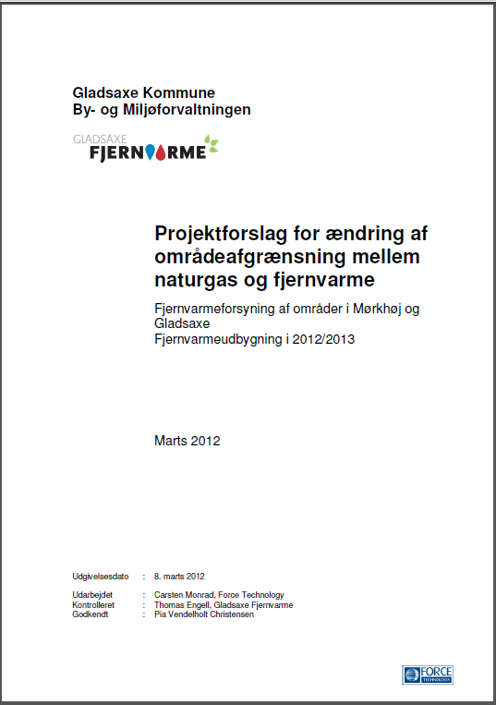
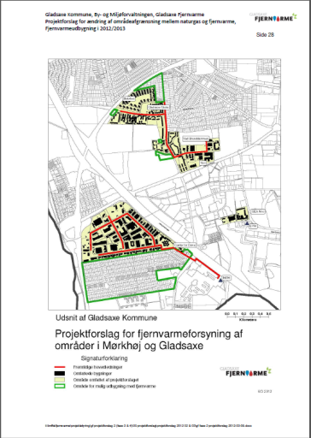
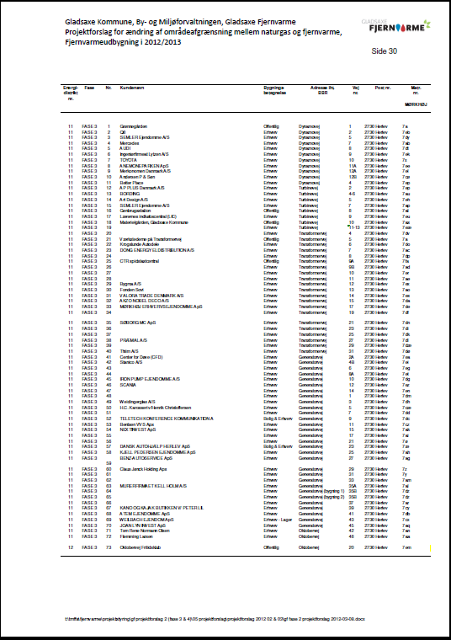
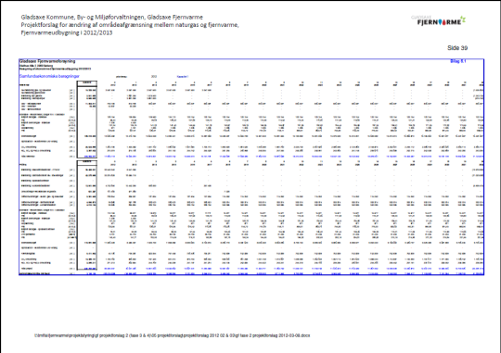
Legal proposal document for
extension of District Heating network
Notes:
Energy planning through demand assessment based on area, building types, age and usage. Areas with highest energy intensity were further investigated…
DH environmentally friendly compared to fossil fuel options.
The challenge is to prepare a Master Plan for DH extension into areas approved for natural gas supply.
Important issues to be resolved:
Assessment of Master Plan – is it feasible – by whom (consultants and/or own staff)
What are future tariffs & competitiveness vs other options?
Present case for political decision in Municipal Council – PPP or Public Enterprise?
Financing & guarantees…
Organisation – outsource other implement by municipal organisation
Staffing – what requirements to the new organisation
Legal proposal includes:
Scope of proposal prepared by DH-company / Municipality in line with policy & stakeholder considerations
i.e. will the project require increase in DH charge for old customers…?
Area covered & building owners
Energy consequences: natural gas, oil, DH and other fuels – before and after project
Energy efficiency
CO2 consequence
Investment costs (DH, Consumers, Utilities, others)
Financial calculations (utility)
Economic calculations
Financial consequences for consumers: DH vs. Natural Gas

Slide 9
Approval of Projects (1)
Approval of projects by District Councils must include:
  Economic net present value of the project must be positive
  Economic analyses should be based on latest guidelines from the Danish Energy Agency & the Ministry of Finance
    E.g. Discount rate of 4 percent
    Economic fuel prices & environmental costs (CO₂, SO₂ etc.)
  Financial analyses (DH company & different size of consumers)
  Ensure compliance with other planning
Notes:
Approval of projects by District Councils must include:
Public hearing period of 4 weeks
among concerned energy companies, municipalities and land owners
Approval by the District Council
and taking into account any relevant comments provided during the hearing period
Energy Appeal Board treat complaint on decisions taken by the municipality
a complaint shall be lodged not later than 4 weeks after the decision is announced

Slide 10
Approval of Projects (2)
Approval of projects by District Council:
  Consider input from public hearing process
  Define which area covered / building owners
  Energy consequences (before and after project)
  (natural gas, oil, DH and other fuels)
  CO₂ consequence & energy saving
  Investment costs (DH, Consumers, other Utilities, etc.)
  Commercial consideration
  & change of DH tariff by consumer category
Notes:
Approval of projects by District Councils must include:
Public hearing period of 4 weeks
among concerned energy companies, municipalities and land owners
Approval by the District Council
and taking into account any relevant comments provided during the hearing period
Energy Appeal Board treat complaint on decisions taken by the municipality
a complaint shall be lodged not later than 4 weeks after the decision is announced

Slide 11
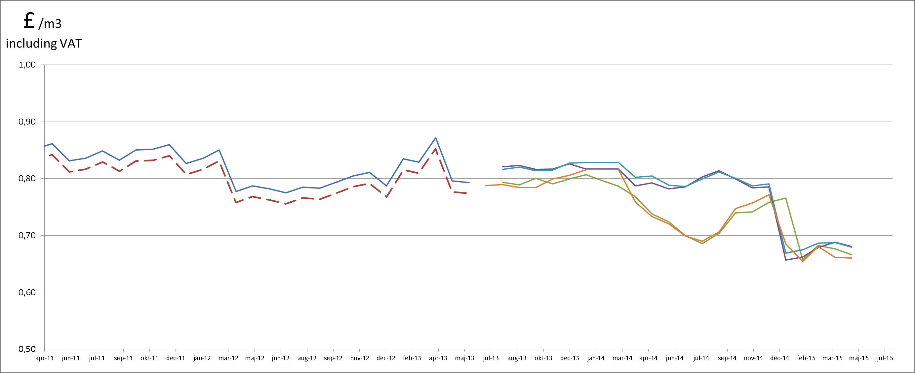
Competitiveness
Local utility - Natural Gas prices
Notes:
District Heating vs Natural Gas:
Recent years the price of District Heating increased due to increased environmental taxes on bio-fuels & low electricity prices
District heating competitiveness*:
Large customers: 10-15 % lower costs
Residential buildings: 0-5% lower costs
*) At current level of natural gas prices

Slide 12
Does it work?
22 % less
CO₂ in six years
Tonnes CO₂
Note 2013:
An increased contribution from coal-fired plants. Caused the share of coal in one kWh of electricity to rise from 27 % in 2012, to 38 % in 2013.
Notes:
Gladsaxe Municipality has set a target to reduce Carbon Dioxide emissions by 40 percent by 2020 as compared to emissions in 2007.

Slide 13



End of presentation
Thank you for your attention !
Any questions?
Head of planning
Thomas Engell
thoeng@gladsaxe.dk

