Slide 1
Exercise In Energy Masterplanning
In Groups choose one area map (or discuss both)
  Elgin
  Lerwick
Discuss the following issues and feed back key points
What are the energy issues for this area – what needs to be covered in a EM Brief?
Who are the stakeholders?
What are the key tasks/ what are the risks?

Slide 2
Feedback/ Plenary
Three points on each question
Choose someone to feedback
Flip charts and pens
Common Issues ? Are the same issues surfacing in both areas?

Slide 3
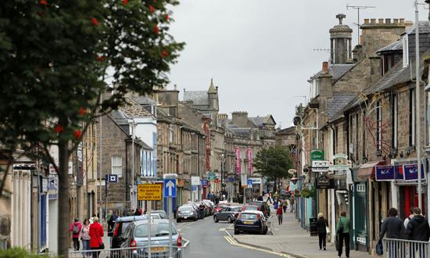
EXAMPLE 1 – FINDRASSIE, ELGIN

Slide 4
Findrassie, Elgin
Findrassie Draft Master Plan – Elgin: - The masterplan which will see a major northward expansion of Elgin over the next two decades has been approved by Moray councillors. The blueprint for Findrassie has been prepared by the landowner, Pitgaveny Estate, in partnership with Moray Council and provides for around 1500 new homes in addition to land which will be developed for business. The plans for the 112 hectare site, which stretches from Duffus Road in the west to Lossiemouth Road in the east, will now go out for public consultation.
The masterplan incorporates elements such as:
· A central spine of open space or park runningeast to west and containing features such as an amphitheatre, sports pitches and allotments
· A range of housing densities and housing types from starter to family to retirement homes and self-build plots
· A centrally located school incorporating provision for community facilities with opportunities for outdoor learning
· A local hub with potential for a farm shop, incubator units and other commercial uses such as a nursery, with further provision for commercial units around the central open space
· Focal points and landmarks at key locations and a number of character areas with distinctive features which will help people find their way around and identify with the development
· Integration of employment, residential and commercial development with good walking and cycling routes that are safe and pleasant
· Recreational assets such as Findrassie woods and a large area of multi-use open space

Slide 5
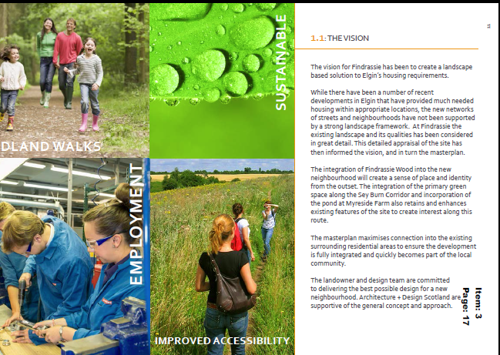
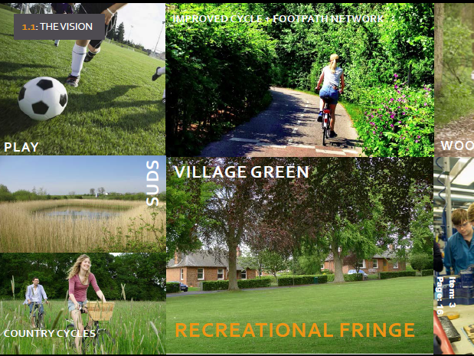

Slide 6
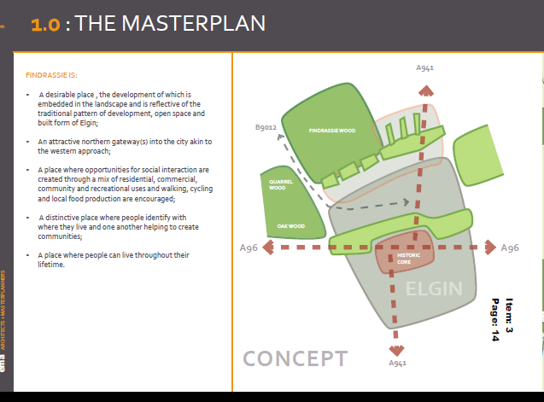

Slide 7
EXAMPLE 2 – LERWICK TOWN

Slide 8
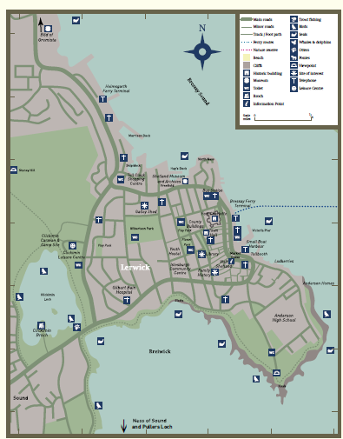
LERWICK TOWN – MOST NORTHERLY TOWN IN BRITAIN

Slide 9
SHETLAND HEAT AND POWER - Lerwick
Timeline for Lerwick District Heating Scheme
1997 - SIC gives go-ahead for the incinerator (now called the Energy Recovery Plant)
1997 - Shetland Charitable Trust agree to proceed with the district heating scheme
1998 - November first customer connection goes live
1999 - SHEAP offices move from Toll Clock Centre to the Peak Load Boiler Station at Gremista
2000 - scheme presented with the Environment Award for Engineers
2006 - hot water storage tank installed
2006 - Ring mains formed around the town with the completion of the new museum
2007 - scheme applications for connections reach capacity for the heat produced
2007/08 - radio transmitting system installed to collect customer meter readings and transmit them directly to our office on demand
2008 - SEPA produces a DVD about the sheme to encourage other local authorities to consider similar schemes
2008 - an additional 6.5MW boiler installed
2009 - joined Combined Heat and Power Association (CHPA) which promotes district heating
2011 - new control system installed at the Peak Load Boiler Station
2011 - new, larger pump installed to replace two original pumps
2011 - 1000th domestic customer connection completed
2012 - governance of Shetland Heat Energy and Power moves from Shetland Charitable Trust to new Board of Directors
2014 - Northfish biomass plant is feeding heat into the district heating scheme. This will help reduce our dependency on oil during high winter loads.

Slide 10
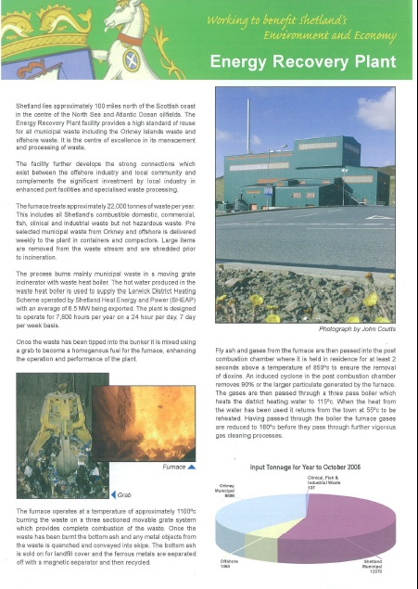
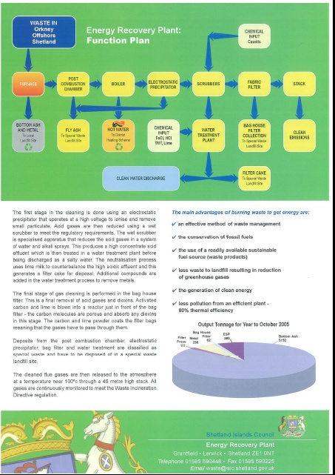

Slide 11
Developing Shetland Heat and Power
Additions to the Scheme
In 2006 a hot water storage tank was installed to store excess heat during off-peak periods and provide heat during peak loads. This allowed for the equivalent of a further 500 properties to be connected without the need for a further heat source. Another 6.5 MW boiler was installed in 2008 to give a total back up capacity of 15 MW based at the Peak Load Boiler Station. Using customers former boilers as additional back-ups, there is a further 6 MW of boiler capacity spread around Lerwick.
During 2007/08 a radio transmitting system was installed to collect customer meter readings which are transmitted directly to our office on demand.
The scheme has proved to be very popular and all the heat produced is currently used. During colder periods of weather we have to burn oil to provide the necessary heat and for this reason we are unable to connect any new properties.
We are currently investigating other potential heat sources.

Slide 12
EDINBURGH INTERNATIONAL:
A World Class location supported as a National Development in NPF3, transforming a massive area of
West Edinburgh into Scotland's Global Hub, by building on the strength and continued growth and expansion
of the Airport.
The proposal is to establish a highly sustainable new city quarter across c.85 hectares. The
‘International Business Gateway’ (IBG) as a location which will become a major growth zone for Scotland.
The proposed Phase 1 development is c.200,000sq metres in size and could support up to 80000 new jobs.
It comprises the development of mixed uses (primarily business and employment), hotels and a broad range of
ancillary uses including a significant component of new housing development in support of the place making
ambition. A phase 2 development of circa 300,000sq metres will follow in the medium and longer term.
The RHASS has an approved PPP consent and overall masterplan in place for the long term
redevelopment and consolidation of Royal Highland Centre into Scotland’s National Showground.
A business plan is in preparation for a first phase of development which includes a new ‘Centre of
Food Excellence and Agri-Business Hub’, coupled to a new hotel to be developed opposite the existing
Hilton Airport Hotel.

Slide 13
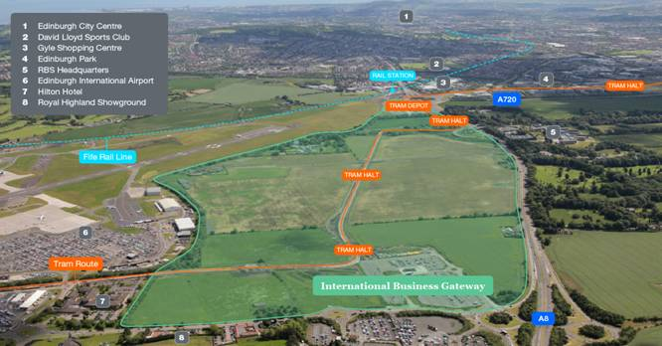

Slide 14
