Slide 1


Planning & Heat
Michael Westwater
SENIOR PLANNER – National Policy Team

Slide 2
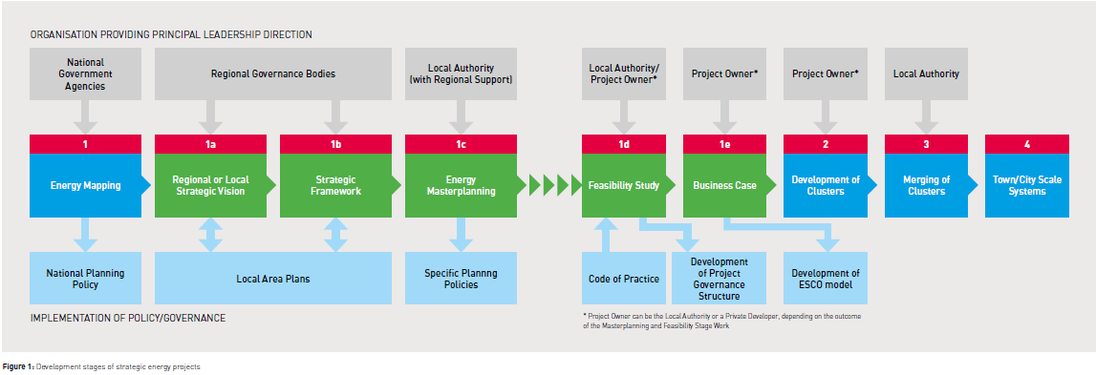

What will we be covering today?

Slide 3
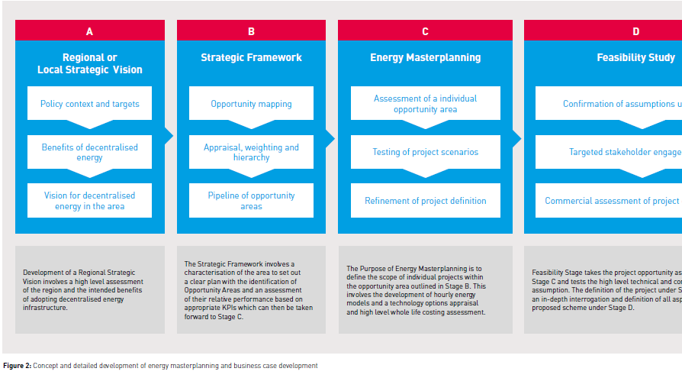
Relevance to planning

Slide 4
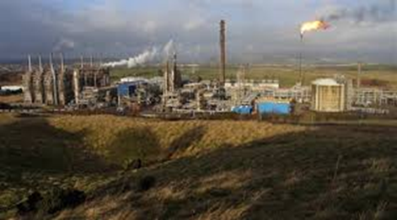

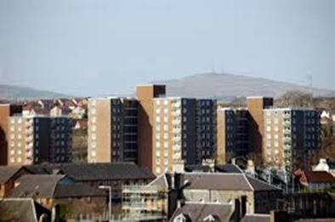
Why is heat important?
Notes:
Heat is at the core of Scotland’s energy system. It is the biggest element of our energy use (over 55%), and the largest source of our emissions (47%). The Scottish Government is committed to largely decarbonising our energy system by 2050, at an affordable price to consumers through maintaining and developing secure supplies of energy. Our current ambition is to achieve 1.5 TWh of Scotland’s heat demand to be delivered by district or communal heating and to have 40,000 homes connected by 2020.

Slide 5

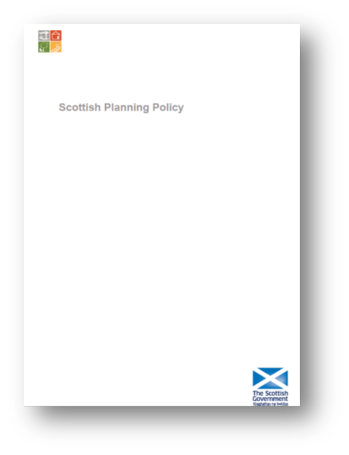

National Planning Policy
Notes:
NPF3
Long term spatial strategy
Formal 5 year review period
Reflects changing context
Economic recovery
Low carbon economy
Placemaking
SPP
First consolidated in 2010
First full review of content
Ensure policy is up to date
Focus on sustainable economic growth
Making placemaking integral to the policy

Slide 7

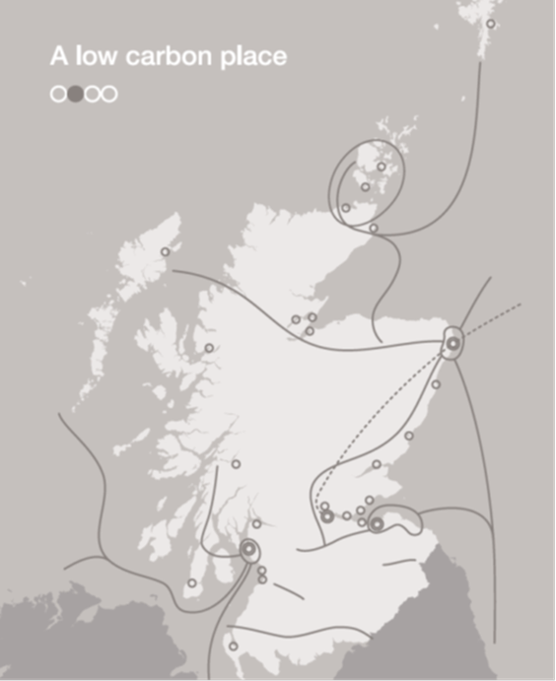
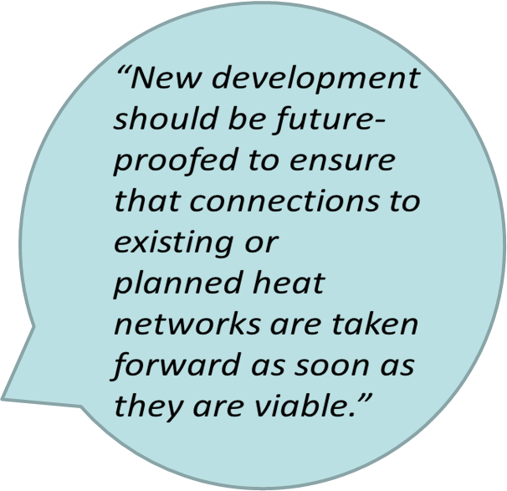
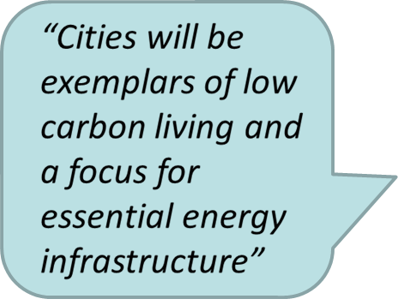
Notes:
NPF3 Chapter 3: A Low Carbon Place sets out the planning priorities for Heat from a National Spatial Perspective.

Slide 8
National Policy
Planning must facilitate the transition to a low carbon economy contributing to delivering by 2020:
- 30% of overall energy demand from renewable sources;
- 11% of heat demand from renewable sources; and
- The equivalent of 100% of electricity demand from renewable sources;
Local Development Plans should:
- Use heat mapping to identify opportunities
- Give policy support for developing heat networks
- Identify where heat networks would be appropriate
Notes:
Spatial planning is has a key role in supporting the development of combined heat and power and district heating and cooling systems. Planning authorities can support the transition to efficient, low carbon and renewable heat, recognising in particular that infrastructure and co-locating supply and demand requirements have spatial as well as policy implications.
SPP paragraphs 158-160 set out the requirements for development plans and SPP clearly states that Local development plans should:
• use heat mapping to identify the potential for co- locating developments with a high heat demand with sources of heat supply;
• support the development of heat networks in as many locations as possible, even where they are initially reliant on carbon-based fuels if there is potential to convert them to run on renewable or low carbon sources of heat in the future;
• identify where heat networks, heat storage and energy centres exist or would be appropriate and include policies to support their implementation.
Policies should:
• support safeguarding of pipe runs within developments for later connection and pipework to the curtilage of development;
• give consideration to the provision of energy centres within new development;
• where a district network exists, or is planned, or in areas identified as appropriate for district heating, policies may include a requirement for new development to include infrastructure for connection, providing the option to use heat from the network;
• secure provision for heat distribution from non-renewable sources if there is potential to switch to renewable sources within the lifetime of the development;
• encourage micro-generation and heat recovery technologies associated with individual properties where heat networks are not viable.

Slide 9
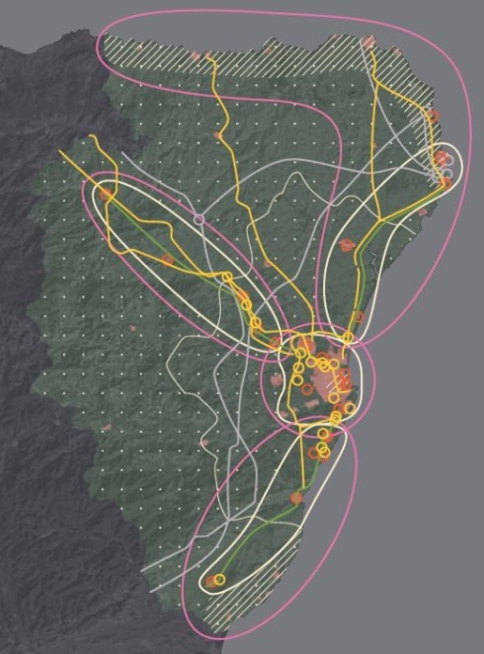
Strategic Development Plans
Notes:
Strategic Development Plan Authorities:-
• align visions and spatial strategies to support climate change and renewable energy and heat targets by identifying strategic opportunities for heat efficiency and renewable heat;
• consider identifying key settlements or major growth areas where opportunities may arise for district heating and cooling networks that should be explored further by LDPs;
• align heating and cooling with other policy drivers such as climate change adaptation, delivering a low carbon economy, reducing fuel poverty, green networks and place-making.
• encourage the efficient delivery of heat in all its forms, looking for potential opportunities to link urban networks across broader metropolitan areas, including across local authority boundaries.

Slide 10
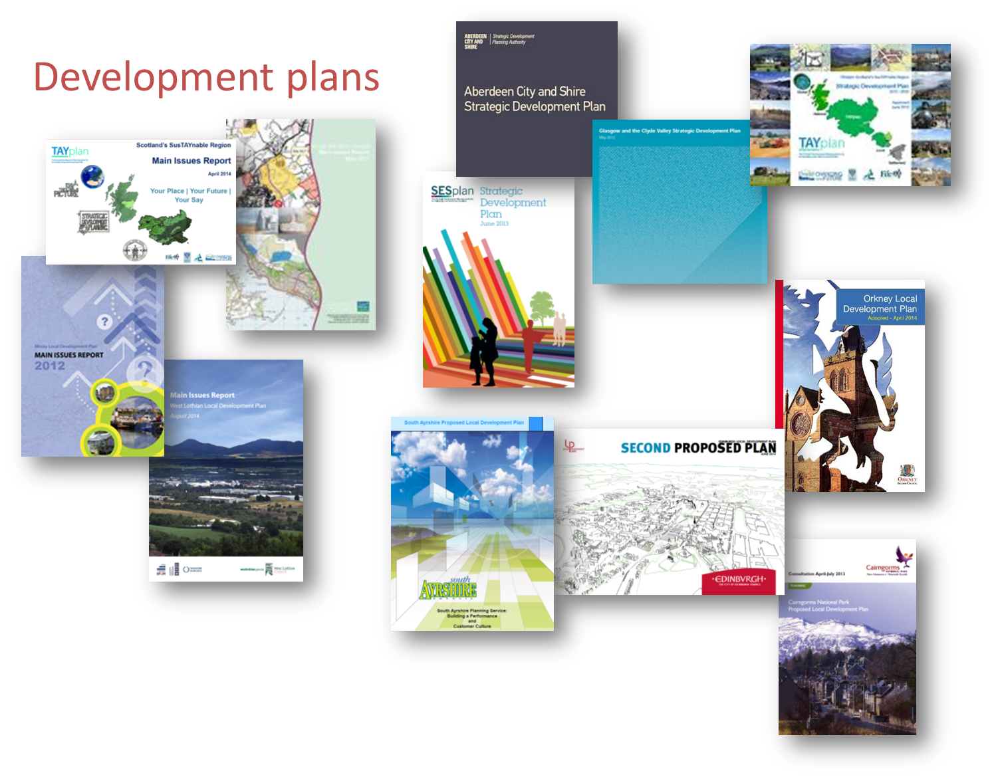
Notes:
Suggested Area of Focus for Planning Authorities:
• support all scales of development associated with the generation and distribution of heat and ensure that efficiency and renewable heat potential is optimised.
•participate in the development and use of heat maps to identify the potential for new and extended heat networks, and develop an indicative spatial plan for heat in the development plan.
•identify short (1-5 years), medium (5-10 years) and potentially longer term (10+ years) opportunities within development plans and action programmes for CHP and district heating and cooling networks.
•consider opportunities for renewable heat sources on brownfield sites and secure integration of heat networks and associated energy centres within multi-functional green networks.
Planners should:-
•share information with developers (e.g. at pre-application stage) and highlight opportunities to link existing or planned heat networks or sources;
•highlight applications that do not address heat efficiency;
•take account of other policy objectives such as Designing Streets; and
•factor heat map information into the decision-making process.

Slide 11
Scotland Heat Map
http://heatmap.scotland.gov.uk/
Notes:
Heat map launched in 2014 . Authorities should use the Scotland heat map to identify:
• heat supply and demand opportunities; and
• locations with high heat demand or need, such as areas of high heat density, communities off the gas grid, fuel poor areas, and anchor heat load operators such as hospitals and universities.
Planning authorities should contribute to updating the heat map, by providing detail of preferred development sites within their areas that should be taken into account in the heat map.

Slide 12
Published on Thursday, June 11, 2015
Scottish Government’s future policy direction for addressing the three key aspects of the Heat system:
•how we use it (heat demand and its reduction)
•how we distribute and store it (heat networks and heat storage)
•where our heat comes from (heat generation.
http://www.gov.scot/Publications/2015/06/6679
Notes:
Published in June 2015. This document is a valuable reference for setting policy for district heating and should be taken into account by local authorities.

Slide 13
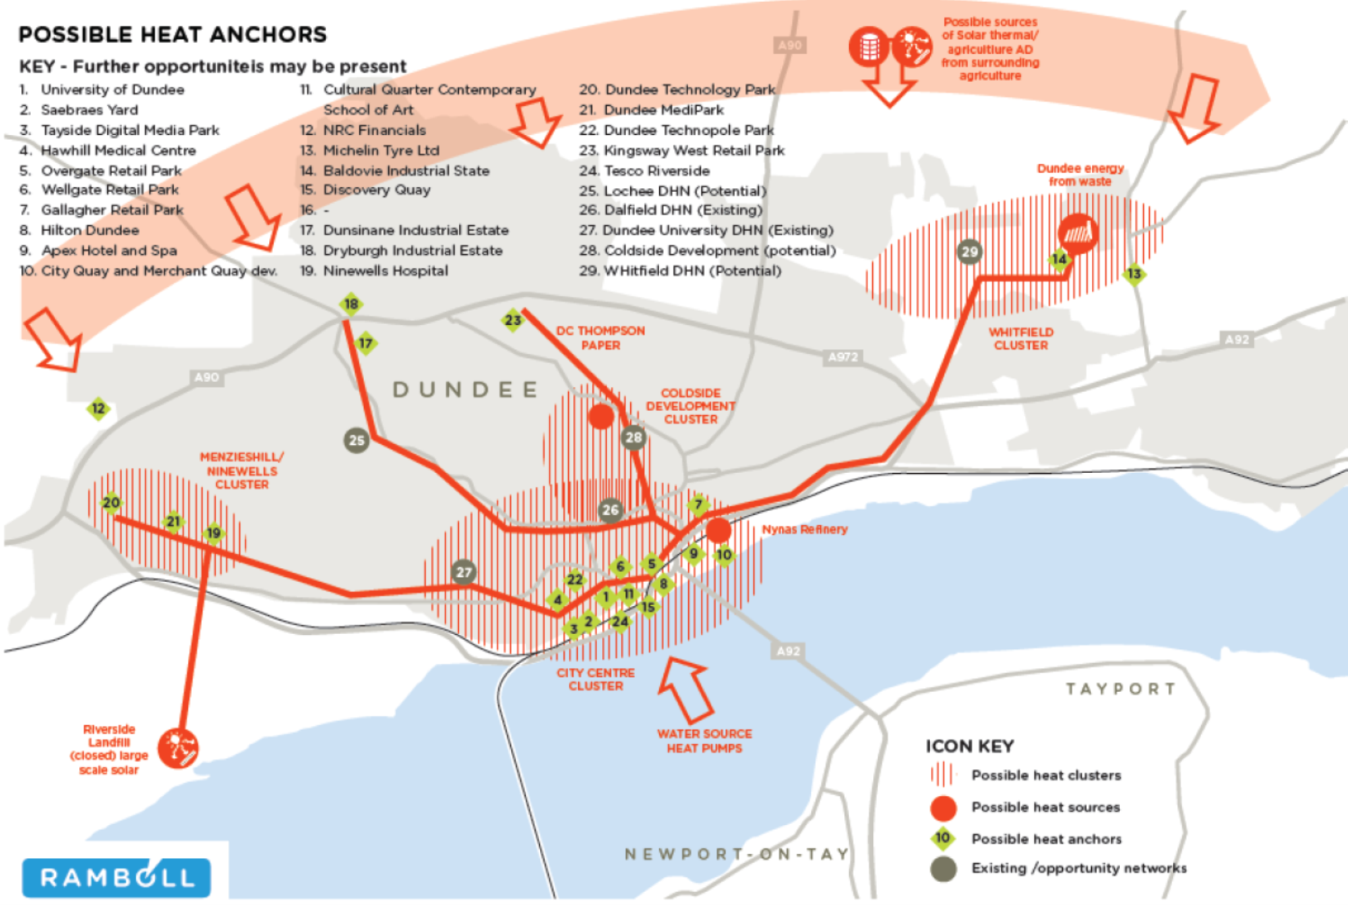
Example heat strategy diagram
Notes:
Last sessions in June we used the heat map in a practical exercise session to identify where there might be opportunities in Dundee for district heating. This map is an example of what a spatial representation of a heat strategy might look at a settlement level and might be appropriate within a local development plan or supporting guidance.
It identifies priority opportunity areas for heat networks. Possible heat sources and anchors and an indicative pipe network that could be delivered longer term to link the areas together. This would provide a framework for policy to be developed around, aiding decision making on planning applications that might fall within the opportunity areas. Including consideration for any cross-boundary co-ordination including potential need for pipe runs beyond a site and the potential for extending low carbon or renewable heat infrastructure.

Slide 14
Planners study visit to Denmark
“A Scottish delegation is here to gain Danish knowledge on Energy Planning and District Heating
The Danish Energy Agency is frontrunner within energy planning and district heating…. Scottish delegation has paid the Danish Energy Agency and Copenhagen a visit to learn from the Danish experience.”
http://www.ens.dk/en/info/news-danish-energy-agency/scots-are-here-gain-danish-knowledge-energy-planning-district-heating

Slide 16
Notes:
Copenhagen district heat network spans almost 45 km across city region. It started as small island networks that over time have linked to form a network on a massive scale.

Slide 17
Notes:
Also possible for smaller rural settlements, with the rural area supplying the fuel for the heat plant, and waste being re-used as fertiliser.

Slide 18

More Info…
view our website: scotland.gov.uk/planning
email: sgplanning@scotland.gsi.gov.uk
telephone: 0131 244 7888
sign up to our planning e-alert
or follow us on twitter ‘@ScotGovPlanning’

Slide 19
QUESTIONS?

