Slide 1



District Heating
Strategy Support Programme
Module 4: Commercial & financial strategies (Part 1)
Paul Moseley, Associate Director, Scottish Futures Trust
Working together for a decarbonised heat sector

Slide 2
Agenda: Module 4
9:30 – Introduction
9:35 - Delivering heat networks
9:55 - Group activity: risk
10:15 - Feedback & discussion on risk
10:30 - Break
10:50 - Commercial strategies
11:10 - Group activity: delivery structures
11:35 - Feedback & discussion of delivery options
11:55 – Financing structures & sources of finance
12:15 – Building a business case

Slide 3
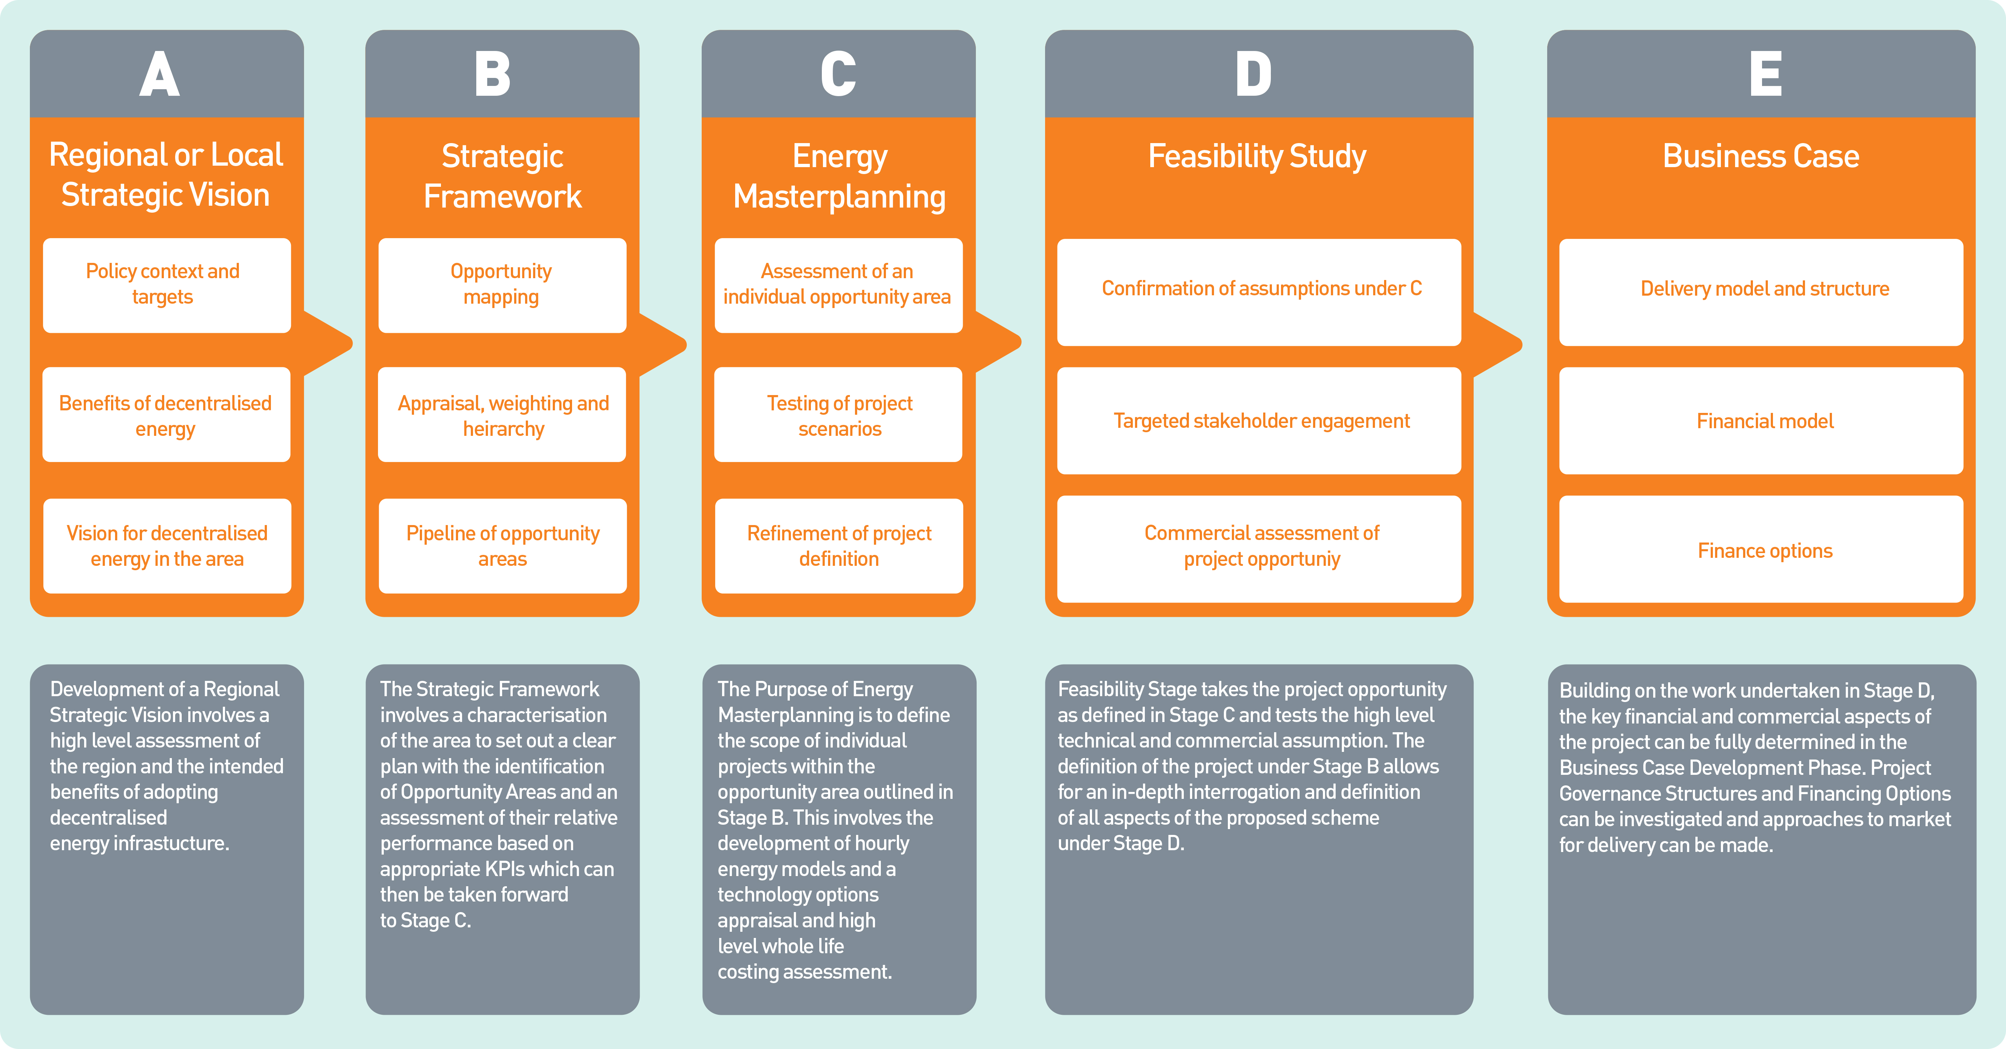

Slide 4
Local authority role(s)
Passive / low risk / control
Facilitator
Use of planning system to encourage development of, and investment in, heat networks
Make land / consents available for energy centre, pipework
Customer
Procure a partner to develop and operate a heat network
Offer up anchor loads for exclusive supply by a heat network
Guarantee a minimum heat demand
Financial contribution
Network operator (‘PipeCo’)
Develop, own and operate network
Charge suppliers to access network
Supplier
Develop, own and operate network
Responsibility for heat supply to customers
Active / higher risk / control

Slide 5
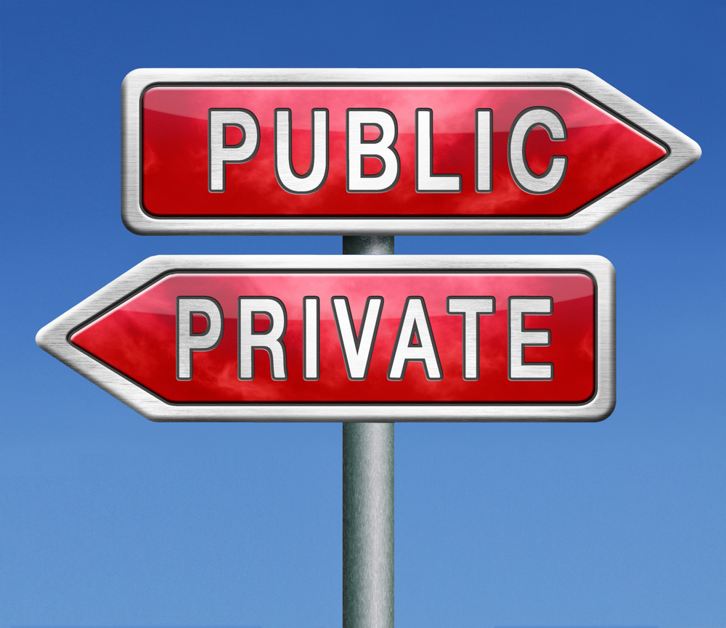
Delivering heat networks
Who is the project owner?
What is their motivation?
Private sector
  Compliance with planning obligation / development agreement / building standards; or
  Commercial opportunity
Public sector
  Project is unattractive to the market as an investment opportunity; or
  Market led solution unlikely to deliver public sector policy objectives

Slide 6
Public sector delivery
Exit strategy
Rewards
-
Capacity
Affordability
Risk
Flexibility
Control
+

Slide 7
Private sector delivery
Expertise
-
Exit strategy
No rewards
Loss of control
Affordability
Risk transfer
+
Inflexible

Slide 8
Public v Private
Factor | Explanation
Risk transfer | Greater risk transfer to the private sector can usually be achieved through, for example, a long-term service concession agreement, in which design, construction, operation (including fuel supply) and maintenance obligations sit firmly with the contractor and are contained in a single contract. In a publicly-led scheme, typically there will be separate contracts for design and build, operation and maintenance, and metering and billing services. This requires careful risk management across the contractual interfaces.
Ability to exercise control | A long-term agreement with a private sector partner involves some loss of control compared with publicly led schemes. The private sector partner needs a reasonable degree of control over how the contract is implemented in order to manage the risks it has assumed, and to protect its investment. The public sector can, however, insist on minimum standards for design, construction and operation of the scheme (e.g. by compliance with the CIBSE Code of Practice on Heat Networks). See further below on flexibility.
Flexibility | A long-term agreement with the private sector will include a detailed change mechanism. However, in practice, changes can be complicated to introduce, with detailed contractor and funder due diligence, and it can be difficult to establish value-for-money. With publicly led schemes, the various contracts (e.g. operation and maintenance, or metering and billing) are usually short-term so there is a natural opportunity to introduce any changes to service requirements when these are periodically re-procured.
Customer interface | A private sector concessionaire would normally contract directly with customers, and would usually therefore exercise a fair degree of control over the tariffs / tariff structure, & the terms on which heat is supplied to customers. The public sector should, however, require the concessionaire to comply with minimum standards of customer service (e.g. Heat Trust). The concessionaire would carry out metering & billing and bear bad debt and demand risk. For publicly led schemes, the public sector controls the form of contract used, hence can set tariffs and heat supply terms. The public sector would, however, normally retain bad debt and demand risk.
Upside | With a privately led / financed scheme, the private sector partner stands to benefit from any returns on its investment. This is the quid pro quo for the investment that the private sector partner is making and the additional risk it is bearing. Under a publicly led scheme, the public sector will be required to invest capital, stands to benefit from any financial upside, but also takes more risk.
Exit strategy | It can be costly to exit a long-term service contract with a private sector partner; compensation for early termination may be payable. The shorter-term contracts associated with publicly led schemes facilitate earlier exit for the public sector partners.
Overall cost / value for money | Providing a project is investible, the private sector can provide finance. This involves considerably less up-front cost for the public sector, so improves affordability. In terms of value-for-money, although private sector finance carries a higher cost of capital than public sector finance, this must be balanced by the additional risk being transferred to the private sector delivery partner.
Text

Slide 9
What influences the approach?
Objectives
Control
Risk
Financial viability
Funding availability
Market appetite
Statutory powers
Capacity & capability
Phasing / exit strategy

Slide 10
Factors influencing approach
Factor | Explanation
Objectives | Establishing the key objectives to be realised from a district energy network for each key stakeholder is fundamental. This can significantly influence the desired level of public/private participation, and how the scheme is procured, financed and delivered.
Statutory Powers | All public sector bodies are constrained by their statutory functions and powers. These differ between different types of public body (e.g. local authorities, NHS Boards, universities), and may limit delivery options for some (especially NHS Boards).
Control | In order to achieve its objectives from the district energy scheme, the public sector may wish to retain a degree of control over certain elements. This can be the case where control over end-user tariffs, or expansion/ inter-connection is required.
Risk appetite | Operating district energy networks is a specialised area and involves key risks (e.g. design, construction, commissioning, operation, maintenance/lifecycle replacement, metering, billing). The public body’s risk appetite will influence the choice of delivery structure.
Financial viability | The internal rate of return (IRR) can constrain the delivery structure: for a private sector led scheme, the IRR will typically be 12-15%. Lower project IRRs may be unattractive to the private sector, but can still be taken forward as public sector led schemes.
Market capacity / appetite | There is a limited market of specialised contractors for district energy schemes, and an increasing project pipeline in the UK. Soft market testing should be conducted at a relatively early stage to establish the market’s interest and preferred contracting approach.
Funding availability | Availability of capital within public bodies may be limited, in which case private sector finance could be sought. The particular type of finance (e.g. project finance, commercial lending, equity investment) will influence the delivery structure.
Resources | The public sector resource needs to be matched to its role in the project. For example, a public led scheme will require more specialist in-house resource than a private led scheme.
Phasing | Many projects start with an initial phase and subsequently expand through future phases. The delivery structure needs to be flexible enough to accommodate future change (e.g. to allow additional investors to come in) as the project is built out over time.
Exit strategy | The investors in a district energy scheme may not wish to retain a long-term interest in the scheme, and may wish to exit after the project reaches a particular stage. The delivery structure should be flexible enough to cater for this scenario.
Text

Slide 11
Business operations
Generation
Energy centre
Waste heat recovery
Distribution
Buried, pre-insulated pipework
Supply
Customer interface
Metering & billing
Can all be under common ownership
Larger networks may separate into different businesses

Slide 12

Risk profile
Demand risk
  Fundamental for investment
  Long-term heat off-take contracts
Technology risk
Design risk
Construction risk
Operational risks
  Bad debt risk
Management of interfaces
Risk v Control

Slide 13
District Heating
Strategy Support Programme
Group activity: risk
Working together for a decarbonised heat sector

Slide 14
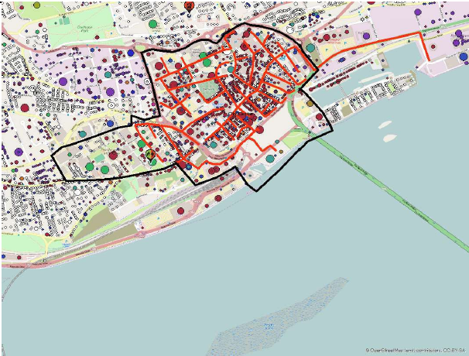
Group activity: risk
Scenario 1: dense urban environment
Multiple public sector stakeholders
Mixed public / commercial heat loads
Scenario 2: small town in rural area
Surplus industrial heat
Industrial & Council heat loads
Task (20 minutes):
Consider information in the scenario
Identify significant risks
Assess probability & impact (L,M,H)
How could these risks be managed?
Report back

Slide 15
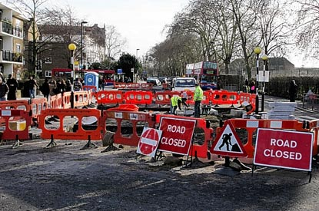
Risk – urban area
Heat loads
Reliance on heat loads under third party ownership
Reliance on future development taking place
Generation
Third party ownership (public)
Restrictions on fuel source?
Distribution network
Dense city environment
Existing utilities / obstacles
Traffic management

Slide 16

Risk – rural, small town
Generation
Third party ownership
Security of supply
Heat loads
Most are under Council ownership
Anchor load is under private ownership
Impact of school PPP contract?
Distribution network
Mainly quiet roads / soft dig
Commercial
Who will be the ‘meat in the sandwich’?

Slide 17
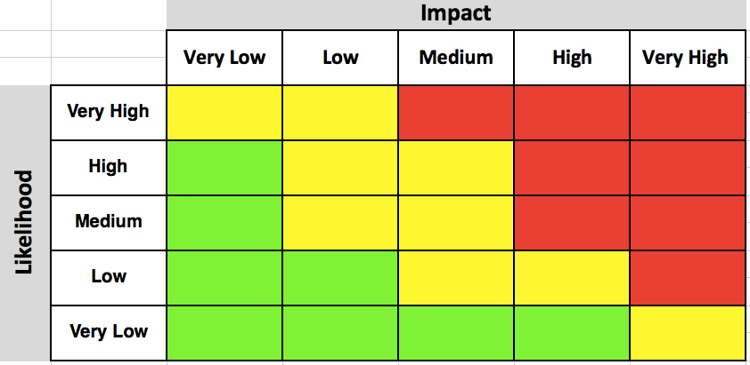
Risk management
Start early – project planning
Workshop approach
  Involve key stakeholders
  Establish risk appetite
  Assign risk owners
  Agree mitigation actions
Dynamic document: keep up-to-date
Actively monitor & manage risks
Issue management / escalation / governance

Slide 18

Questions?

