Slide 1



District Heating
Strategy Support Programme
Module 4: Commercial & financial strategies (Part 2)
Paul Moseley, Associate Director, Scottish Futures Trust
Working together for a decarbonised heat sector

Slide 2


Agenda: Module 4 (Part 2)
10:50 Commercial strategies
  Stakeholders objectives / constraints
  Alignment of interests / risk in suitable delivery structures
11: 10 Group activity
  Delivery structures
11:55 - Financing
  Strategies & sources of finance
12:15 – Business Case
  Building a business case around a preferred option
Notes:
10 year payback
Lifecycle Cost savings
CO2 savings
Job Creation
Affordable Warmth
Deliverability

Slide 3
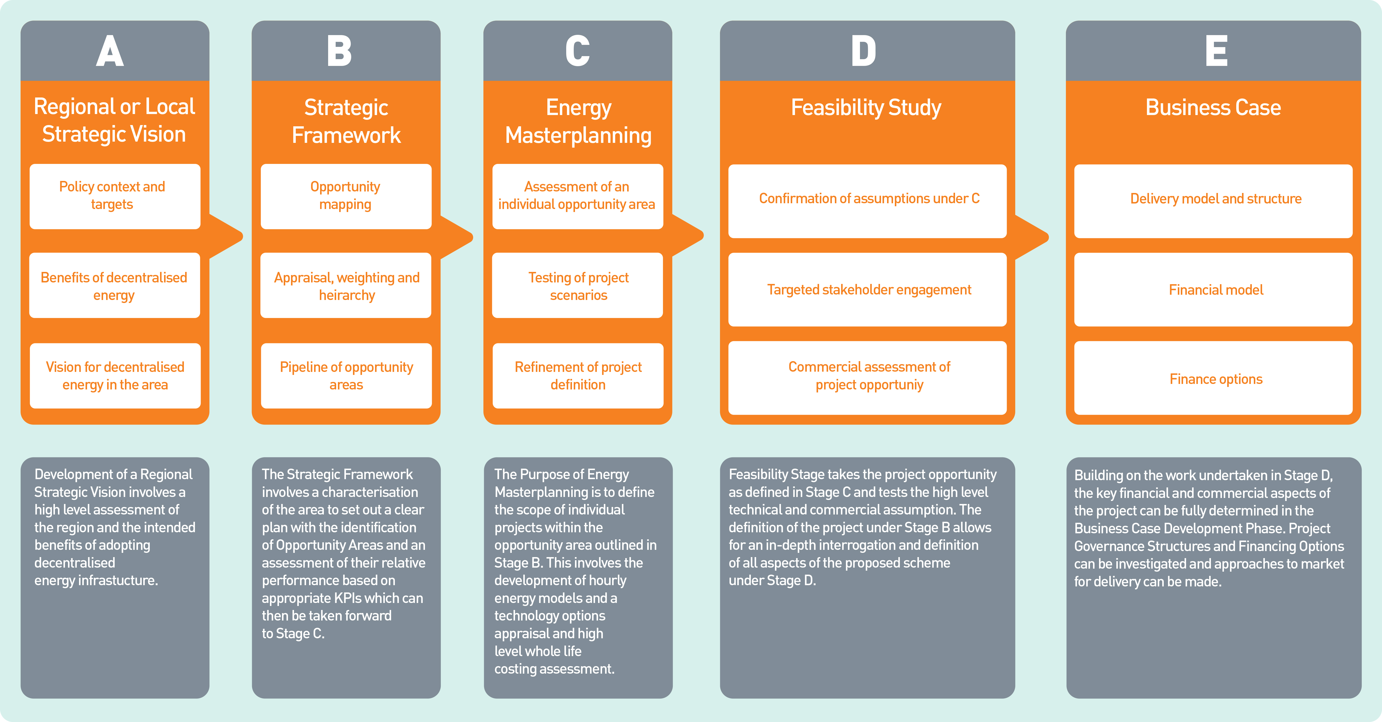

Slide 4
District Heating
Strategy Support Programme
Commercial Strategies
Charles Smith, Partner, Brodies LLP
Working together for a decarbonised heat sector

Slide 5
Factors influencing delivery
strategy
Delivery Strategies
Objectives
Constraints
Public Procurement
Alignment of interests
Project Participants
Control
Contributions/role
Affordability/ Investibility
Risk

Slide 6
Local Authority
Objectives
Constraints
Cost saving
Income generation
Energy efficiency
Carbon reduction targets
Affordable heat
Control
Flexibility
Facilitation
Risk
Affordability
Complexity
Experience
Public procurement
Statutory powers (trading)

Slide 7
Housing Association
Objectives
Constraints
Affordable heat
Housing energy targets
Carbon reduction targets
Control
Risk
Experience
Public procurement
Statutory powers
Charitable status

Slide 8
Other Public Sector
Objectives
Constraints
Cost saving
Income generation
Energy efficiency
Carbon reduction targets
Control
Flexibility
Risk
Affordability
Complexity
Experience
Public procurement
Statutory powers (esp. NHS Boards)
Charitable status
Non-core activity

Slide 9
Private Sector
Objectives
Constraints
Commercial opportunity
Meet regulatory requirement
Energy efficiency
Cost saving
Cost
Risk
Experience

Slide 10
Contracting Structures:
Local Authority led schemes
LA
D&B
O&M
M&B
LA
D&B
O&M
M&B
ESCO
Customers
Customers
Fife Council
Islington Borough Council
Aberdeen Heat & Power
Pimlico (Westminster)

Slide 11
Contracting Structures:
Private sector concession
Private Sector
Owned
LA
D&B
O&M
M&B
SPV
Customers
Leicester City Council
Birmingham City Council

Slide 12
Contracting Structures:
Joint Venture
LA
JV Partner
(Private or Public)
JV
Customers
D&B
O&M
M&B
Few existing examples: expect more in future

Slide 13
Contracting Structures: PipeCo
LA
Third parties provide
Generation
Distribution
Supply
Customers
Sheffield City Council (EfW)
Coventry City Council (EfW)

Slide 14
Contracting Structures:
Private sector led schemes
Private sector ESCO
D&B
O&M
M&B
Private sector developer
LA
Customers
Local authority role limited to facilitation, and use of the planning system
King’s Cross
Cranbrook

Slide 15
Contracting Structures:
Features (1)
Type | Points to Note
Local Authority Led Scheme (1) | This is, in effect, in-house provision. While a contract will certainly be tendered for design and build, operation and maintenance (other than significant maintenance) and/or metering and billing may be done in-house. This structure can ensure control and flexibility, in that contracts can be let for relatively short periods, but significant risk stays with the local authority.
Local Authority Led Scheme (2) | In this structure, use of an ESCO goes some way to isolating the local authority from risk. Ultimately risk may still rest with the local authority unless it is prepared to allow the ESCO to fail. If the ESCO requires to borrow from a third party, the local authority will likely have to guarantee that borrowing. The ESCO, as with the local authority in variant (1), may undertake aspects of operation and maintenance, and metering and billing, in-house. Again, contracts can be let for relatively short periods.
Concession | This model should enable a significant transfer of risk by the local authority. It will also result in a reduction in control and flexibility. Overall cost will increase in order to enable the private sector to achieve an appropriate internal rate of return, typically 12-15%. The private sector SPV will have responsibility for letting the appropriate contracts. From a local authority perspective, the approach should be seamless, i.e. all aspects of construction and subsequent service provision are addressed . In some cases, the private sector may also finance the scheme (partly or fully). The contract let will usually be long-term (20+ years).

Slide 16
Contracting Structures:
Features (2)
Type | Points to Note
Joint Venture | As with use of an ESCO, this goes some way to isolating the local authority from risk. Joint Ventures with private sector partners are currently not common. The structure could be used where the local authority wishes to part finance the scheme and to participate in the return on that investment. A public sector JV partner (such as a university or housing association) may be involved for public procurement reasons, explained in the next slide.
PipeCo | This structure may be used where there is a source of heat and customers who wish to take a supply of that heat, but where there is a need for a party to provide and operate a distribution network to transfer the heat from source to customers. Energy from waste (EfW) projects provide a useful example. The focus of an EfW operator is on managing the treatment and disposal of waste. They may not be interested or have any expertise in operating a heat network, but do want (and may be required by regulation ) to utilise the heat generated. Equally, customers will not wish to operate and maintain a heat network. The role of the local authority in this situation, therefore, is to marry generation and supply.
Private Sector Led Schemes | The role of a local authority may involve use of the planning system (to ensure low carbon heating) / bringing stakeholders together / making local knowledge available. Various private sector models are in use. The slide illustrates the Cranbrook model, where the developer has contracted with E.ON as ESCO supplier, who then contract with customers. At Kings Cross, the ESCO provides services to the developer who in turn has contractual/supply relationships with customers. The developer pays the ESCO a “use of system” charge, and the developer takes demand risk. In both schemes, this risk is mitigated because there is no competing gas distribution network within the sites which could be used to supply individual premises.

Slide 17
Public Procurement
University Heat Supply LA
Private Sector Heat Supply LA
LA has procurement requirement in both cases
No “public to public” exemption
But in example (1) could use a JVCo which the University and LA jointly control (“Teckal” exemption)
See section 8 of SFT Guidance on Powers of Scottish public bodies to generate/procure heat and electricity supplies

Slide 18
Delivery Vehicles
Contracting structures may involve a specific delivery vehicle
Public or private sector controlled, or a JV
ESCOs: may use (not a requirement)
  focus/expertise
  risk transfer
  public procurement considerations
Types of Vehicle
  companies (shares/guarantee)
  limited liability partnerships
  others
See SFT Guidance on ESCOs

Slide 19

Questions?
Working together for a decarbonised heat sector

Slide 20
District Heating
Strategy Support Programme
Group activity: delivery strategy
Working together for a decarbonised heat sector

Slide 21
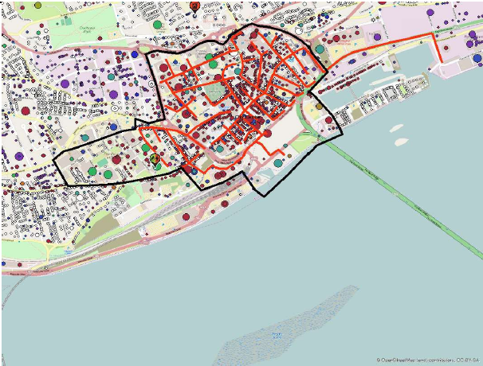
Group activity: delivery strategy
Task (20 minutes)
Same scenarios as before
Consider information in the scenario
How could the project be delivered?
Who should take the lead?
What further information would be required to enable a preferred structure to be identified?
How would this influence your decision as to the most appropriate model?
What steps could you take to validate your thinking on this?

Slide 22
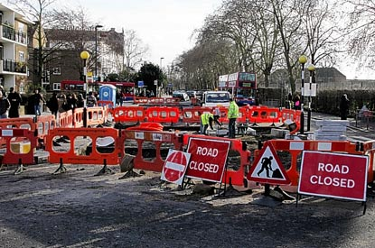
Delivery strategy– urban area
Potential delivery structures
Council-led development, contracts with universities (possibly via Council ESCO)
JV between Council and universities
JV between public and private sector
Council lets concession to private sector
Council acts as PipeCo
Additional information required
Stakeholders: objectives – aligned?
Stakeholders commitments, ability to fund, appetite for risk, exit strategy?
Who is willing / able to take the lead?

Slide 23

Delivery strategy – small town
Potential delivery structures
Council-led development
  Separate D&B, O&M; Council M&B
Council lets concession to private sector
JV between public and private sector
Additional information required
Stakeholders: objectives – aligned?
Stakeholders commitments, ability to fund, appetite for risk, exit strategy?
Who is willing / able to take the lead?
Validation
Who will be the ‘meat in the sandwich’?
Carry out soft market testing

Slide 24

Delivery – options appraisal
Contracting strategy
Identify objectives – weight appropriately
Identify potential contracting options
Score options
Identify preferred contracting strategy
Procurement strategy
Which contracts need to be procured, and by whom?
Impact of public procurement regime
Refer to SFT Guidance (HNP website under ‘procurement’)
Commercial
Is the preferred strategy deliverable (soft market testing)?
Is the preferred strategy value-for-money and affordable?

Slide 25
District Heating
Strategy Support Programme
Financing of District Heating Schemes
Toby Tucker, Associate Director, Scottish Futures Trust
Working together for a decarbonised heat sector

Slide 27
Agenda
    How does the business model link to finance?
    What is finance and what types are there?
    Factors to consider in selecting sources of finance
    Public and private financing options
Working together for a decarbonised heat sector

Slide 28



Business Model Considerations
  Legal powers
  Ability to borrow
  Procurement issues
  Economic growth
  Fuel Poverty relief
  Cost savings
  Energy efficiency / Carbon emission reduction
  Supply assets / heat loads
  Facilitation / co-ordination
  Simple offtaker
  Cost contributer
Powers
Objectives
Role
  Ownership / Return & control requirements
  Allocate risk - DBFM, O&M, Offtake?
  Capital budgets
  Borrowing headroom
  Cost of public / external borrowing
  Project life? 25-40 years
  Delivery vehicle
  Who leads development
  New / existing scheme
Risk Appetite
Finance Availability
Stage of Development
Notes:
10 year payback
Lifecycle Cost savings
CO2 savings
Job Creation
Affordable Warmth
Deliverability

Slide 29
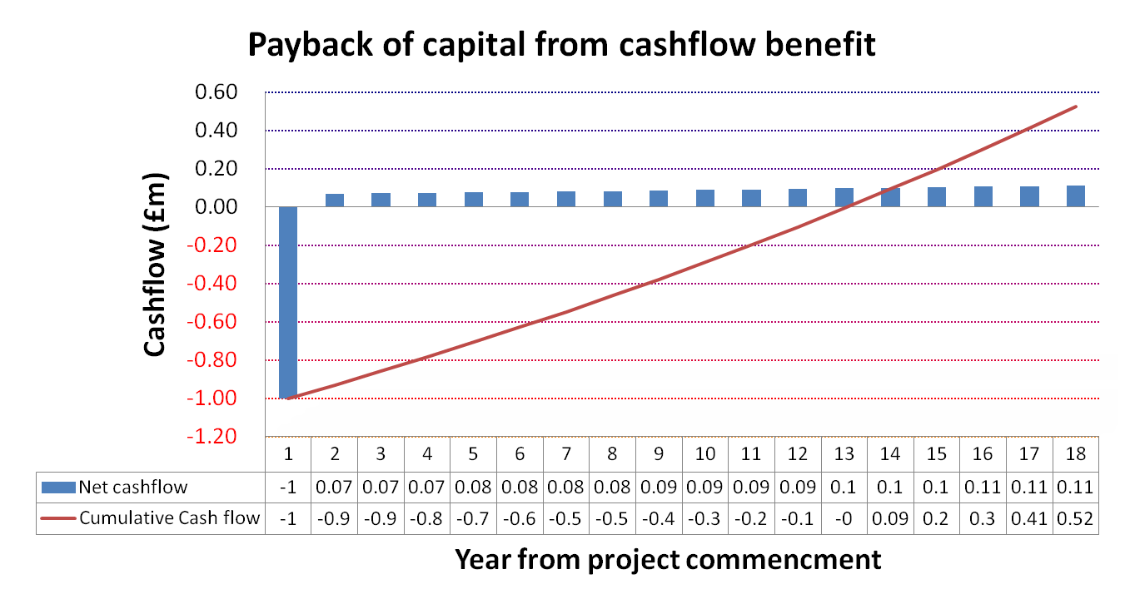
What do we mean by Finance?
Financing
“The raising of cash to pay for the infrastructure”
Funding
“The budget we use to repay the financing”
Notes:
10 year payback
Lifecycle Cost savings
CO2 savings
Job Creation
Affordable Warmth
Deliverability

Slide 30

Summary of DH cashflows
Cashflow | £m | Cashflow Drivers
Income | 10 | heat demand (kWh) x forecast tariff (p/kWh)
Incentives eg RHI | 1 | heat supply (kWh) x forecast incentive rate (p/kWh)
Fuel costs for heat supply | (6) | heat supply (kWh) x forecast fuel cost (p/kWh)
Operating & Maintenance | (3) | fixed and increasing with RPI
Lifecycle costs | (3) | periodic and increasing with RPI
Net cashflow for DH Scheme | (1) | Net cash ‘outflow’ ie overall it still costs money to provide heat.
Current ‘business as usual’ cost | (10) | The status quo - This is the current overall net cashflow reflecting existing income and operating costs
Overall cash benefit from project | 9 | This is the overall cash benefit obtained from undertaking the project compared to ‘business as usual’
Use funding to pay for financing costs of DH scheme
Notes:
10 year payback
Lifecycle Cost savings
CO2 savings
Job Creation
Affordable Warmth
Deliverability

Slide 31
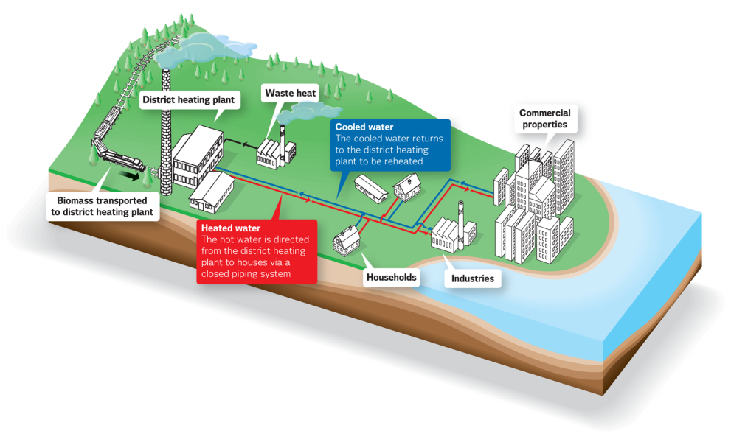
Types of finance
LOAN – SUBORDINATED DEBT
LOANS – SENIOR DEBT
EQUITY
£
FINANCING GAP
Capital contributions
Incentives eg RHI / FIT
Guarantees
Notes:
10 year payback
Lifecycle Cost savings
CO2 savings
Job Creation
Affordable Warmth
Deliverability

Slide 32
EQUITY
Risk taking
Dividend return, >15%
Sub Debt
Element of control & ownership
Element of risk
Control & Ownership
Typical cost 10%-12%
Senior Debt
Low risk
No link to control or ownership
LIBOR+ margin. Typically 5%-6%
Financing
Gap
Addresses non-finance-able risk
Fully risk bearing
-Guarantees
-incentives
-Capital contribution
Characteristics of different finance
reducing risk
reducing interest
increasing security
Notes:
10 year payback
Lifecycle Cost savings
CO2 savings
Job Creation
Affordable Warmth
Deliverability

Slide 33
Delivery model and financing options
Private sector delivery
Private / public delivery
public JV delivery
public sector delivery
Public sector ESCO
LA delivery
JV Model
Services typically procured from private sector supply chain
Potential Risk & Reward to public sector
Full outsource & revenue share
Fully outsourced eg Private sector ESCO
No financing required
Internal Funding
Bank Funded
Equity Investor
Other / incentives
Financing need from public sector
Notes:
10 year payback
Lifecycle Cost savings
CO2 savings
Job Creation
Affordable Warmth
Deliverability

Slide 34
Public & private financing
Sources of public financing
REIF
Sources of private financing
Corporate debt
SPRUCE
GIB
Project finance
Equity funds
Pension funds
Asset finance
District Heating Loan Fund
PWLB / European funds
Private sector led schemes
Schemes meet public policy objectives
Developing market
  Financing for capital investment delivery. LCITP financial support can be obtained for development of projects through to FBC approval
Notes:
10 year payback
Lifecycle Cost savings
CO2 savings
Job Creation
Affordable Warmth
Deliverability

Slide 35
Financing and Funding issues
Heat source
Transmission
Heat load
Installation cost
Utilisation
Operations
Demand increases / expansion
Reliability
Customer covenant
Contract duration
Pricing
Capital costs
Economic value
Technology
Construction
Fuel supply
Fuel price
Subsidy (RO/RHI)
Notes:
10 year payback
Lifecycle Cost savings
CO2 savings
Job Creation
Affordable Warmth
Deliverability

Slide 36
Summary - factors influencing finance
Initial Strategy
Scale
Risk
Available finance
Customers
Timing of cash flows
Financing / delivery model
Payback & Return
Meeting Objectives
Notes:
10 year payback
Lifecycle Cost savings
CO2 savings
Job Creation
Affordable Warmth
Deliverability

Slide 37
Questions?
Working together for a decarbonised heat sector

Slide 38
District Heating
Strategy Support Programme
The Business Case
Paul Moseley, Associate Director, Scottish Futures Trust
Working together for a decarbonised heat sector

Slide 39
Building a business case
Strategic Outline Case
to make the case for change
Outline Business Case
to make the value-for-money case for the preferred option
Full Business Case
to optimise the evidence-based VFM solution following procurement
define scope and objectives for project
identify expected benefits, recommend options to be taken forward
outline the procurement strategy, delivery mechanism and project management plan
to set out the detailed implementation plan

Slide 40
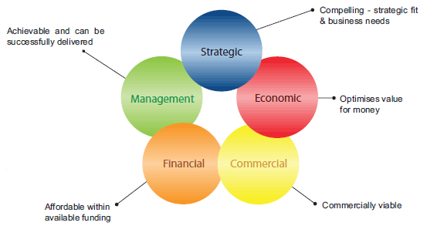
Five case model

Slide 41


Business case – top tips (1)
  Establish a robust business-as-usual scenario
  Need a robust baseline against which the project’s expected benefits can be measured
  Include full capital, operational, maintenance and lifecycle costs over whole evaluation period
  Use appropriate indexation of forecast costs
    Energy costs – DECC forecasts
    Operating costs – e.g. RPI/CPI
  If BAU costs are over-optimistic, the project benefits will be under-stated

Slide 42



Business case – top tips (2)
  Articulate all the benefits of the project
  Economic benefits
    energy costs – short-term & long-term hedge
    carbon taxes
    local economy - jobs created / safeguarded
    energy security / resilience / fuel switching
    reduced plant room requirements
  Environmental benefits
    Carbon savings
    Air quality
  Social benefits
    Impact on fuel poverty and associated health benefits

Slide 43

Business case – top tips (3)
  Sense check
  Will the project meet the original objectives?
  Do the expected benefits justify the investment?
  Have key risks been identified and mitigated?
  Is the project value-for-money?
  Is the project affordable?
  Is the project deliverable?
  Are robust governance arrangements in place?

Slide 44
Questions?

