Slide 1
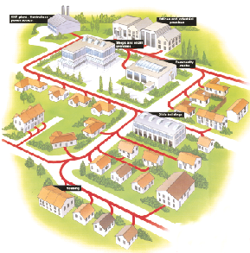



District Heating Loan Fund
Ken Brady Programme Manager
Energy Saving Trust
ken.brady@est.org.uk

Slide 2

District Heating Loan Fund
To support the development of district heating networks in Scotland.
Offer low interest loans to both renewable and low carbon technologies
Open to HA’s, LA’s, SME’s, community groups & ESCO’s (with less than 250 employees)

Slide 3
District Heating Loan Fund
  Loans of up to £1M+ per project are available (up to 100% of project costs)
  £5M to allocate this year
  Competitive interest rates (3.5%)
  Security not required (loans are unsecured)
  10 year payback
  Advice/technical support available through Programme

Slide 4
District Heating Loan Fund
  38 projects funded (to date)
  £8.4M committed (to date)
  190,000 tonnes Lifetime CO2 savings
  14.5MW(th) installed capacity
  395 Households connected
  52 non domestic buildings connected

Slide 5
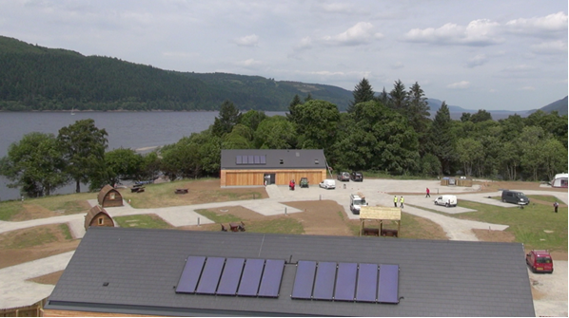
Loch Ness Shores

Slide 6
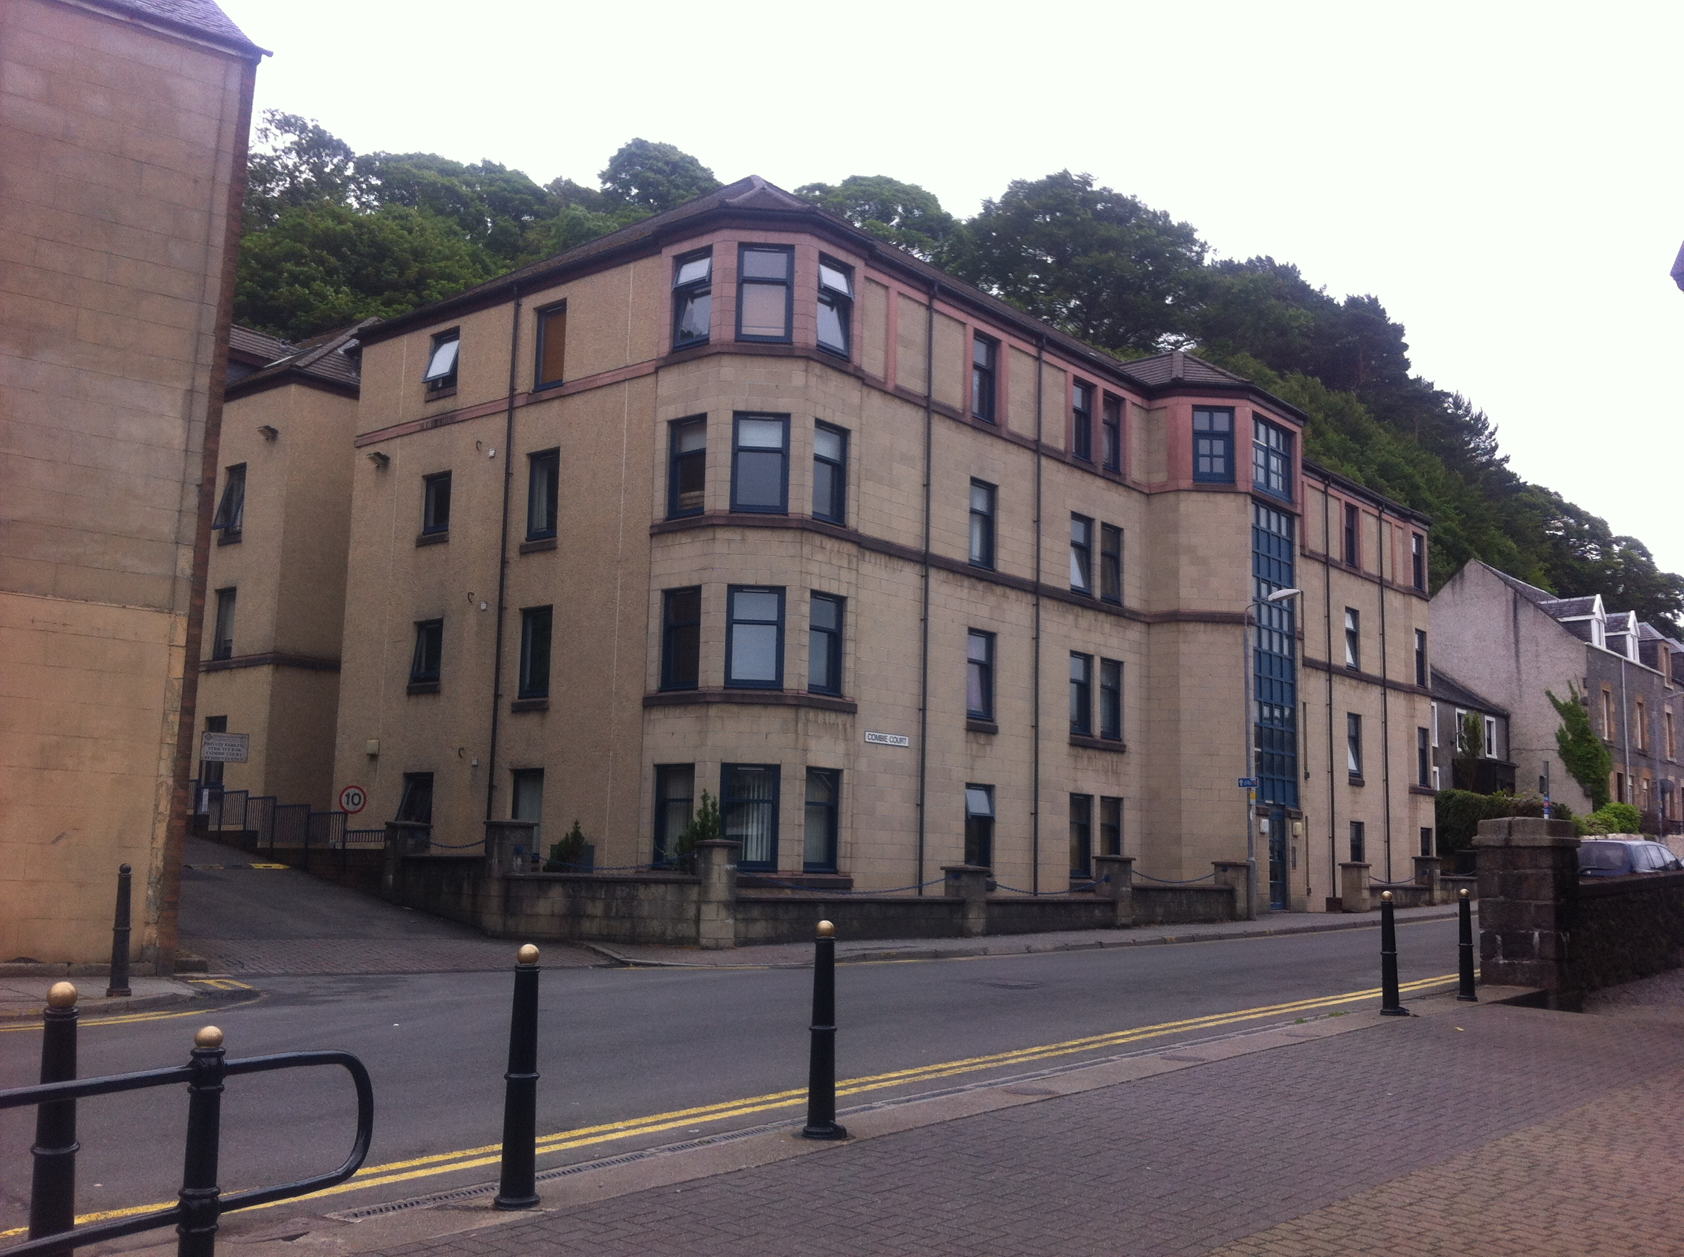
Combie Court - WHHA

Slide 7
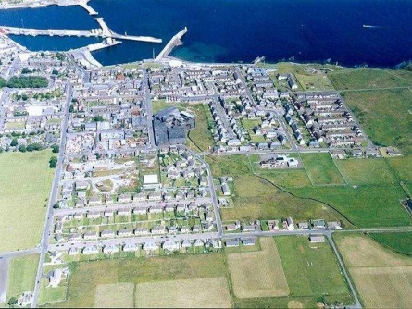
Wick district heating

Slide 8
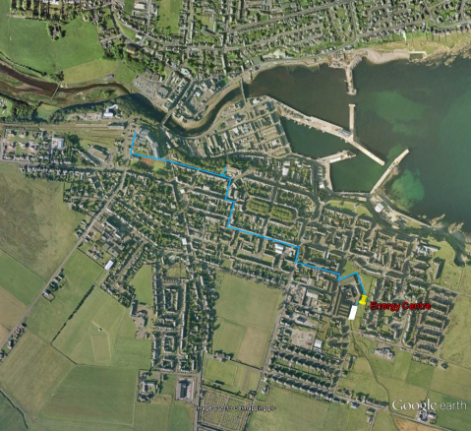
Wick district heating

Slide 9
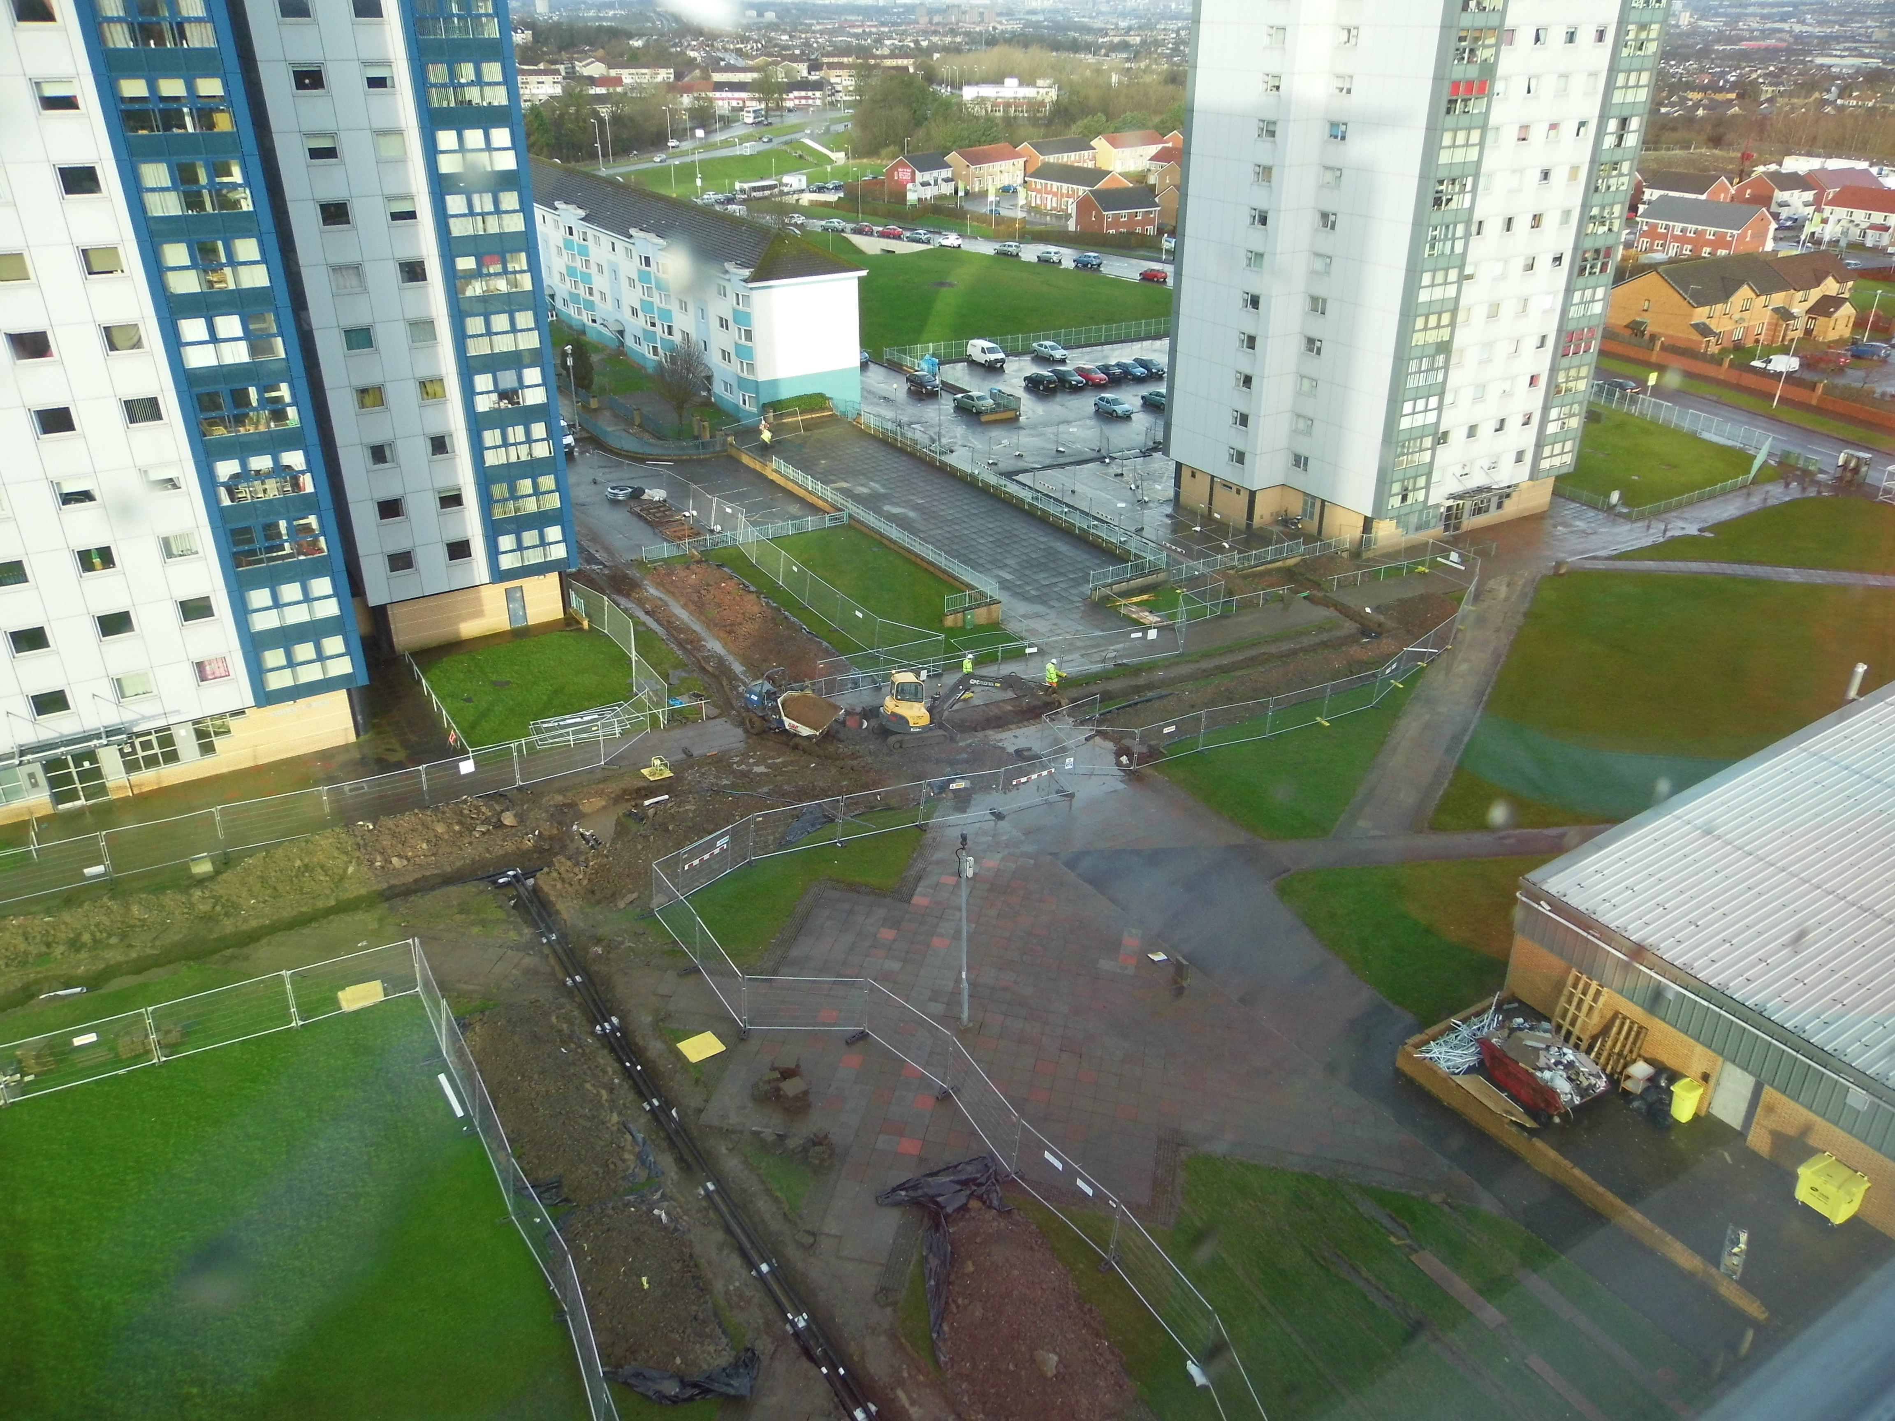
West Whitlawburn - HC

Slide 10
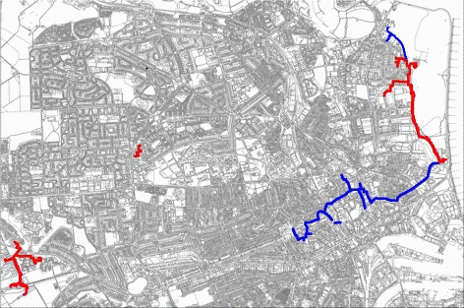
Aberdeen Heat & Power

Slide 11
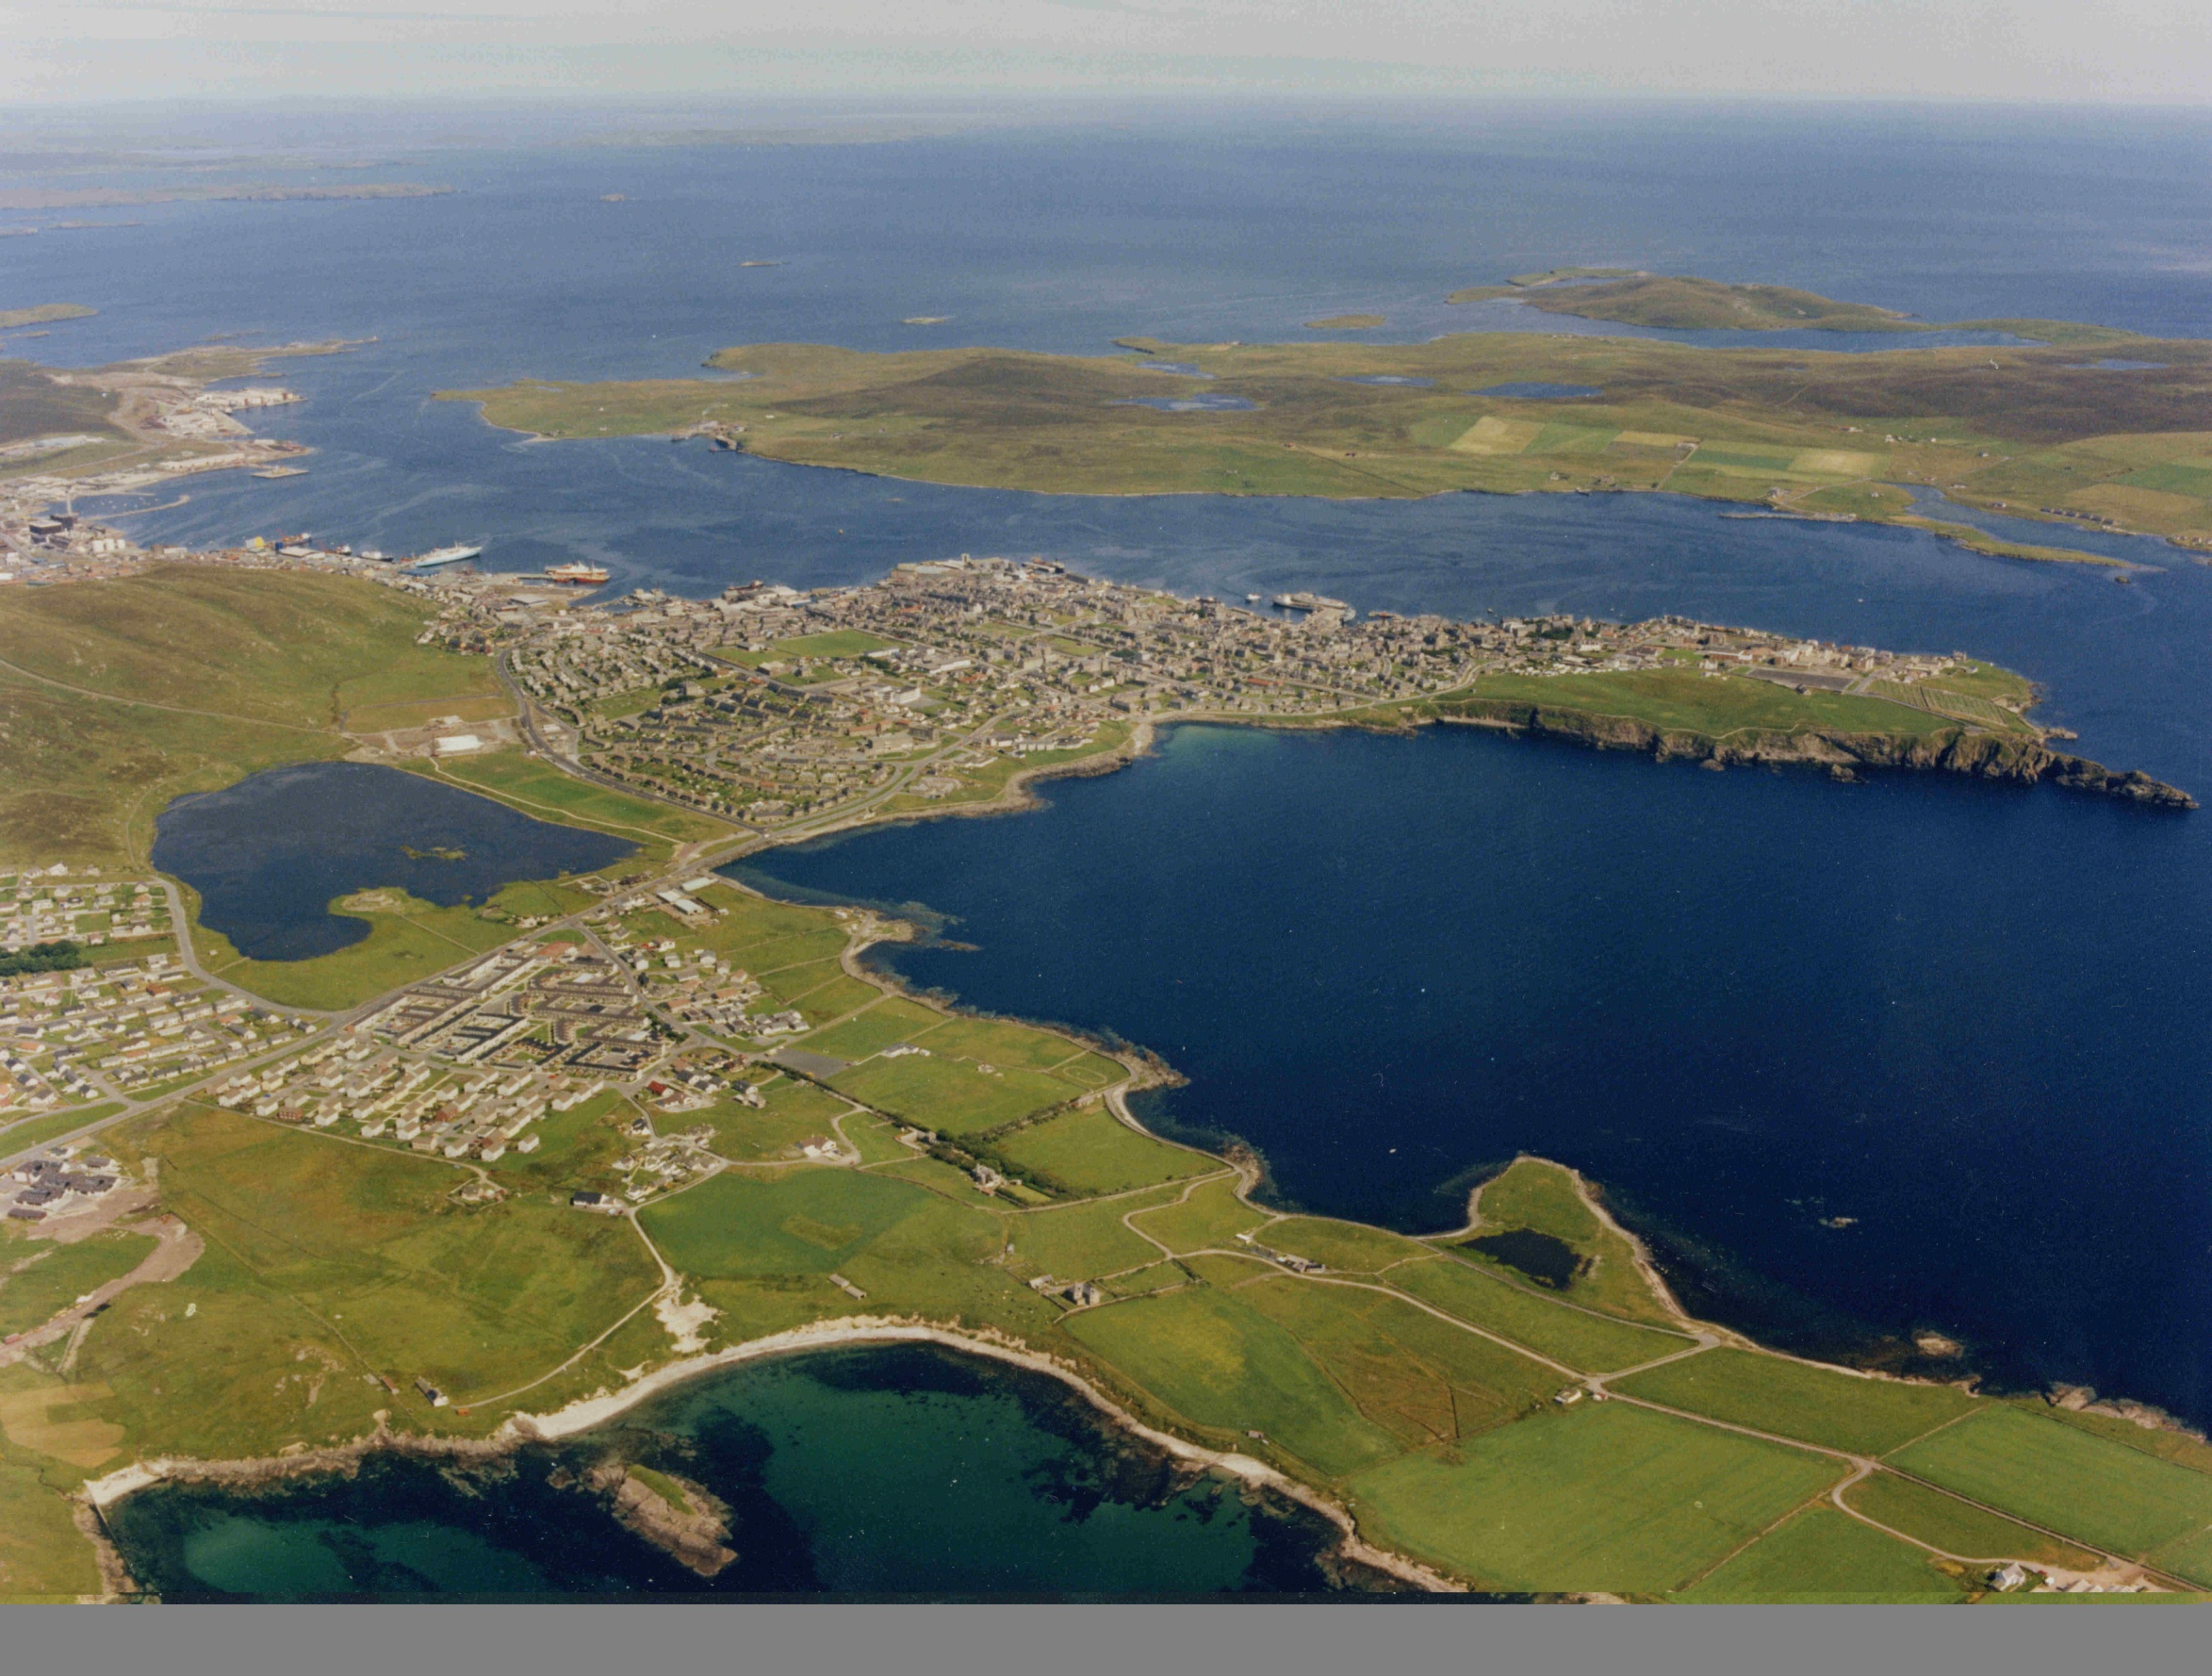
Lerwick
ENERGY
RECOVERY
PLANT
AREA BEING REDEVELOPED
NEW MUSEUM
Offices
INDUSTRIAL AREA
COMMERCIAL
COMMERCIAL STREET
ANDERSON
HIGH SCHOOL
PEAK LOAD BOILER STATION
SPORTS CENTRE
CAMPSITE
HOSPITALS
BELLS BRAE SCHOOL
LERWICK HOTEL
HEALTH CLINIC
PHASE 1 (1998/9)
3 CARE CENTRES
FIRE STATION
PHASE 2 (2000/02)
PHASE 3 (2004 /07)
SOUND
SCHOOL

Slide 12
DHLF Application Process
www.est.org.uk/scotland/districtheatingloans
(submit an expression of interest)
districtheatingloans@est.org.uk
ken.brady@est.org.uk

