Slide 1
Enabling Support
2 September 2015
Rebecca Carr
Senior Heat Policy Advisor

Slide 2
District Heating Action Plan
Completed 19 out of 23 actions set out in the District Heating Action Plan,
with the remainder ongoing or under review.

Slide 3
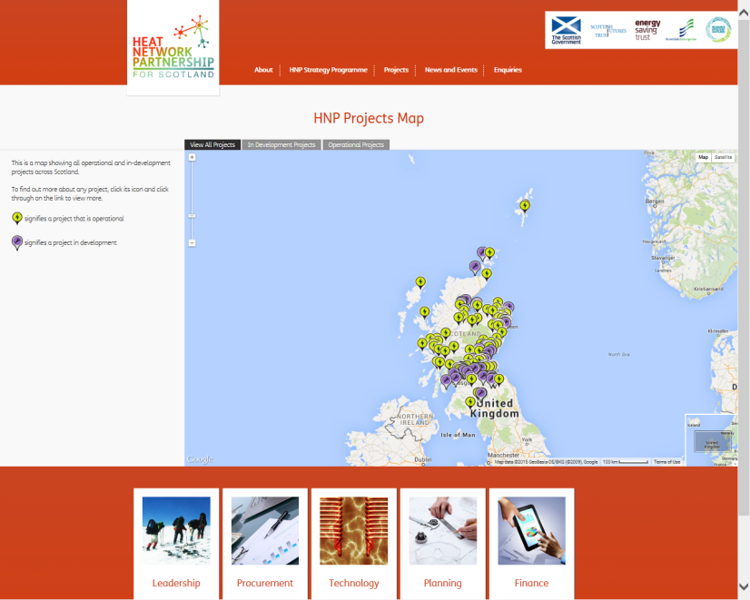

Support
- Information and Guidance
Dedicated Web Portal
Guidance notes
Case Studies
Policy documents
Knowledge sharing
www.districtheatingscotland.com

Slide 4
Regulation and Standards
Scottish Government
National Planning Framework and Scottish Planning Policy (www.scotland.gov.uk/Topics/Built-Environment/planning/NPF3-SPP-Review)
Heat Network (Metering & Billing) Regulation 2014 (www.gov.uk/heat-networks)
The Pollution Prevention & Control (Scotland) Amendment Regulations 2014
(www.legislation.gov.uk/sdsi/2014/9780111023990)
Tenements (Scotland) Act 2004
  Industry
  Heat Trust
  (www.heatcustomerprotection.co.uk)
  Heat Networks Code of Practice for the UK consultation
  (www.theade.co.uk/consultation-launched-to-improve-heat-network-design-build-and-operation_2470.html)

Slide 5
Incentives and Finance
Scotland Energy Efficiency Programme – energy efficiency designated as National Infrastructure Priority
Resource Efficient Scotland SME Loans - fixed rate loans of between £1,000 to £100,000 for businesses
Home Renewables Loans - up to 100% of the total cost of connecting to a renewable district heating scheme up to £5,000
Home Energy Efficiency Programme: Area Based Scheme – support through LAs to private households in fuel poor areas for ECO eligible measures
ECO2 – district heating connections, upgrades and heat meters
Ofgem Fuel Poor Network Extension Scheme – consultation on inclusion of district heating connections
Renewable Heat Incentive – renewable heat generating technologies
Renewables Obligation (Scotland) / Contracts for Difference (CfD)
EU Emissions Trading System
Climate Change Levy
Carbon Reduction Commitment Energy Efficiency Scheme
Horizon2020

Slide 6
Development and Implementation
Low Carbon Infrastructure Transition Programme
www.gov.scot/Topics/Business-Industry/Energy/Action/lowcarbon/LCITP
A Scotland wide, cross-sector project development unit, to support the development and acceleration of over 100 low carbon infrastructure projects in the next 3 years.
£250,000 Geothermal Energy Challenge Fund
www.scottish-enterprise.com/geothermal
Round 2 of Local Energy Challenge Fund developed in partnership with the LCITP
www.localenergyscotland.org/challenge
District Heating Loan Fund
Since 2011, 38 projects with loan offers totalling £8.2 million
In 2015, increase in maximum loan on case by case basis - £1 million loan to Aberdeen Heat & Power in February 2015

