Slide 1

A joint project between the Chartered Institute of Building Services Engineers (CIBE) and the Association for Decentralised Energy (ADE) finalised June 2015

Slide 2
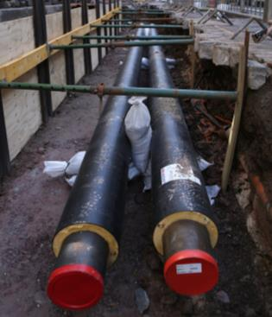
Key to a low carbon infrastructure
The Code seeks to provide clear and measurable outputs which will ensure that a heat network operates effectively and meets client and customer expectations.
Setting minimum standards is a key step to provide greater confidence for specifiers and clients and these can also be included in the tendering/contracting process.

Slide 3
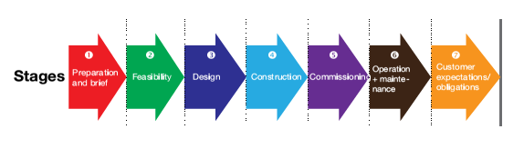
Scope of the code
Preparation and briefing
Feasibility
Design
Construction and installation
Commissioning
Operation and maintenance
Ensuring Customer expectations are met
Select dummy image and right click> change image> and then select the high res image you wish to use. Hold down shift whilst using the mouse to scale the image up or down, to avoid it from stretching. Please delete this instruction after doing so.

Slide 4
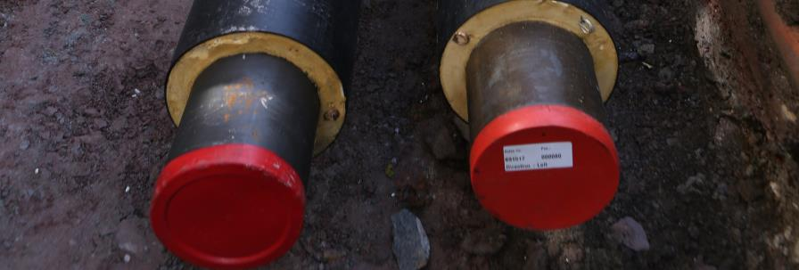
Focus on feasibility studies
Improve the quality of feasibility studies, design, construction, commissioning and operation by setting minimum requirements and identifying best practice
Increase energy efficiency
Ensure high quality customer service
Increase confidence in heat networks for customers and investors

Slide 5
HNP and the Code
To achieve sufficient accuracy of peak heat demands and annual heat consumptions – CIBSE TM22 applied to annual loads
To identify the most suitable low carbon heat sources and location of an energy centre
To determine the location of top-up and standby boilers and use of existing boilers
To select suitable operating temperatures – Consider renewables, heat loss and heat storage requirements.
To define heat network distribution routes, pipe sizes and costs – HNP standard schedule of rates for pipework and heat loss
To determine building connection costs including heat metering
To minimise the negative impacts of phasing the development

Slide 6
Detailed Feasibility
Development of scope and preparation of specification.
Framework of credible study providers
Evaluation of responses
Preparation of financial viability
HNP added value– Brief, Procurement, quality control and reduced cost
Output to feed into LCITP funding
Notes:
not paying for expensive consultant time for front end
Assistance in the procurement and commissioning of detailed feasibility studies to determine technical issues, and generate data to enable accurate costing and financial modelling.
Assistance in the development of scope and assistance in preparing specification. Note ensuring a tight and well defined scope will ensure cost effectiveness.
Assistance in the preparation of team to respond to data requirements to expedite project
Provision of advice on credible study providers, including access to CT’s consultant network
Development of evaluation criteria
Evaluation of responses, and assistance in selection of appropriate provider

Slide 7
Framework contract for DH feasibility
8 Delivery contractors
Arup
Burro Happold
Craighall Energy
GEP Environmental
Parsons Brinckerhoff
Ramboll
Ricardo-AEA
Jacobs

Slide 8
Investment grade proposal
Business case and proposition to prospective investors
Contents:
Information memorandum
Project description
Investment Proposition
Delivery Strategy
Potential investor exit points
Timeline
Information is available to potential investors
Collaborative Partners and Advisers
Market demand analysis
List of project backers
Valuations

