Slide 1

Low Carbon Infrastructure Transition Programme (LCITP)
Background
Programme aims
Projects areas supported
Eligible applicants
Case Study
What's next
Contact information

Slide 2




LCIP – Scotland's new low carbon project development unit

Slide 3
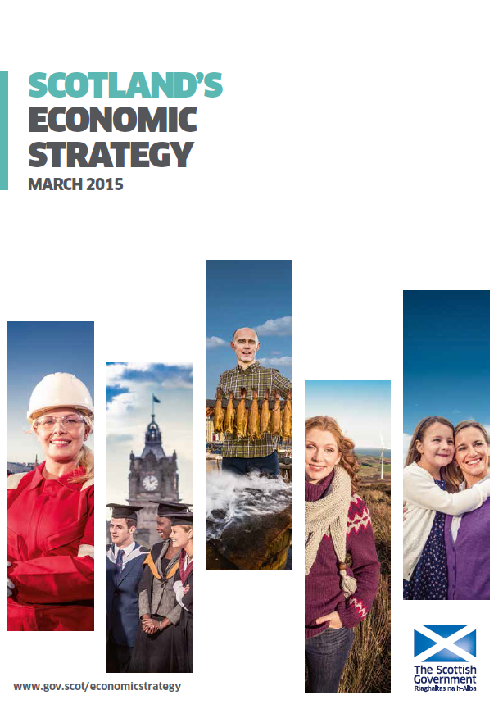
Our Transition to a Low Carbon Economy
Long-term target of reducing greenhouse gas emissions by 42% by 2020
Sustainable investment in the low carbon economy

Slide 4
Programme Aims
Support the development of substantive private, public and community low-carbon projects across Scotland
Reduce greenhouse gas emissions
Supporting the acceleration of projects to develop investment grade business cases
Collate evidence on recurring barriers and challenges to ensure support is appropriate

Slide 5
Project areas
low carbon and/or renewable electricity and heat generation
local energy economies
heat recovery (e.g. district heating)
energy storage and distributed energy systems
hydrogen
demand side management and active network management
innovative/local finance solutions and investor readiness for low carbon projects
energy efficiency (e.g. non domestic building retrofit)
resource efficiency
materials recycling and re-use.
Notes:
It isn't a replacement for existing schemes and we will work closely with existing partners
ensure that we ADD value
Next slide: support available

Slide 6
Support available
A range of support mechanisms including project development,
expert advice and funding, where appropriate
Notes:
Support available across three phases although no automatic progression from one phase to the next
Support will be predominantly focussed on development but there will be a small number of demonstrator calls throughout the programme
Next slide: Eligible organisations

Slide 7
Eligible organisations
SMEs
Non SMEs - Private Businesses
Community groups
Registered charities
Third Sector
Community Benefit Societies
Community Interest Companies
Local Authorities
Public sector organisations
Registered Social Landlords
Academic institutions
Notes:
Next slide : Current calls

Slide 8
Case Study
£250,000 Geothermal Energy Challenge Fund
feasibility studies exploring the capacity of Scotland’s geothermal resource to meet the energy needs of local communities.
It is aimed at consortia working together to benefit local communities, achieving measurable and sustainable carbon reductions
The maximum grant award available for each feasibility study is £50,000.
Notes:
More information on the Scottish Enterprise website including application forms
Also work in partnership to deliver the LECF
Next Slide: What's next

Slide 9
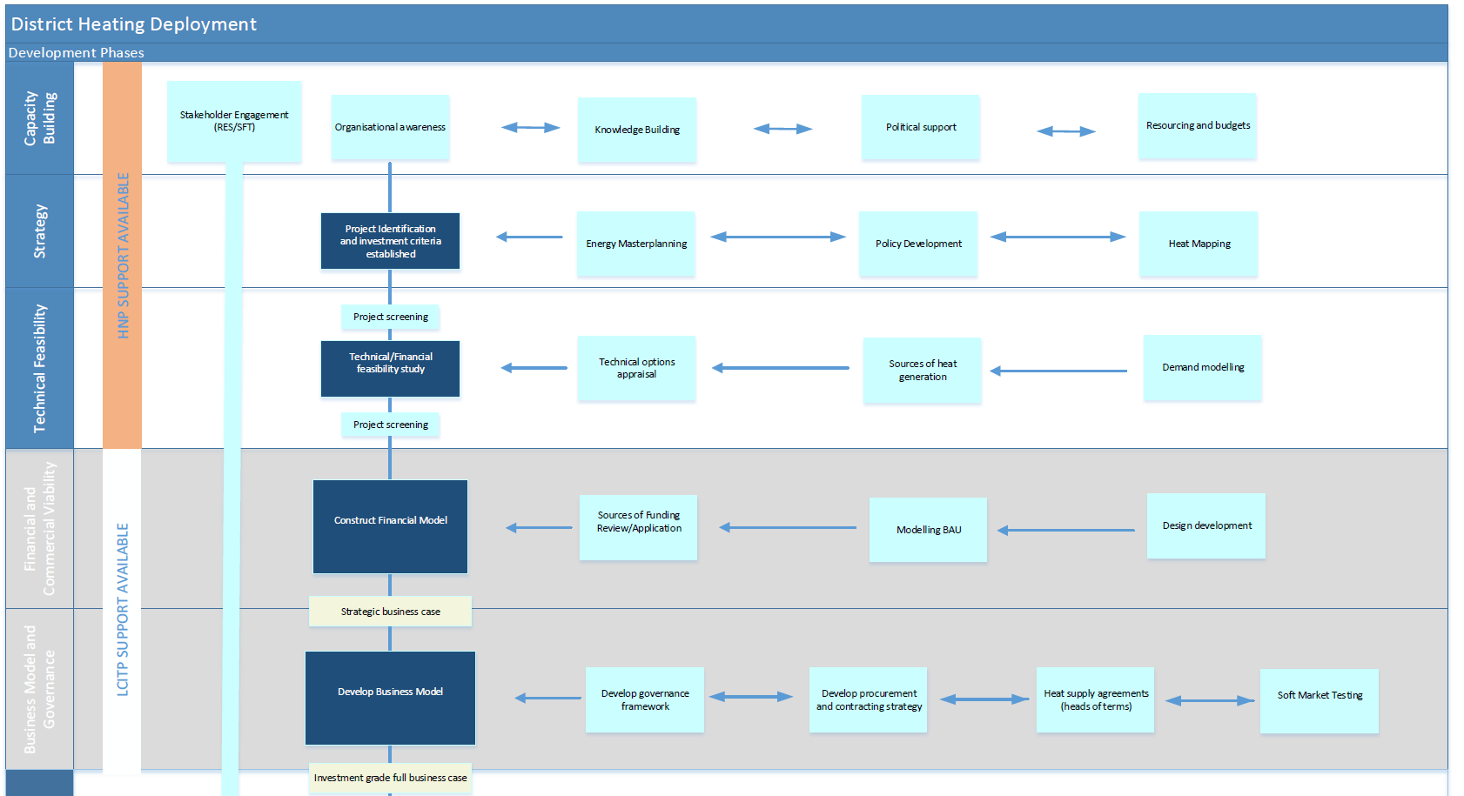

Slide 10
What's next?
Enquiry form
http://www.gov.scot/lowcarbon
  Enquiry form and further schemes details
Notes:
Roadshows, meet the team and discuss your project
Website launched with contact form and further scheme details
Works closely with the CARES team on the local energy challenge fund which is to be supported through the Low Carbon Infrastructure transition Programme
Next slide: Contact Us

