Slide 1
Heat Network Partnership
Local Authority District Heating Strategy
Allan Crooks
www.districtheatingscotland.com

Slide 2



Working together for a decarbonised heat sector
^{In partnership with:}

Slide 3

Website Strategy Page
www.districtheatingscotland.com
Useful Strategy information for Local Authorities, Including:
Guidance notes
Case Studies
Policy documents
Knowledge sharing

Slide 4
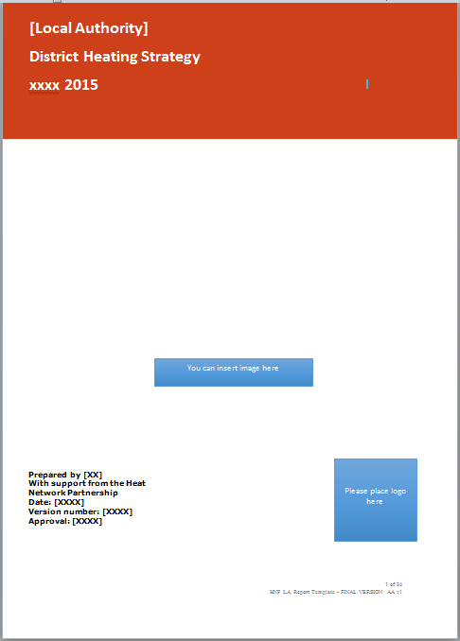
Strategy Template
Provides guidance on the content and structure of a district heating strategy
The strategy document will define the steps a Local Authority will take to implement district heating.
The document is intended to put in place formal and practical plans for communicating, seeking approval of, and implementing district heating
Integrated into wider council strategy

Slide 5
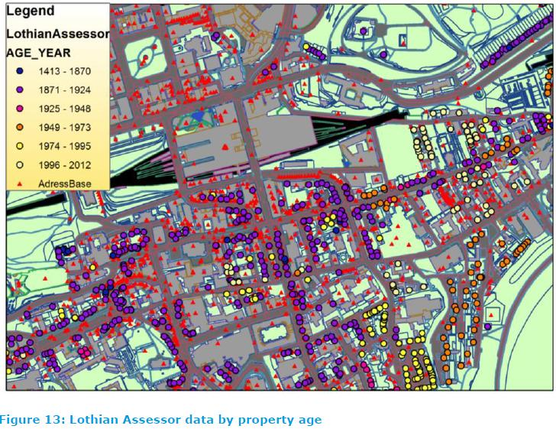
Strategy Template
Contents:
Stakeholder engagement
  Internal
  External
Opportunity assessment
Planning
Business, commercial and financial models

Slide 6
Stakeholder Strategy
External
Universities and colleges
Schools
Hospitals
Sports centre operators
Community organisations
Businesses and business forums
Property developers
Housing associations and tenants’ organisations
District heating industry suppliers
Internal
Council Members
Chief Executive and senior officers
Finance
Planning
Estates and facilities management
Legal and corporate services
Housing
Regeneration
Highways
Energy and sustainability
Enterprise and economic development
Procurement

Slide 7
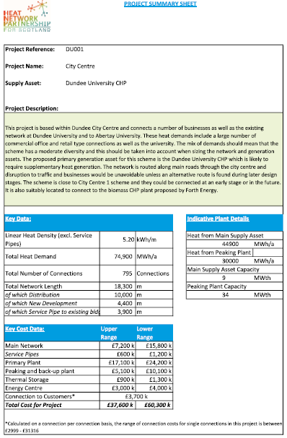
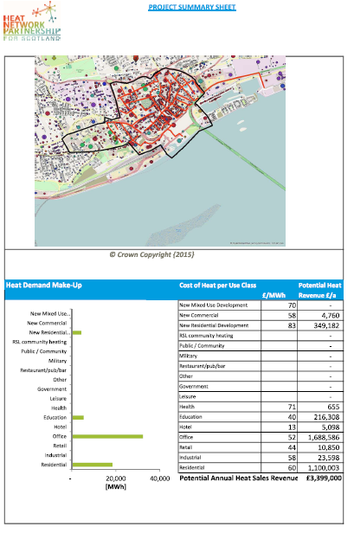
Opportunity Assessment
Opportunity Assessment Tool
Interface with heat map information
Dashboard report on individual projects
High level project information
  Pre-feasibility
Total heat demand
Network length
Outline costs (benchmark analysis)
RES – Feasibility studies (match funding)

Slide 8
District Heating Loan Scheme
Offer low interest loans on a commercial basis for both renewable and ‘low carbon’ technologies.
The scheme open to; Registered Social Landlords, Local
Authorities, small and medium enterprises (SME’s) and Energy Service Companies (ESCO’s) in Scotland
Loans of up to £400,000 per project are available
Competitive interest rates (3.5%) unless high risk.
Security not required (loans are unsecured)
Notes:
10 year payback
Lifecycle Cost savings
CO2 savings
Job Creation
Affordable Warmth
Deliverability

Slide 9
Strategy Programme Support
Help and advice from the HNP
Opportunity assessment and technical support
  allan.crooks@resourceefficientscotland.com
Finance and business models
  Paul.Moseley@scottishfuturestrust.org.uk

Slide 10
Questions?
www.districtheatingscotland.com

Slide 11
Module 3 – Policy
Strategic Environmental Assessment (SEA) screening;
Impact Assessment;
Assessment of potential Legal and Risk implications;
Approval by a committee of local elected officials.

Slide 12
Module 4 – Financial and commercial structure
Developing appropriate funding and delivery strategies:
Local authority powers
Public procurement and other regulatory regimes
Business models
The role of ESCOs
Financing structures, and sources of finance

Slide 13
Module 5 – Project definition and delivery
Developing opportunities identified from the strategy into actual projects:
The project development process
Resources, project and risk management
Commissioning feasibility studies
Developing a business case
Moving towards procurement and delivery

Slide 14
Tasks for completion
Stakeholder strategy
Opportunity assessment
Schedule a catch-up call with HNP

