Slide 1


Local authorities as catalysts for heat network development
Ruth Bush – Stratego Project Officer
09 June 2015
^{districtheatingscotland.com}

Slide 2
Outline
A vision for Scotland’s energy system in 2050
How much district heating do we need?
How to be a catalyst? - Some thoughts on prioritising activities

Slide 3
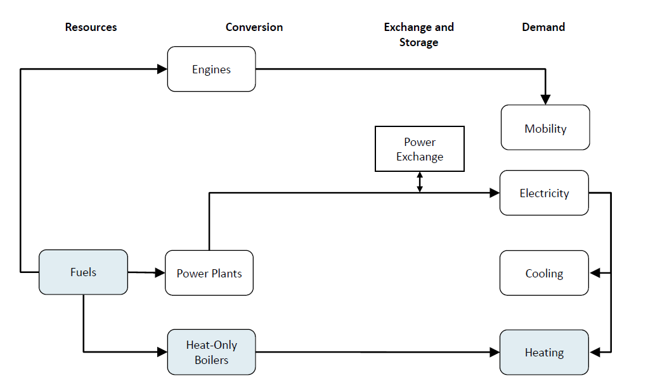
Today’s national energy system
Reference: David Connolly, Heat4EU
Notes:
Fuels here are burned as and when they are needed. When you have an intermittent electricity system you need more flexibility and heat networks give you that.

Slide 4
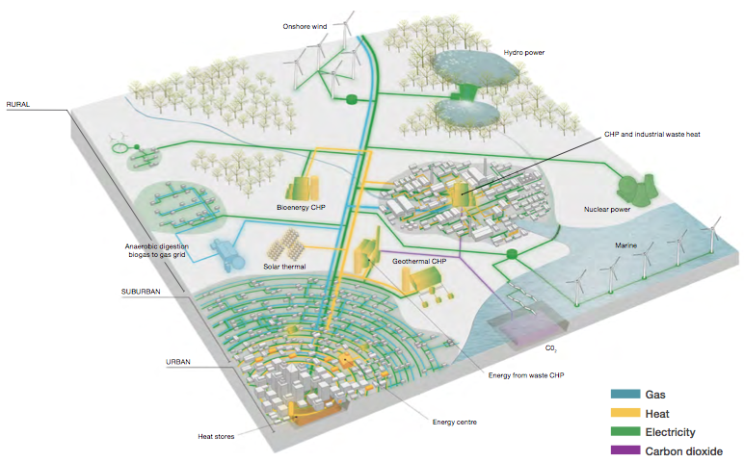
A vision for 2050: An integrated system
(DECC, 2015, Delivering UK Energy Investment: Networks)
Notes:
In the future we’ll want to use a mix of technologies and renewable energy sources to deliver a low carbon energy system.
Some of these technologies will be intermittent (wind, solar) – some will be in limited supply, like biomass – and demand will change through increased energy efficiency.
This will require an integrated energy system where the heat and electricity sectors work together.
Would also be helpful to emphasise how and where heat networks fit in here. Particularly reasons why big networks which link up all the buildings in an area fit better into this picture than a handfull of buildings. All the buildings because that gives a better load and solves lots of buildings' heating problem, and big network so you can afford flexibility and multiple energy inputs, rather than just having effectively a multi-building central heating system. (This applies even to relatively small settlements - Skagen has a population of 8,000)

Slide 5
How much district heating do we need?
There isn’t a definitive answer
14% across the UK
Element Energy report for DECC (2009)
40% across the UK
Energy Technologies Institute (2012)
70% across the UK
Stratego project research (2015)
Notes:
But no study answers "none"

Slide 6
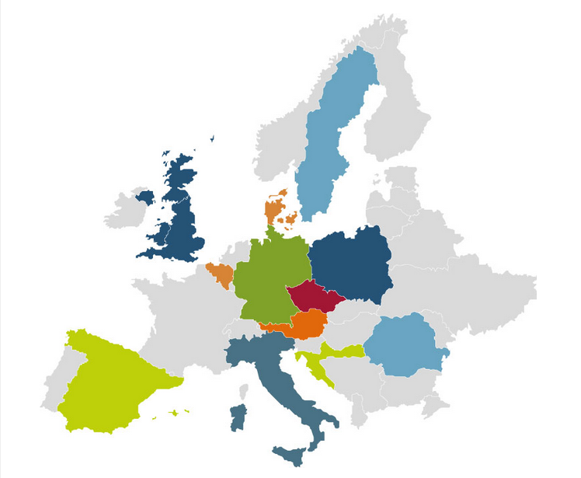


A quick look at the Stratego research
Stratego project aims to to help local and national authorities develop effective heating and cooling plans that are joined up, evidence-based and strategic.
This research has been created to inform debate around low carbon heating and cooling across Europe.
Why is the Stratego scenario so high?
Notes:
We are all trying to achieve a similar aim (we want the best value system, that is low carbon and renewable, and provides affordable heating and cooling for citizens). So what can we learn from each other?
Why we think there is a need for us to do this research…
Still a lack of data, mapping and evidence base upon which to make decisions.
For some countries, whole energy system modelling is a matter of course whereas others there is very little data and experience.
In the UK, we have some very good heat maps (particularly the Scottish heat map) but we don’t have information on cooling and we are still developing experience of creating scenarios that take into account local and spatial aspects of the energy system.

Slide 7
It looks at the energy system costs as a whole – for heat and electricity together in an integrated way.
  Results are optimised for:
Energy
Environment
Economy
Primary Energy Supply
Carbon Emissions
Total Annual Energy System Costs

Slide 8
Headline results - UK 2050 Roadmap
Optimum heat savings for 2050 (as a % of the BAU scenario) are 40%
Heat provided by district heating in 2050, after heat savings, is 70%
http://stratego-project.eu/nhcps/
Notes:
Key research outputs for the UK:
Put table?
The final Heat Roadmap scenarios all have a higher share of investment costs and a lower share of fuel costs. In a European context, investments are most likely locally based while fuel costs are most likely based on imports from other countries. Therefore, it is likely that the final Heat Roadmap scenarios will results in more jobs and an improved balance-of-payment in each of the STRATEGO countries.
Our research indicates that the optimum level of DH in the UK could be 70% of our heat demand after energy efficiency savings (this is XXX TWh of heat) in 2050. It will be interesting to see how the Article 14 NCA compares to this.

Slide 9
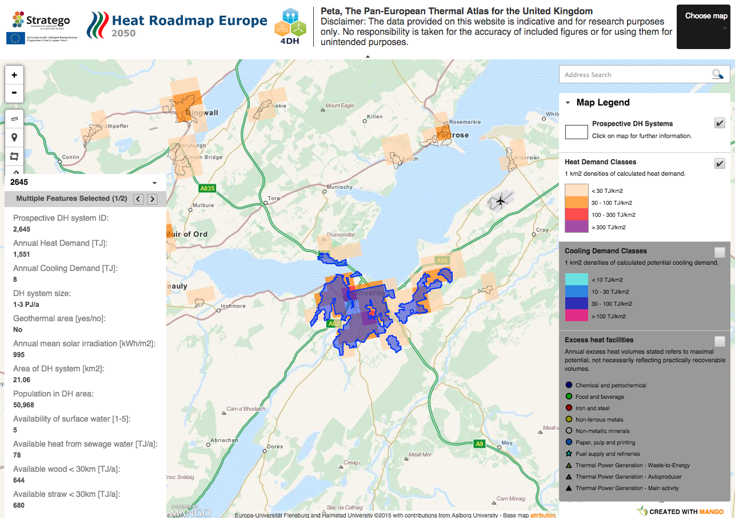
What does this look like at the local level?
Have a look at your own local area:
http://mgo.ms/s/ii7ep
Notes:
We know that schemes deliver the most benefits when they are at scale.

Slide 10
The local context is critical to delivery
LA-owned buildings for anchor loads
Use of planning policy
Trusted local actor
Local knowledge
Opportunity to reflect the drivers & ambitions of your local area in energy system development
Notes:
Maybe have something about why local authorities are considered important to heat network development
Have buildings which can anchor a system
Can use planning policy to draw new development onto networks
Trusted local actor, can broker agreements, coordinate local actors with whom it has already established relationships
Local knowledge

Slide 11
Local visions for the future
Fuel poverty;
CO₂ reduction;
Local economic growth and job creation;
Reducing public sector energy bills;
Lowest cost delivery of heating systems;
…All of the above?
Notes:
Your answers to these questions influence
Are these perhaps short term objectives that might help justify working on such a long term project as making large heat networks?

Slide 12
Local authorities as catalysts
How should we prioritise projects?
  Use of the public sector estate;
  Sites offering highest rate of return;
  Areas with high rates of fuel poverty.
What ownership structures deliver the most benefits?
  Local authority owned;
  Public-private partnerships;
  Private sector.
What scale of scheme are we aiming at?
  Provision for future expansion
  Transition to low carbon heat sources
Notes:
Part of catalysing the kinds of network discussed earlier in the presentation being making sure that what happens in the near term makes sense in the long term.
Highest returns so you can get the private sector to pay for it, or highest returns so it generates surpluses which can be used to support and even subsidise extension to other users?
Might be worth gently at this point suggesting that different models have different implications for the extent to which local authorities will be able to influence longer term development.

Slide 13
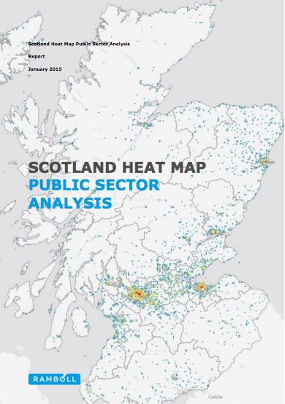
Example: The potential of the public sector estate
Study done by Ramboll
  Considers the potential of using the public sector estate as an anchor load to reduce the risk associated with projects
  Carbon reduction potential calculated (page 3)
Notes:
One of the ways that previous scheme developments has found is productive is to begin with the public sector estate
Maybe set this up as setting out a strategy to get from no heat network to having something that connects lots of users. Can't be done in one step. Public estate can anchor a local network-growth model

Slide 14
More information about the Ramboll study
What criteria did it take into account?
  Number of public buildings with large heat demands, total heat demand in the area, social housing, etc.
  Weightings of different criteria can be adjusted to reflect local priorities
Available on the Scottish Government website:
  http://www.gov.scot/Topics/Business-Industry/Energy/Energy-sources/19185/Heat/HeatMap/PublicSectorAnalysis
Notes:
Criteria in the study are all weighted equally in this study, but they can be adjusted by you to reflect your local priorities and circumstances.

Slide 15
Summary
There are many scenarios for the level of district heating we need in the UK;
Local authorities can shape and define the way low carbon heat is delivered in Scotland
It will be a mix of national and local visions that give us the final result

Slide 16
Contact information
Ruth Bush
Stratego Project Officer
ruth.bush@ed.ac.uk

